Slide 1
Student Services and Enrollment Management – University Housing
Tuition and Fees Advisory Board
Fiscal Year 2027 Proposed Rates

Slide 2
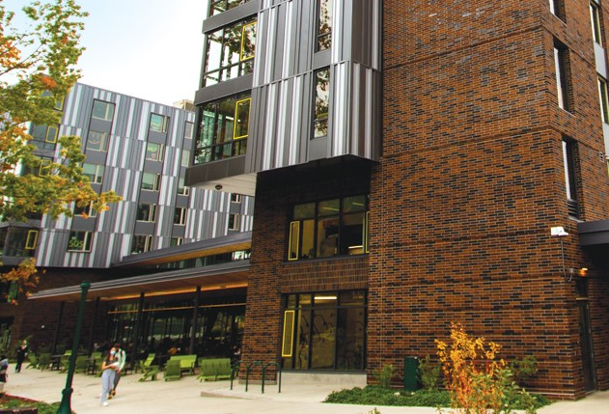
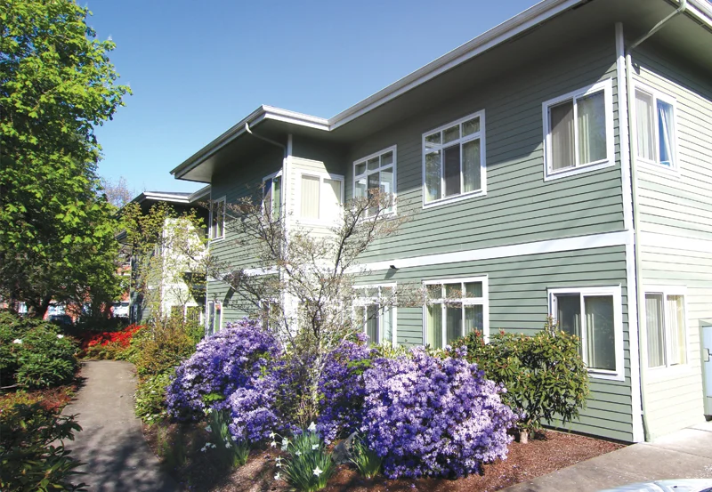
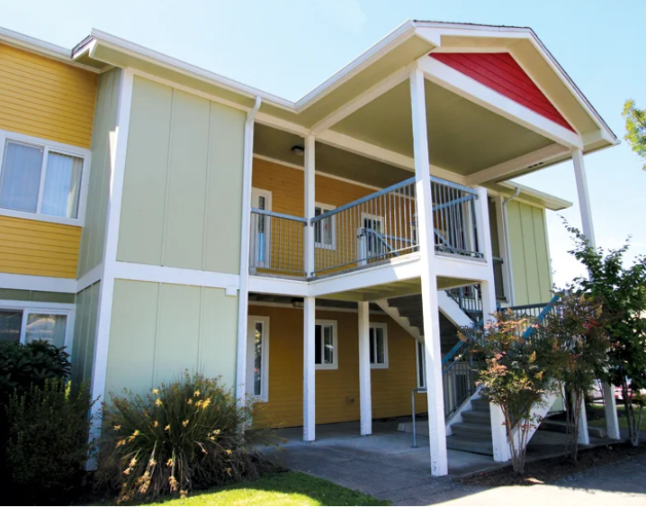
UO-Eugene Proposed Residence Hall Room & Board and Family Housing & University Apartments FY27 Rates
4.5%-5% residence hall room and board rate increase: 4.5% multiple occupancy; 5% single occupancy; similar rate structure to previous years with a couple exceptions
  Barnhart rates were reduced (about 0.6%) to match the newer halls on similar room types
  Riley rates were increased (about 8.4%) to be in alignment with Earl, Carson and Justice Bean Hall
3% to 5% Family Housing and University Apartments increase: 3% Spencer View Apartments, Agate Street Apartments, East Campus Houses; 5% Graduate Village
$423 Residence Hall returner discount
  This does not apply to Yasui Hall

Slide 3
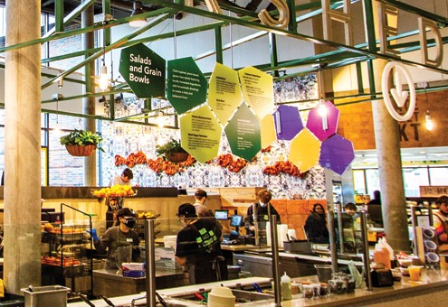
UO-Eugene Proposed Residence Hall Room & Board and Family Housing & University Apartments FY27 Rates
Primary Cost Drivers:
Labor and OPE (Other Personnel Expenses)
  Officers of Administration (~75); 3% in 2025 & 3.75% 2026
  Classified Staff (~395); Negotiations underway, future increases are unknown
  Student Employees (~600); increases as outlined in the CBA and Resident Assistant re-structure
  PERS (Public Employee Retirement System) increases
  OPE Cost Drivers as University Housing pays actual benefit costs
Construction & Maintenance increases 3-4%
Food Commodity increases 5-6%
Utility increases 2-6%
Continued necessary capital investment in our existing buildings

Slide 4
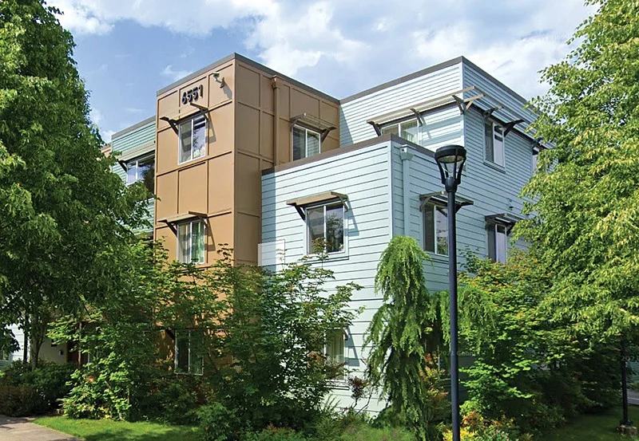
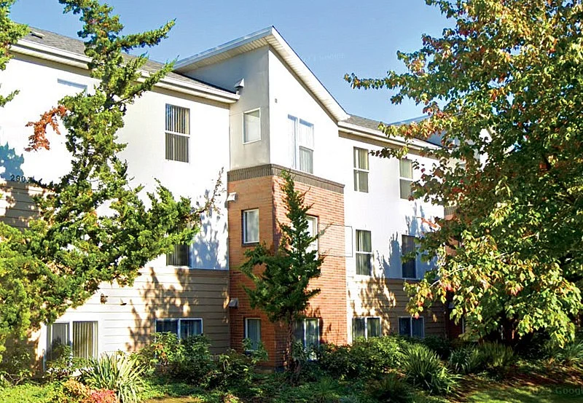
UO Portland Proposed FY27 Apartment Rates
NE 27th Apartments &
Holman Street Apartments
  Rate Drivers
    10-year proforma and sensitivity analysis
    Analysis of Portland housing market rates
    Analysis of student housing rates

Slide 5
Questions/Answers/Discussion

