Slide 1


Tuition and Fee Advisory Board
University of Oregon
Financial Briefing
October 27th, 2025
Brian Fox, Associate Vice President for Budget, Financial Analysis, and Data Analytics

Slide 2
Agenda
UO Budget Structure
Key Sources of University Funding
Cost Drivers
E&G Fund Challenges

Slide 3
UO Budget Structure
E&G Funds
Other Funds
Tuition revenue
State Appropriation
F&A Return
Overhead revenue
Fee revenue, interest earnings
Grants and Contracts revenue
Auxiliary Revenue
Service Center Revenue
Designated Operations Revenue
Restricted gifts
School & College Budgets
Grants & Contracts
Central Admin
Budgets
Plant Funds
Institutional Expenses
(Debt, assessments, utilities, leases)
Auxiliary, Service Centers, and Designated Ops Funds
Restricted Gifts

Slide 4
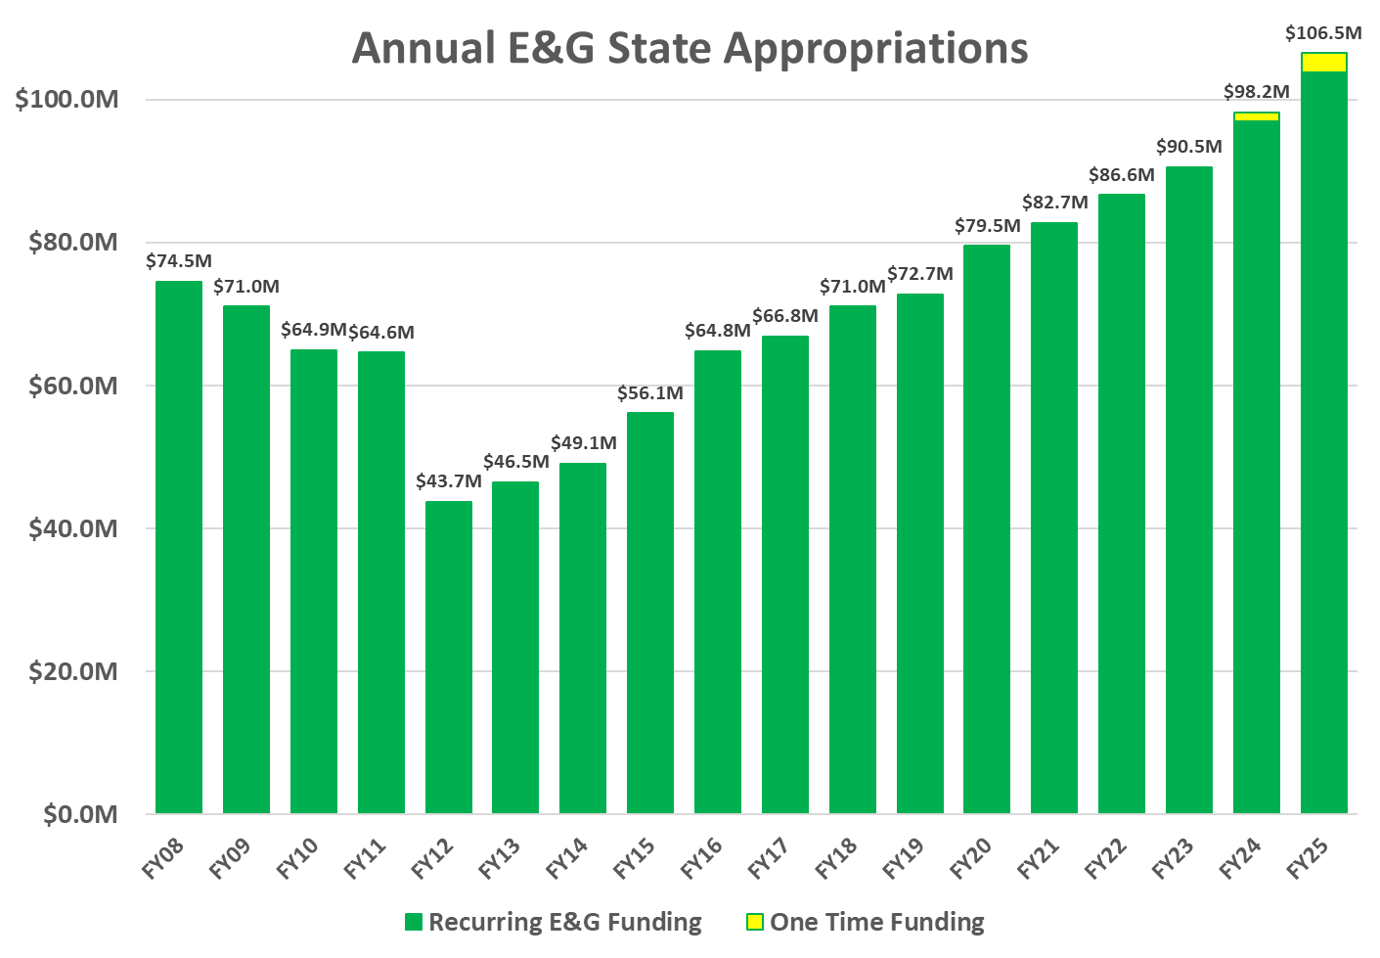

Slide 5
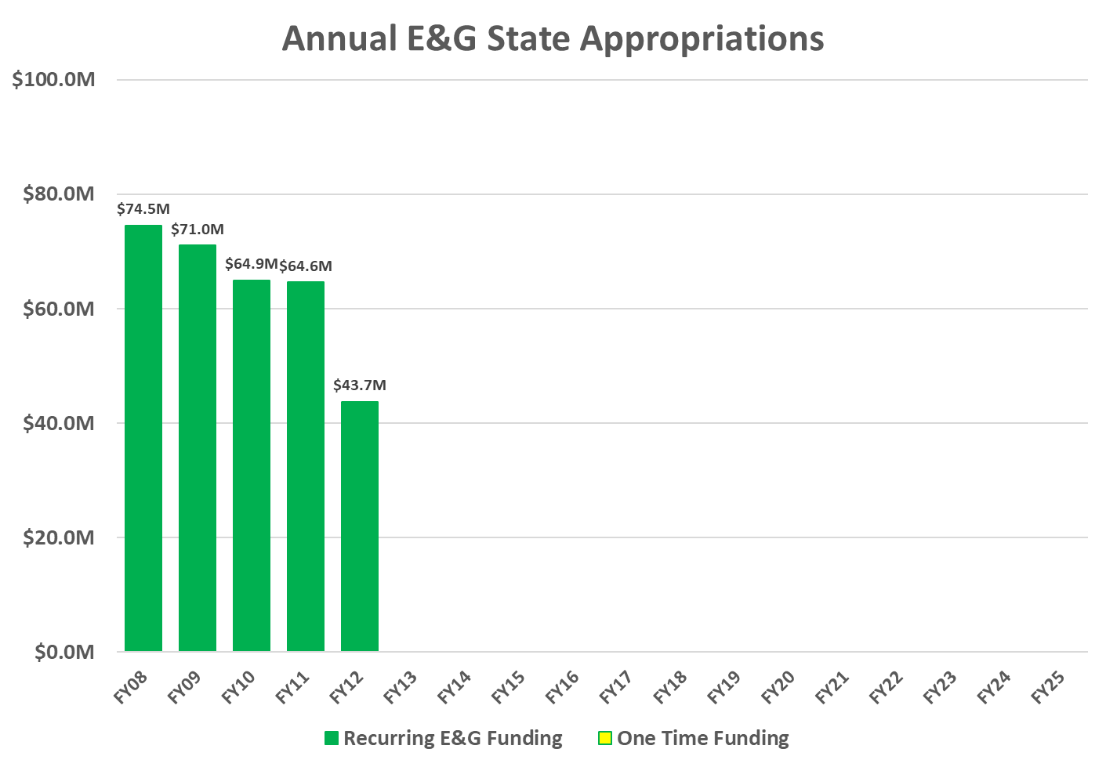

Slide 6
Compound Annual Growth Rate Since FY08: 2.1%

Slide 7
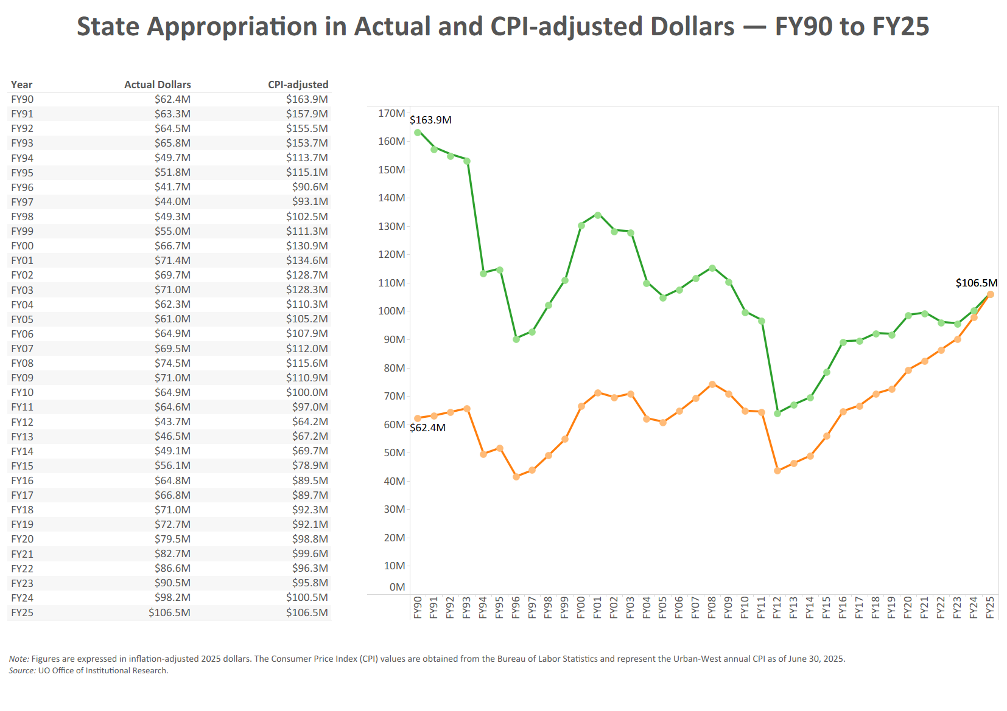

Slide 8
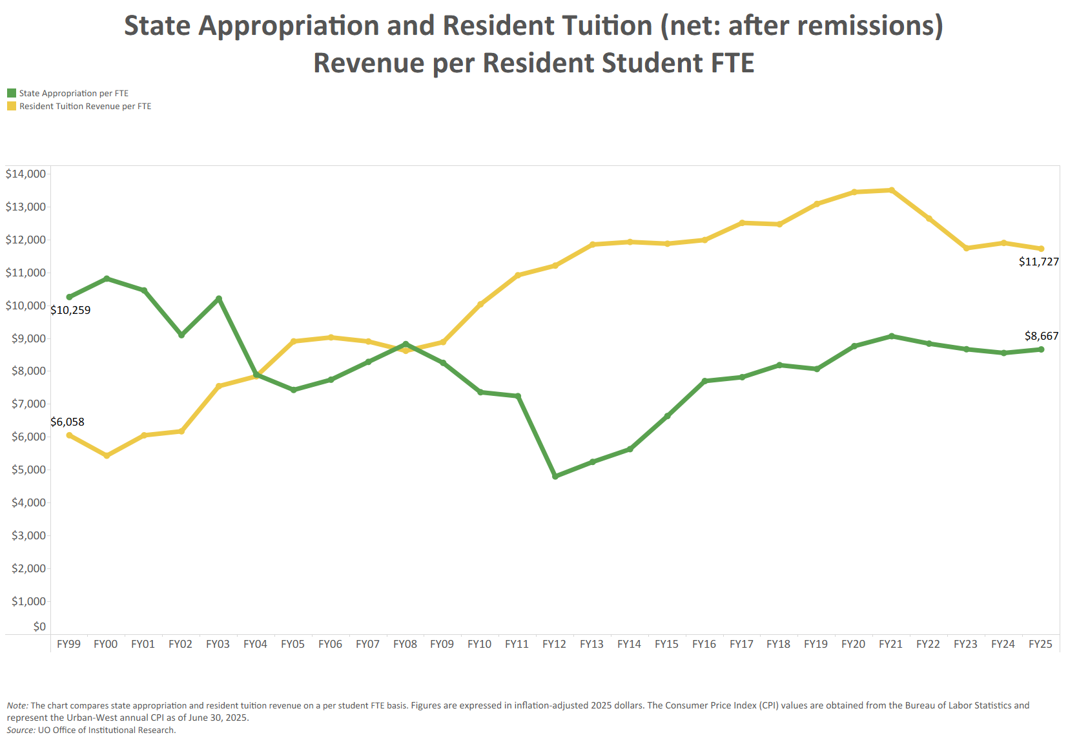

Slide 9
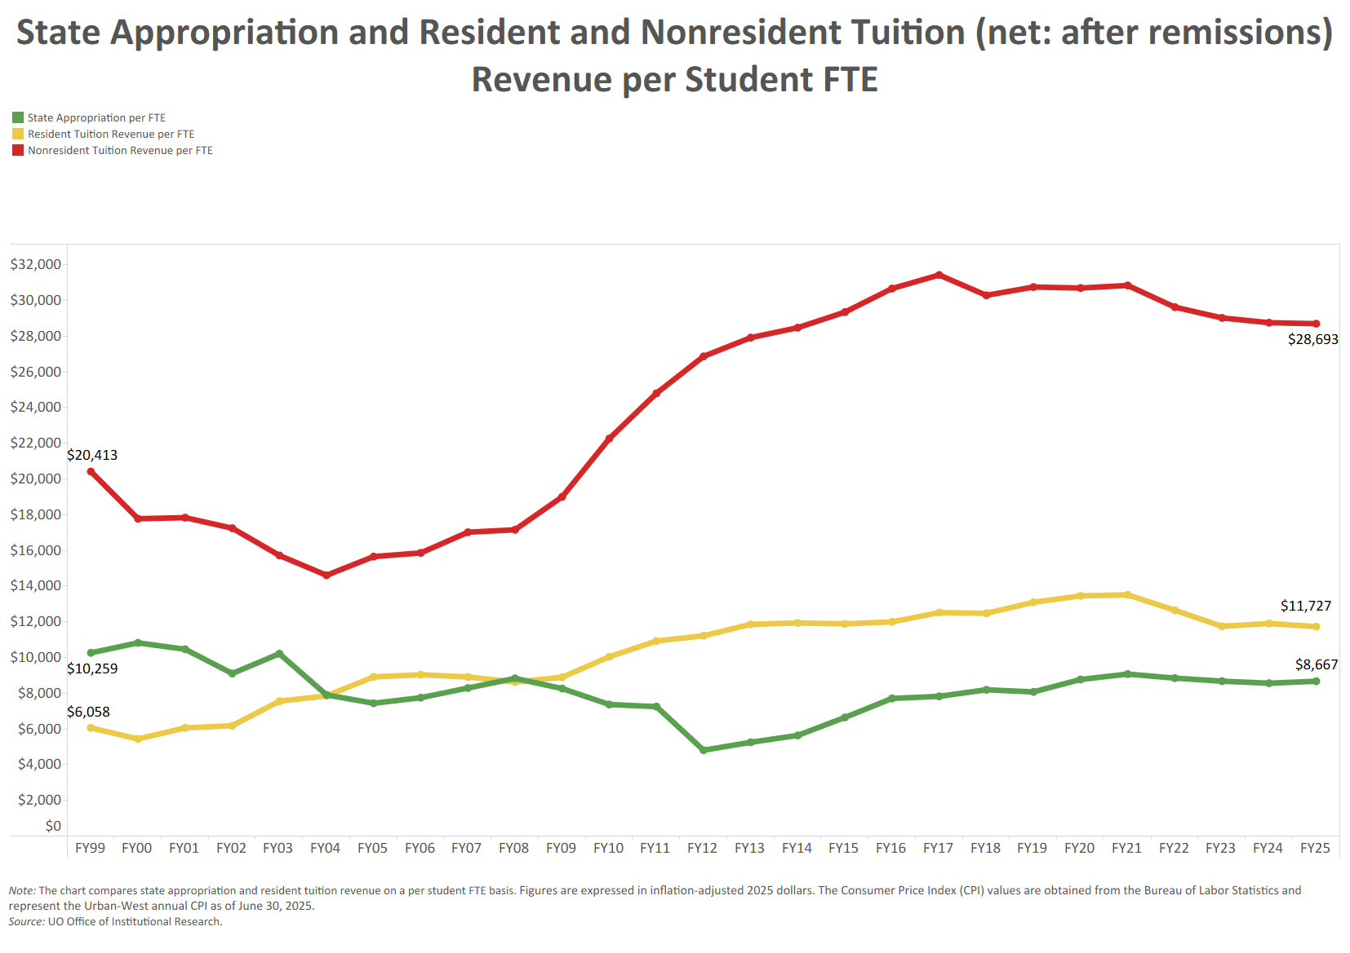

Slide 10
University Resources
FY2025 Major Revenue Streams
(E&G Fund – Net of Remissions)
State Appropriation $106.5 million
Resident Tuition $114.5 mill
Resident UG Net Tuition $106.0 million
Nonresident UG Net Tuition $306.9 million

Slide 11
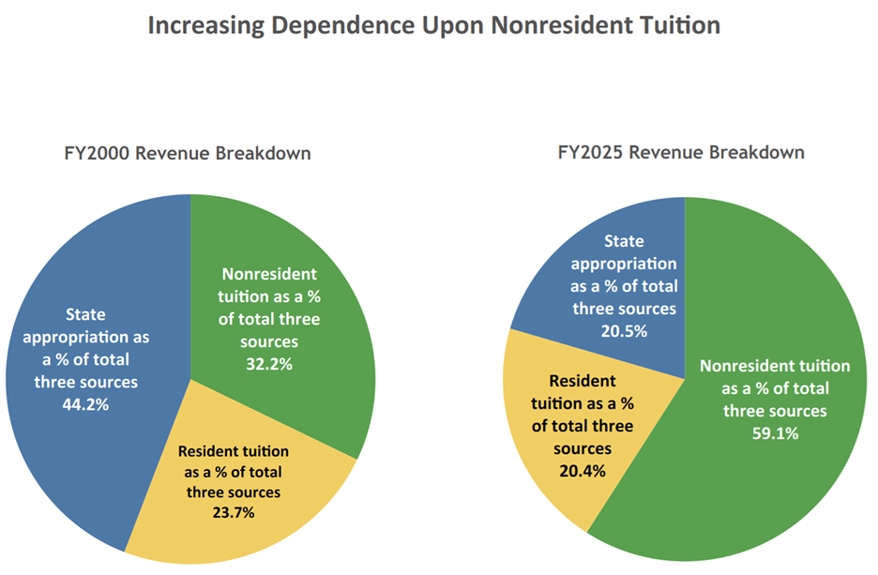

Slide 12
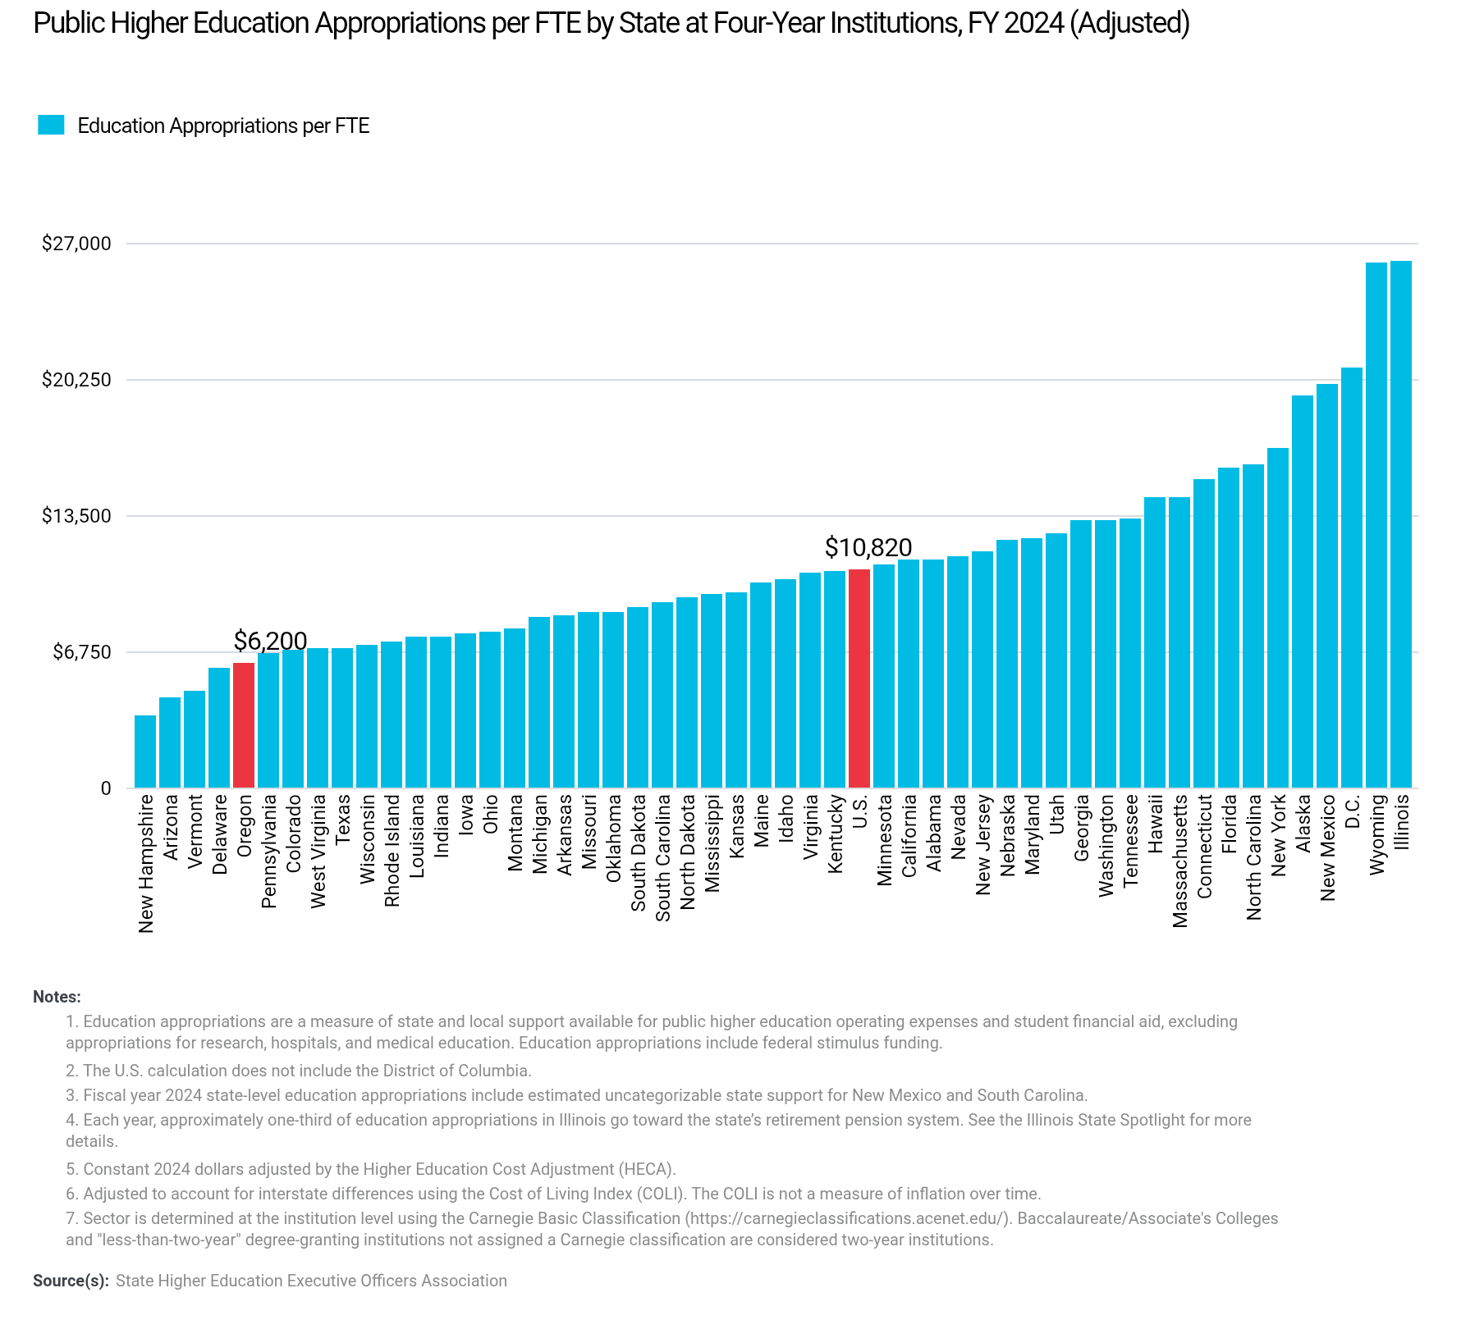
Oregon is ranked 46th in the country in 4-year university per-student funding

Slide 13
Agenda
UO Budget Structure
Key Sources of University Funding
Cost Drivers
E&G Fund Challenges

Slide 14
UO Budget Structure
E&G Funds
Other Funds
Tuition revenue
State Appropriation
F&A Return
Overhead revenue
Fee revenue, interest earnings
Grants and Contracts revenue
Auxiliary Revenue
Service Center Revenue
Designated Operations Revenue
Restricted gifts
School & College Budgets
Grants & Contracts
Central Admin
Budgets
Plant Funds
Institutional Expenses
(Debt, assessments, utilities, leases)
Auxiliary, Service Centers, and Designated Ops Funds
Restricted Gifts

Slide 15
Summary – Major FY2026 E&G Fund Cost Drivers
Cost Driver | Projected FY26 Cost Increase | Notes
Faculty, Staff and GE Salary and OPE | $19.5 million | E&G compensation increases based on current contracts (e.g., classified staff, GE), announced increases for OAs and historical rates / current administrative proposals for those groups without ratified contracts. Includes approximately 1,200 graduate employees, 1,630 faculty, 850 classified staff and 1,220 unrepresented staff on the E&G fund. Does not include any projected expenses related to adding staff.
Medical Costs | $2.9 million | Includes increases of 4.15% on December 1, 2024, and 4.6% on December 1, 2025.
Retirement Costs | $7.6 million | Increases for PERS rates for FY26 as approved by PERS board.
Blended OPE | ($7.2 million) | Blended OPE carryforward (atypical leave and hiring dynamics) balances from a previous period are buying down benefits expenses during FY26 on a one-time basis.
Institutional Expenses | $2.6 million | Increases related to utilities, insurance, debt for academic buildings, assessments, and leases.
Faculty Hiring | $1.6 million | 8 Net Tenure Track Hires.
Strategic Investments | $1.0 million | Allocated via strategic investment process. Note that President has only allocated $1.0 million to the BAG process this year as funds are needed for strategic priorities.
Total Projected Cost Increases | $28.0 million

Slide 16
Summary – Major FY2026 E&G Fund Cost Drivers
Cost Driver | FY25 Base | Projected FY26 Cost Increase | FY26 Increase (%)
Faculty, Staff and GE Compensation | $546.0 million | $19.5 million | 3.6%
Medical Costs | $63.3 million | $2.9 million | 4.6%
Retirement Costs | $80.9 million | $7.6 million | 9.4%
Blended OPE | $179.5 million | ($7.2 million) | (4.0%)
Institutional Expenses | $49.0 million | $2.6 million | 5.3%
TTF Faculty Hiring | $145.1 million | $1.6 million | 1.1%
Strategic Investments | $690.5 million | $1.0 million | 0.1%
Total (E&G Budget) | $690.5 million | $28.0 million | 4.1%

Slide 17
Summary – Major FY2026 E&G Fund Cost Drivers
Cost Driver | Projected FY20 Cost Increase | Projected FY21 Cost Increase | Projected FY22 Cost Increase | Projected FY23 Cost Increase | Projected FY24 Cost Increase | Projected FY25 Cost Increase | Projected FY26 Cost Increase
Faculty, Staff & GE Salary & Wages | $10.6 million | $11.6 million | $7.3 million | $15.0 million | $11.9 million | $13.0 million | $19.5 million
Medical Costs | $1.9 million | $2.5 million | $1.2 million | $1.6 million | $2.2 million | $2.5 million | $2.9 million
Retirement Costs | $7.1 million | ($500K) | - | - | $1.9 million | - | $7.6 million
Oregon Paid Leave | - | - | - | - | $900K | $300K | -
Blended OPE | - | - | - | - | $4.0 million | - | ($7.2 million)
Institutional Expenses | $1.0 million | $1.5 million | $1.2 million | $1.2 million | $1.5 million | $2.0 million | $2.6 million
Faculty Hiring | - | - | - | - | - | $3.0 million | $1.6 million
Strategic Investments | $2.0 million | $2.0 million | $600K | $2.0 million | $2.0 million | $2.0 million | $1.0 million
Minimum Wage Increase | $1.0 million | $1.9 million | $320K | $257K | - | - | -
Total Projected Cost Increases | $23.6 million | $19.0 million | $10.6 million | $20.1 million | $24.4 million | $22.8 million | $28.0 million

Slide 18
Agenda
UO Budget Structure
Key Sources of University Funding
Cost Drivers
E&G Fund Challenges

Slide 19
E&G Fund Context
E&G Fund – Characteristics (FY26)
  Approximately $708 million in Revenue
  77% funded with tuition revenue
  Funds majority of activity in schools and colleges and administrative units
  79% invested in people
E&G Fund – Recent History
  FY16, FY17, & FY18: Balanced due to state investments, tuition increases, and budget cuts
  FY19: $11.5 million deficit
  FY20: $7.6 million deficit
  FY21 – FY25: Balanced budget due to
    Actions taken to mitigate impact of COVID-19.
    HEERF lost revenue funding
    Staffing challenges / compensation cost one time savings

Slide 20
E&G Fund Challenge #1 – Benefits Costs
Health Insurance Program
  Required to participate in state health insurance plan
  Average cost per employee: $19,920 per year
Retirement Program
  Required to offer PERS to faculty and staff
  State pension program is underfunded by over $20 billion
  PERS Board has been increasing rates over the last 10 years to fund the deficit

Slide 21
E&G Fund – PERS Impact
Over the last 10 years, retirement costs increased by 5.7% of salary due to rate increases. This equates to additional charges of $17.6 million per year against the E&G fund.

Slide 22
ALL FUNDS – PERS Impact
Over the last 10 years, retirement costs increased by 5.0% of salary due to rate increases. This equates to additional charges of $25.7 million per year against the entire university budget.

Slide 23
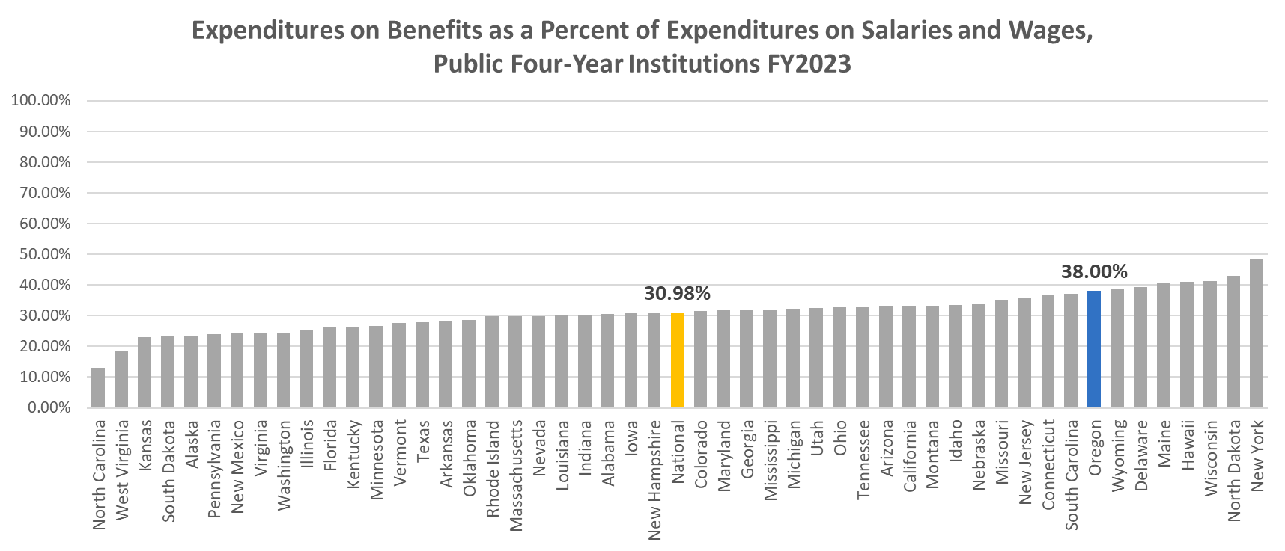
Source: U.S. Department of Education, National Center for Education Statistics, Integrated Postsecondary Education Data System (IPEDS), 2023, Total expenses and deductions - Employee fringe benefits, Total expenses and deductions - Salaries and wages. Retrieved from https://nces.ed.gov/ipeds/datacenter/Statistics.aspx on April 29, 2025.

Slide 24
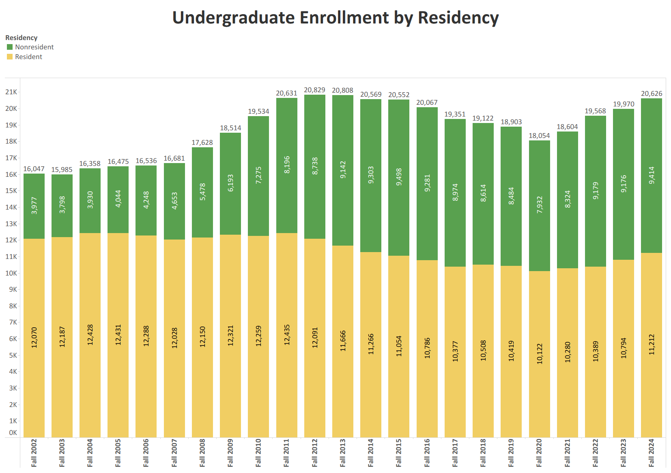
E&G Fund Challenge #2 – Enrollment

Slide 25
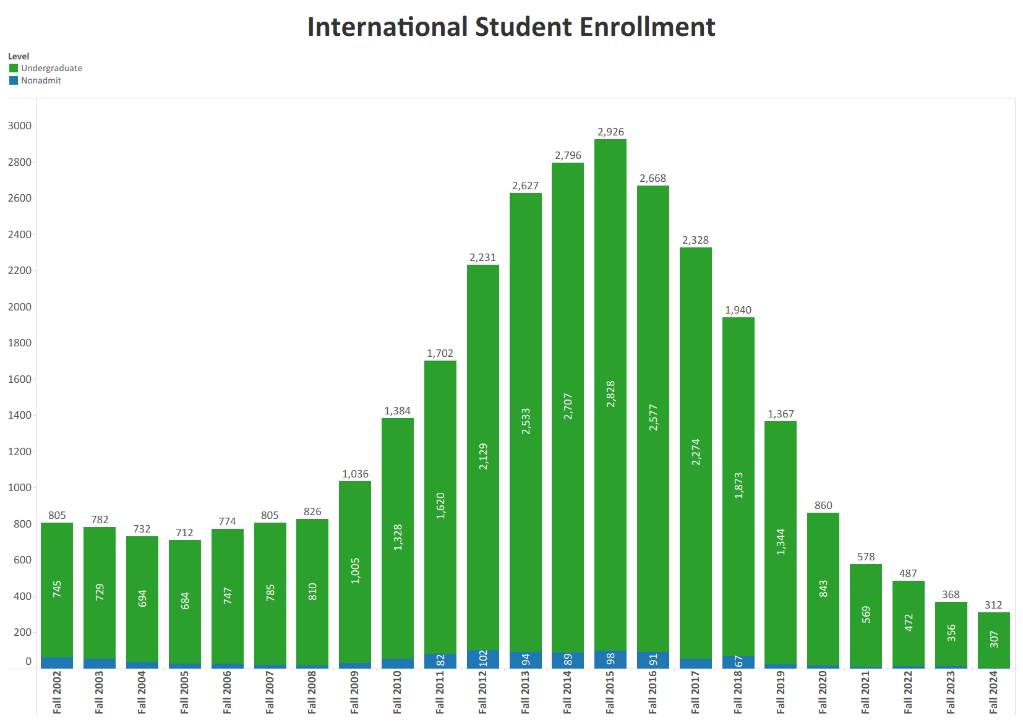

Slide 26
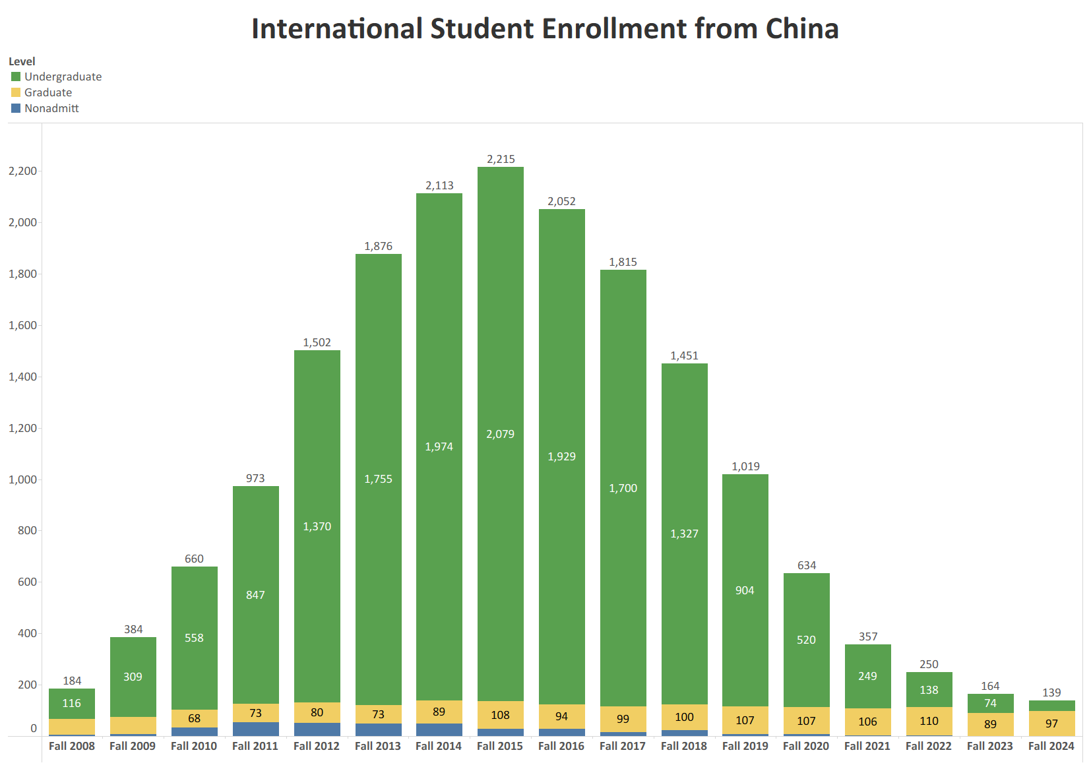

Slide 27
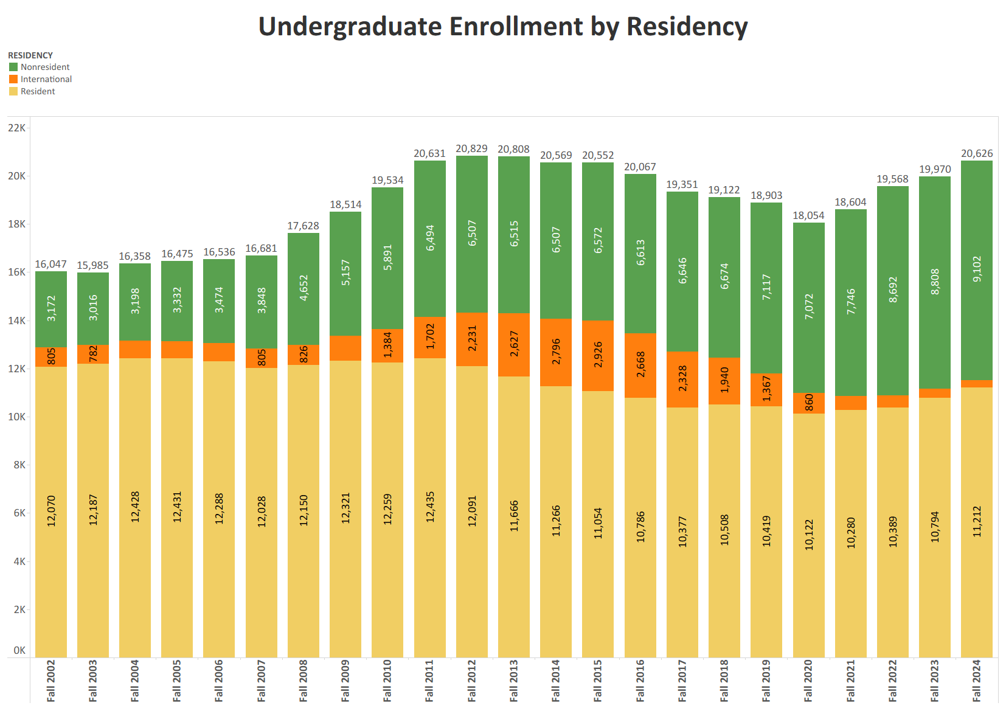

Slide 28
E&G Fund Challenge #3 –
Cost and Revenue Dynamics
    79% Invested in People
    Costs
    77% Tuition & Fees Funded
    Revenue

Slide 29
Cost Dynamics – Personnel Costs
Cost Driver | FY26 Projected Cost Increase | FY26 Percentage Increase | Notes
Faculty, Staff, & GE Salary and Wages | $19.5 million | 3.6% | E&G compensation increases based on current contracts (e.g., classified staff, GE), announced increases for OAs and historical rates / current administrative proposals for those groups without ratified contracts. Includes approximately 1,200 graduate employees, 1,630 faculty, 850 classified staff and 1,220 unrepresented staff on the E&G fund. Does not include any projected expenses related to adding staff.
Medical Costs | $2.9 million | 4.6% | Includes increases of 4.15% on December 1, 2024, and 4.6% on December 1, 2025.
Retirement Costs | $7.6 million | 9.4% | Increases for PERS rates for FY26 as approved by PERS board.
Blended OPE | ($7.2 million) | (4.0%) | Blended OPE carryforward (atypical leave and hiring dynamics) balances from a previous period are buying down benefits expenses during FY26 on a one-time basis.
TTF Faculty Hiring | $1.6 million | 1.1% | 8 Net Tenure Track Hires.
  Total Projected Personnel-Related Cost Increase: $24.4 million
  Equates to 4.5 percent annual increase to personnel costs in a year WITH the large Blended OPE one time offset (5.8% increase without it)
Notes:
Added brackets to (4.0%)

Slide 30
E&G Fund Challenge #3 –
Cost and Revenue Dynamics
    79% Invested in People
    Costs
    77% Tuition & Fees Funded
    Revenue

Slide 31
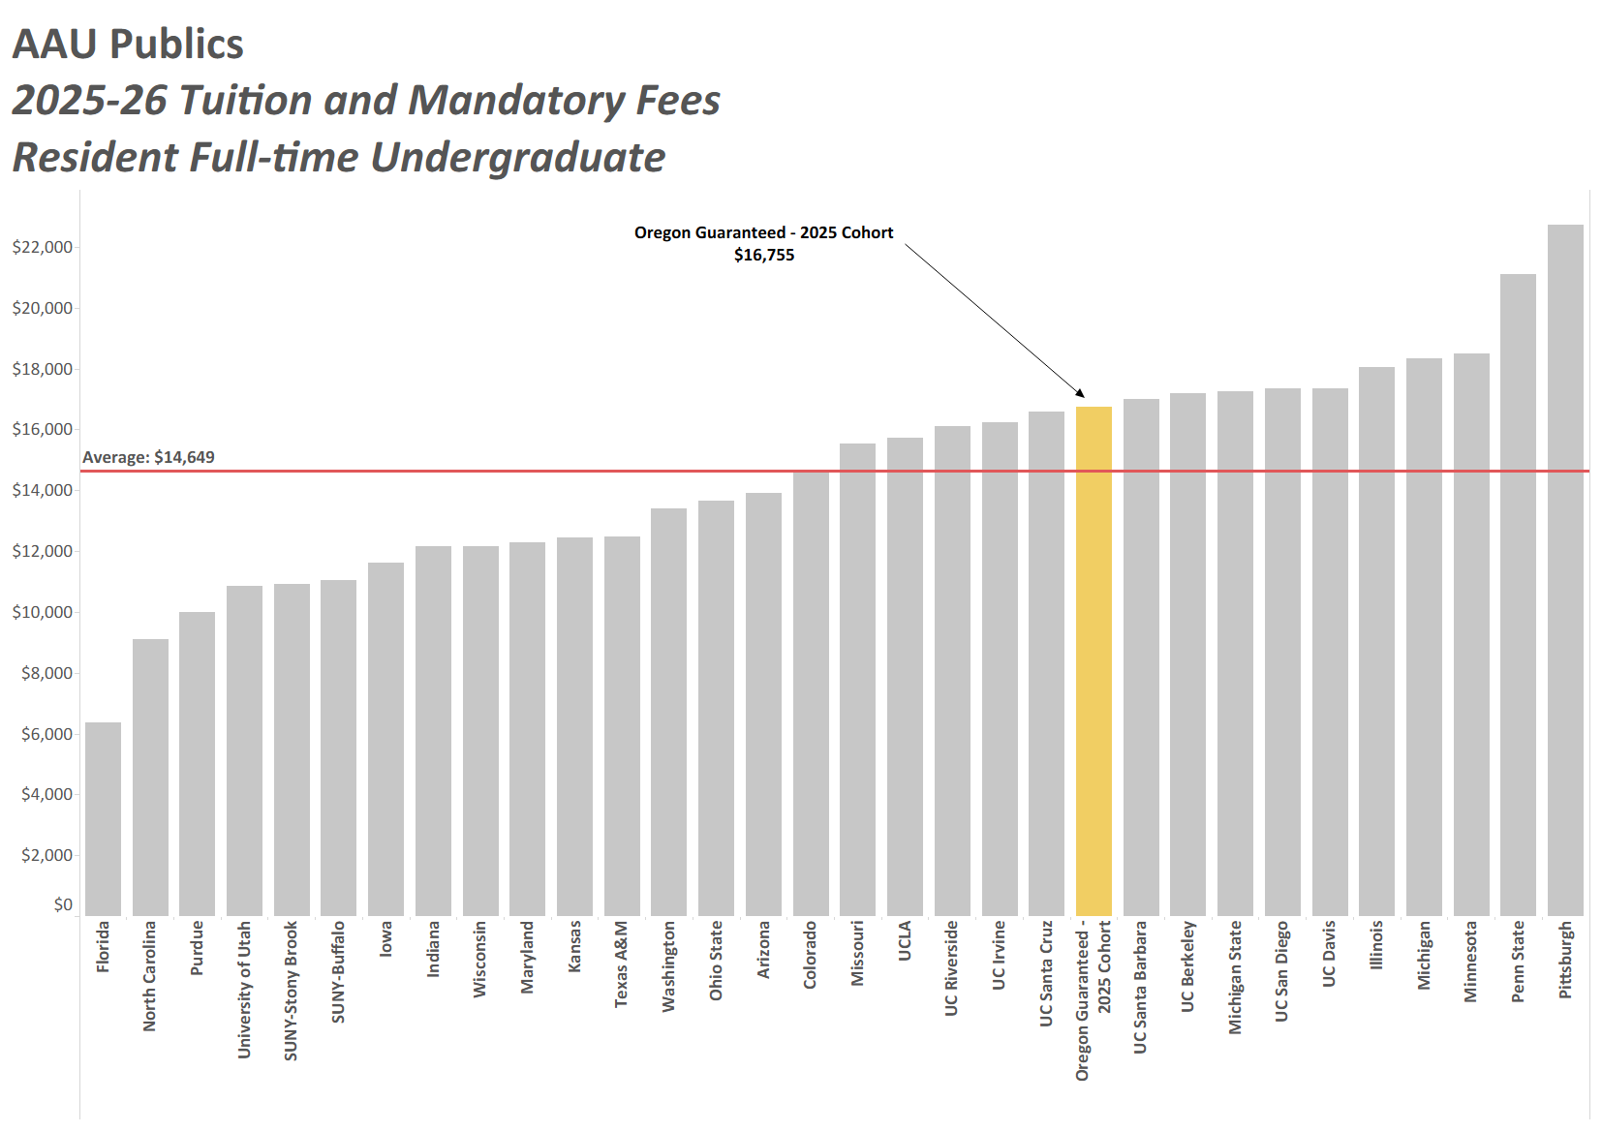

Slide 32
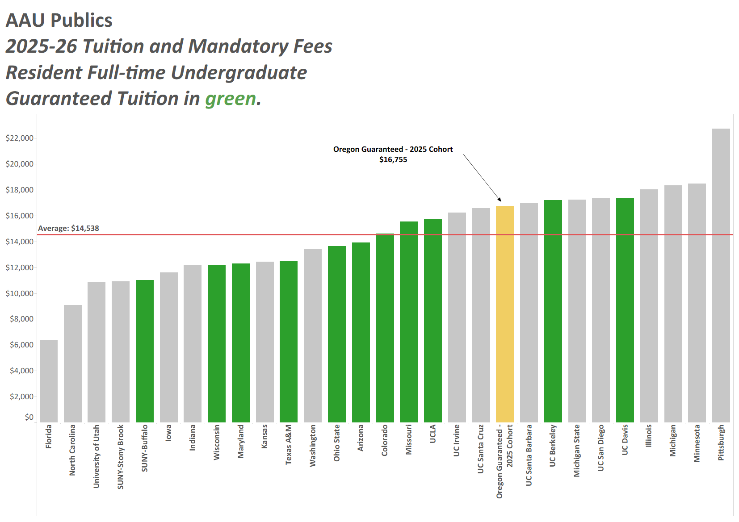

Slide 33
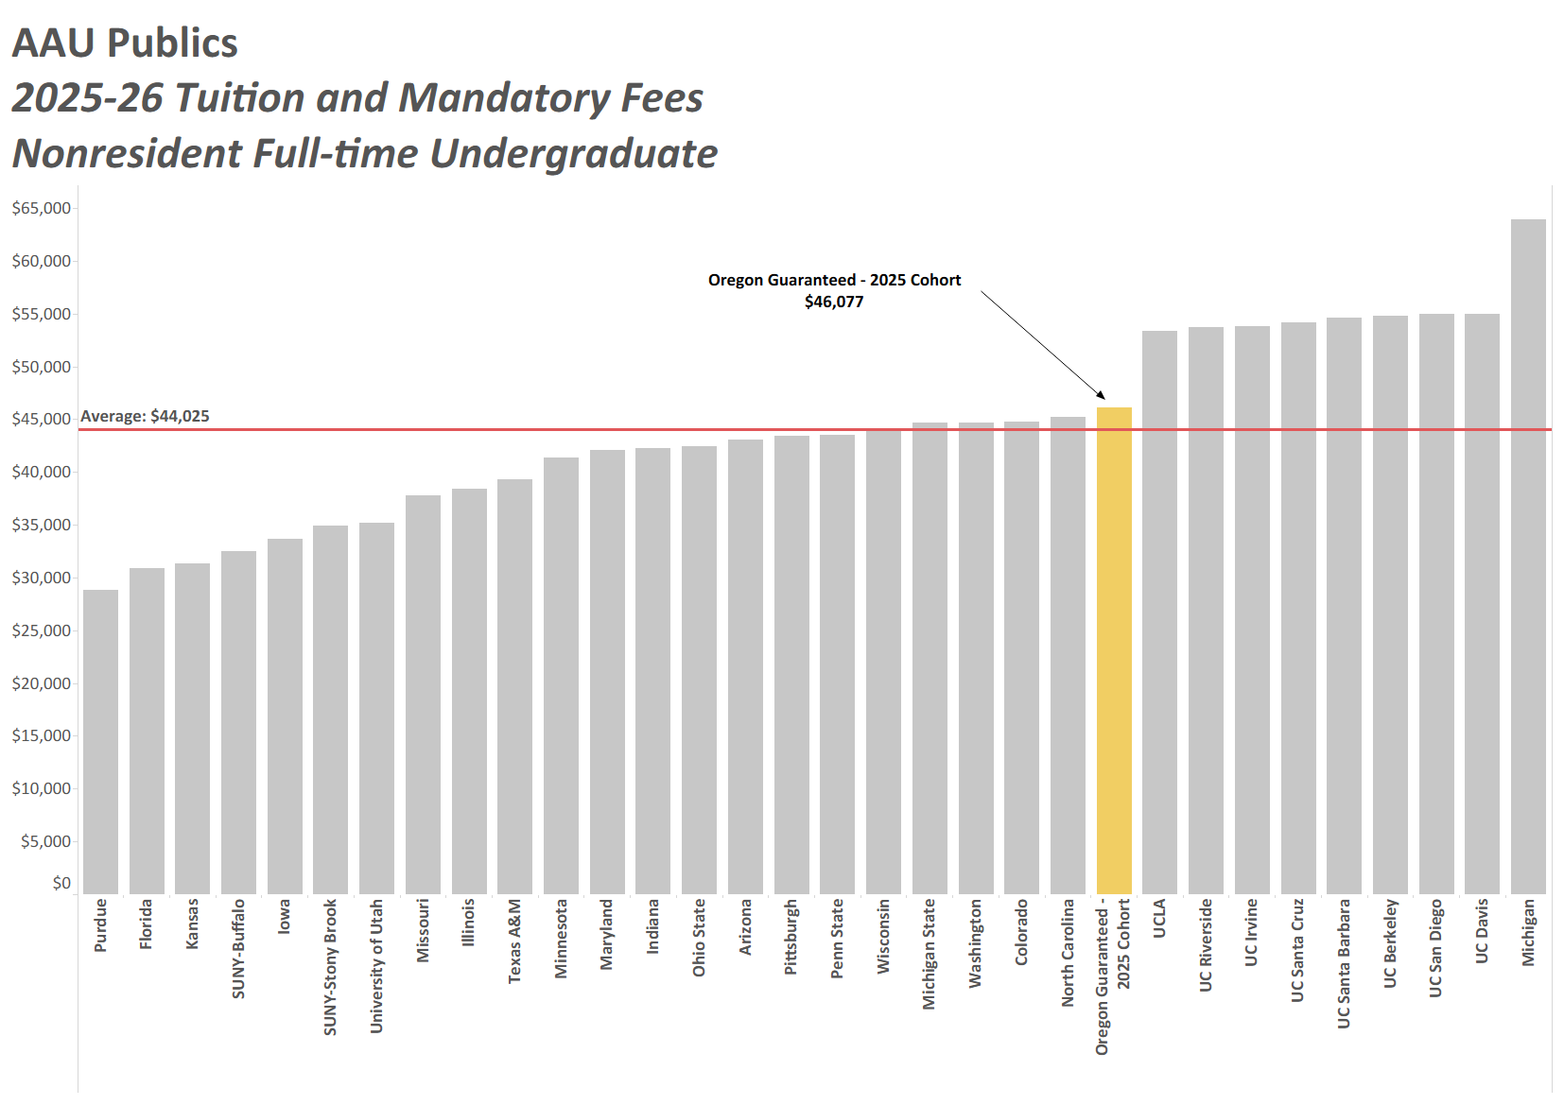

Slide 34
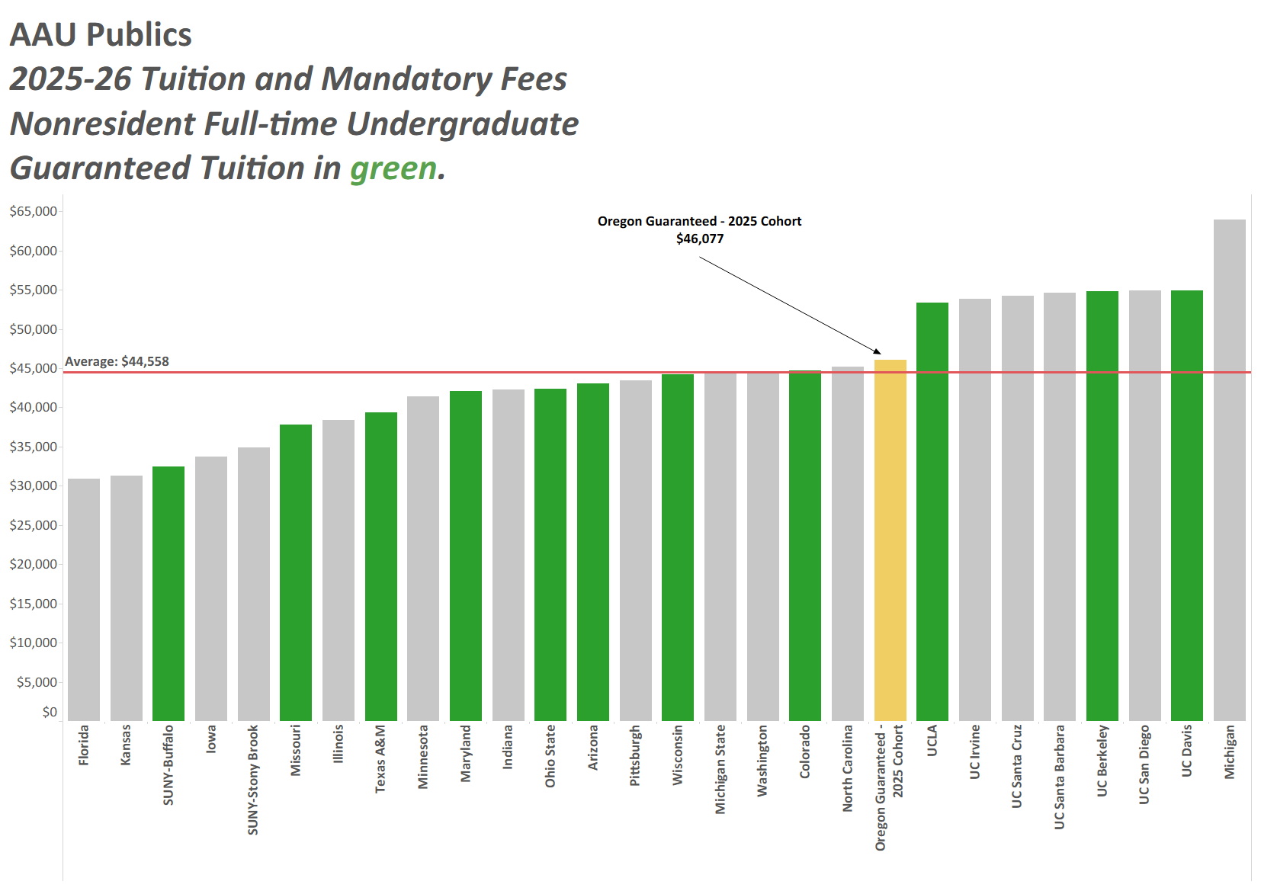

Slide 35
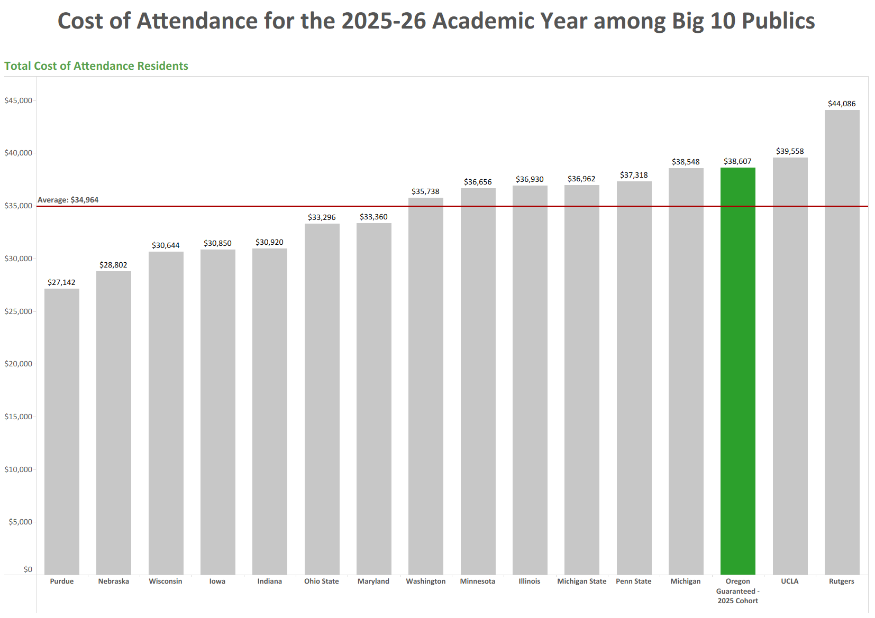

Slide 36
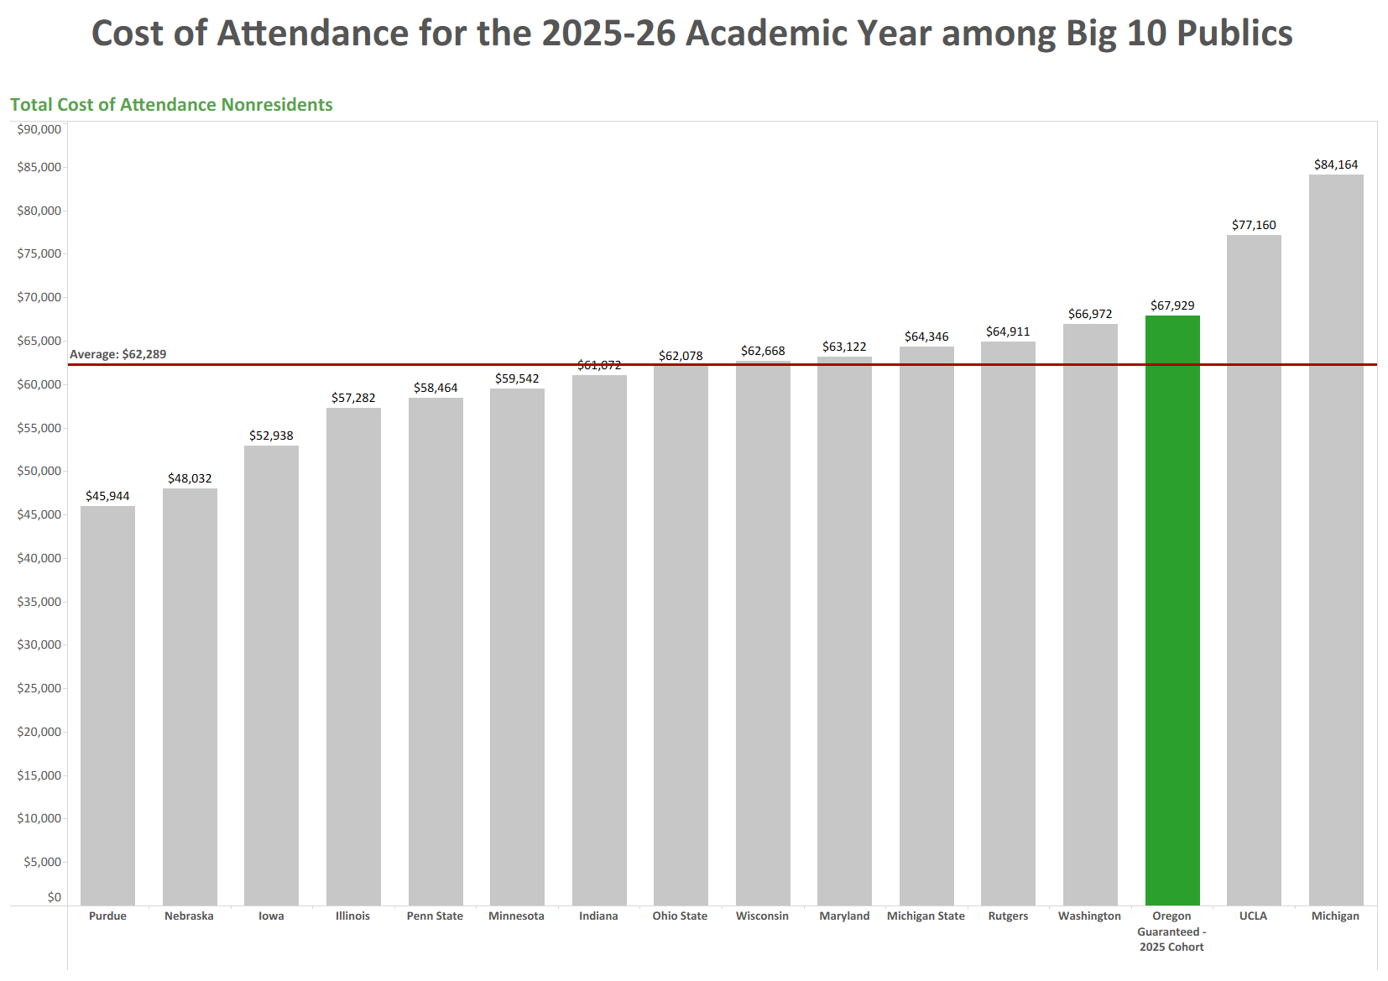

Slide 37
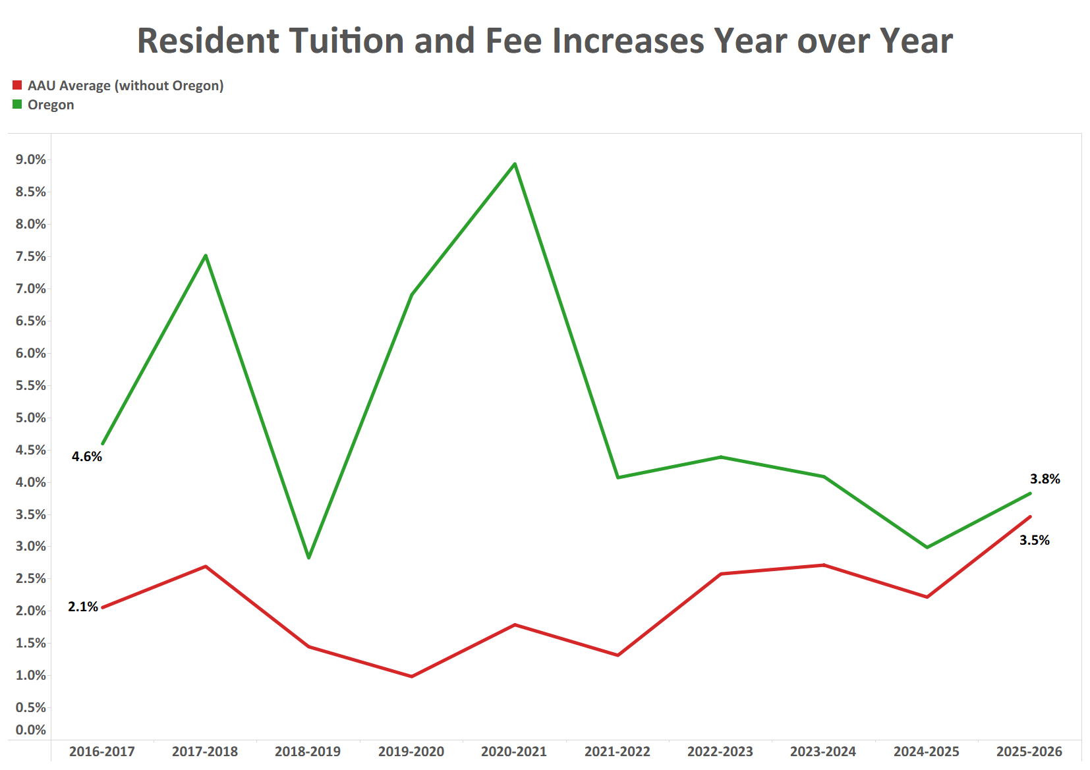

Slide 38
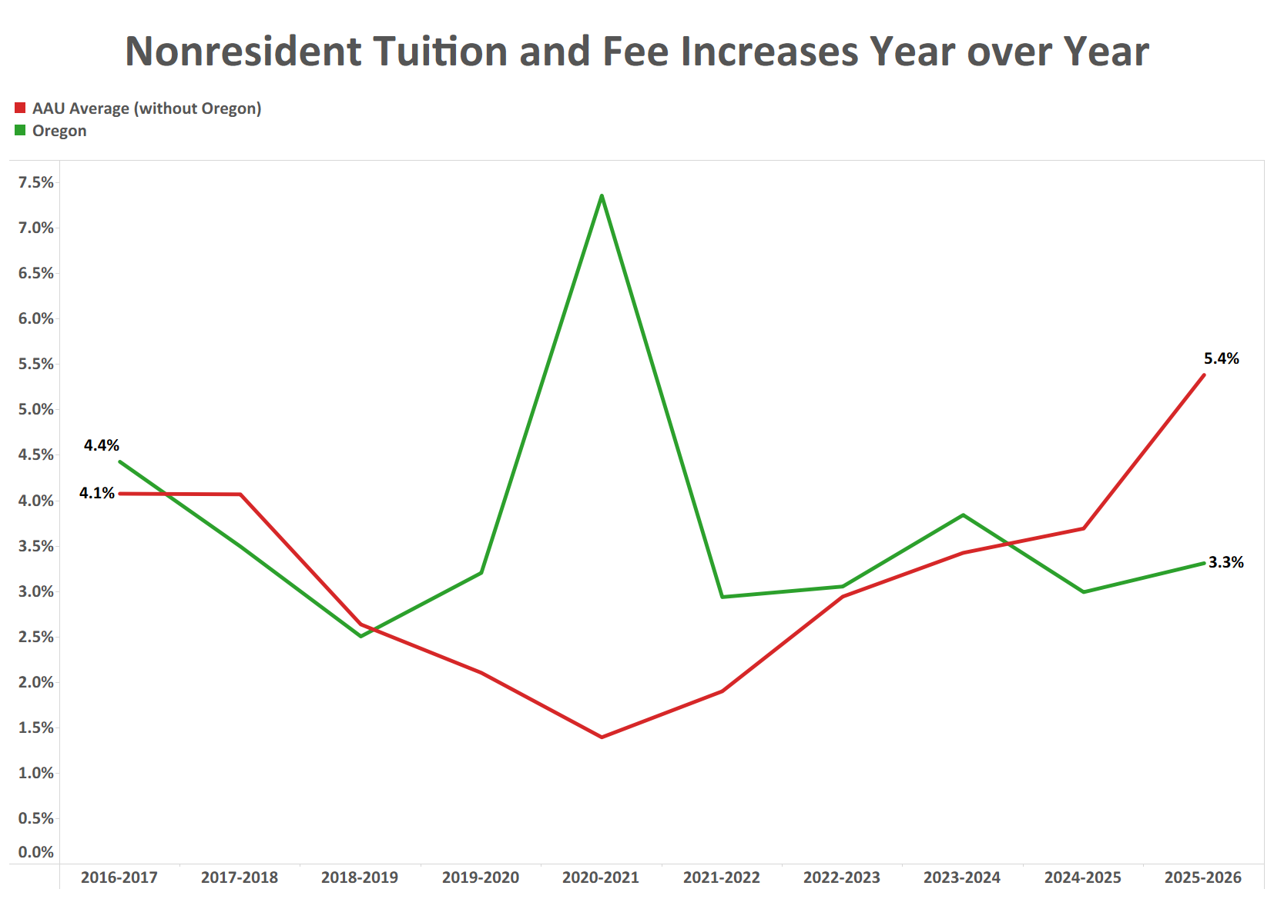

Slide 39
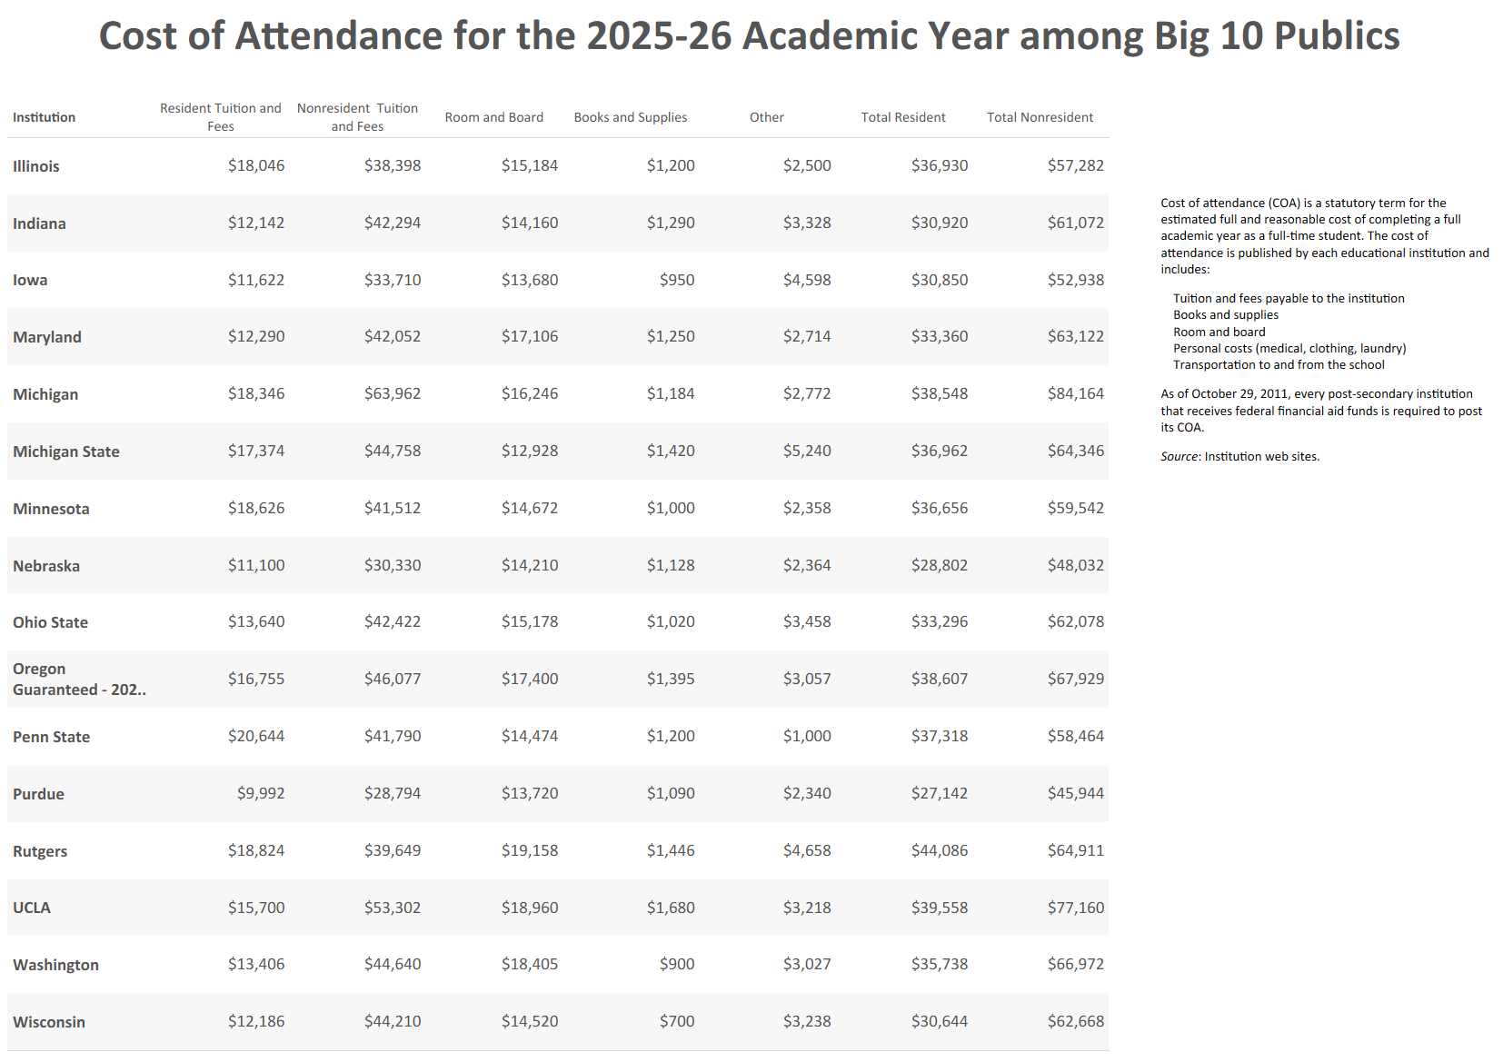

Slide 40
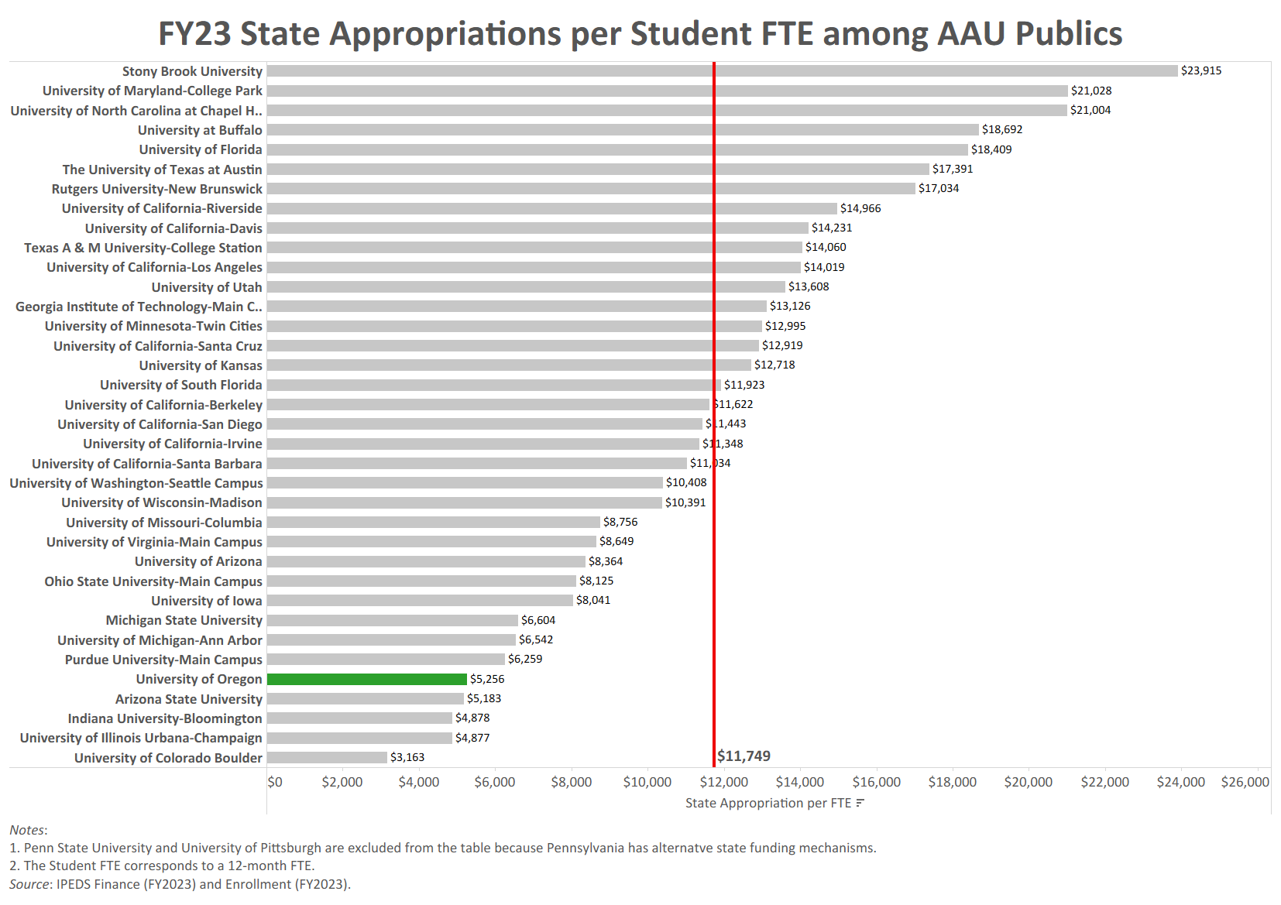

Slide 41
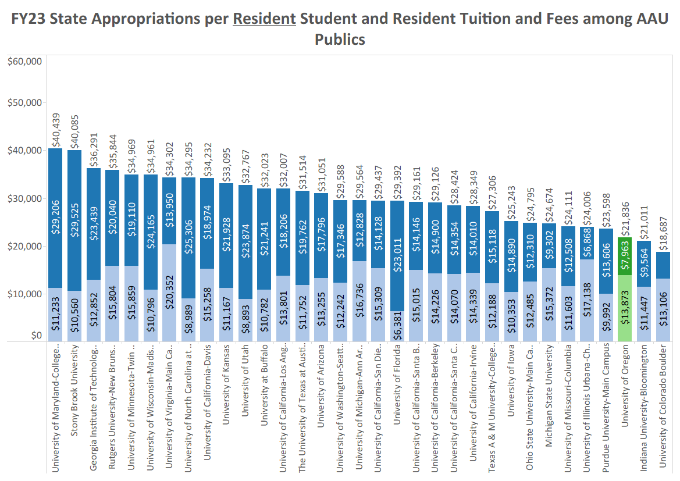

Slide 42
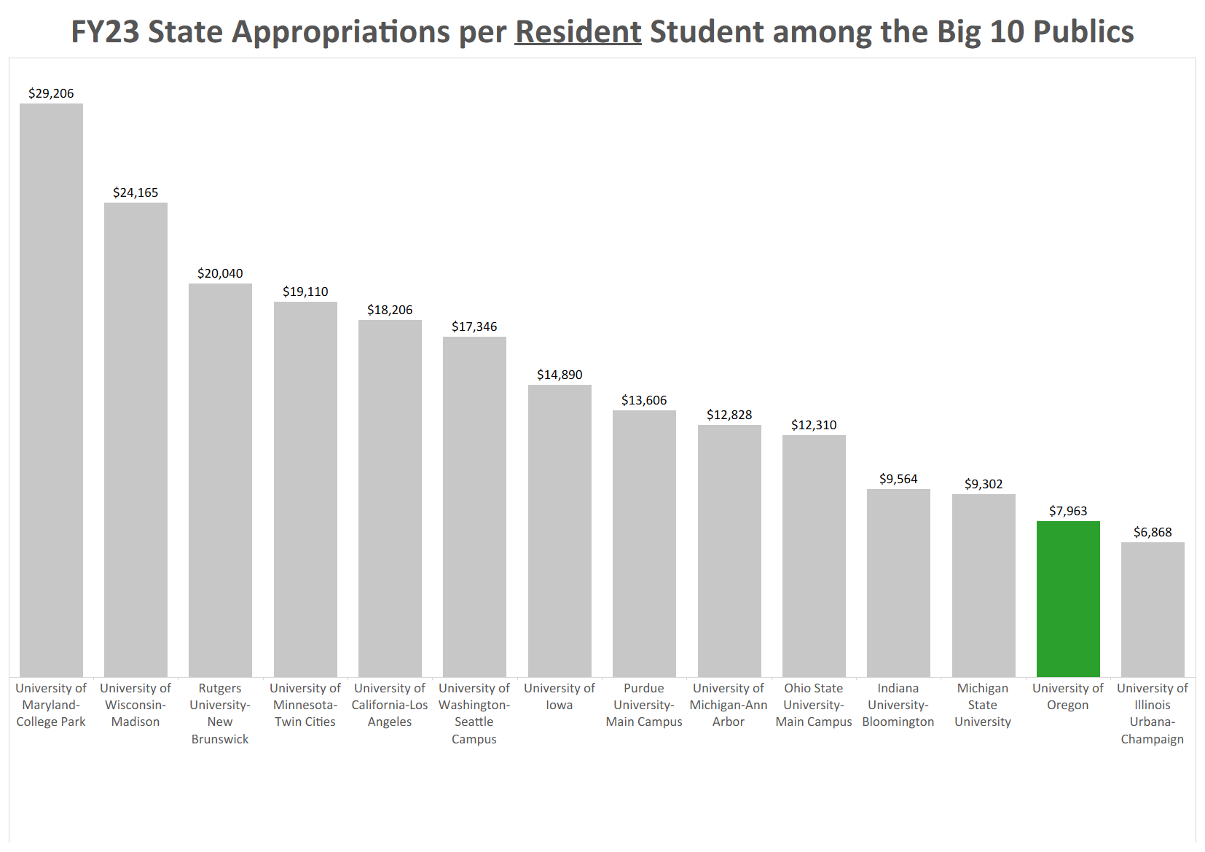

Slide 43
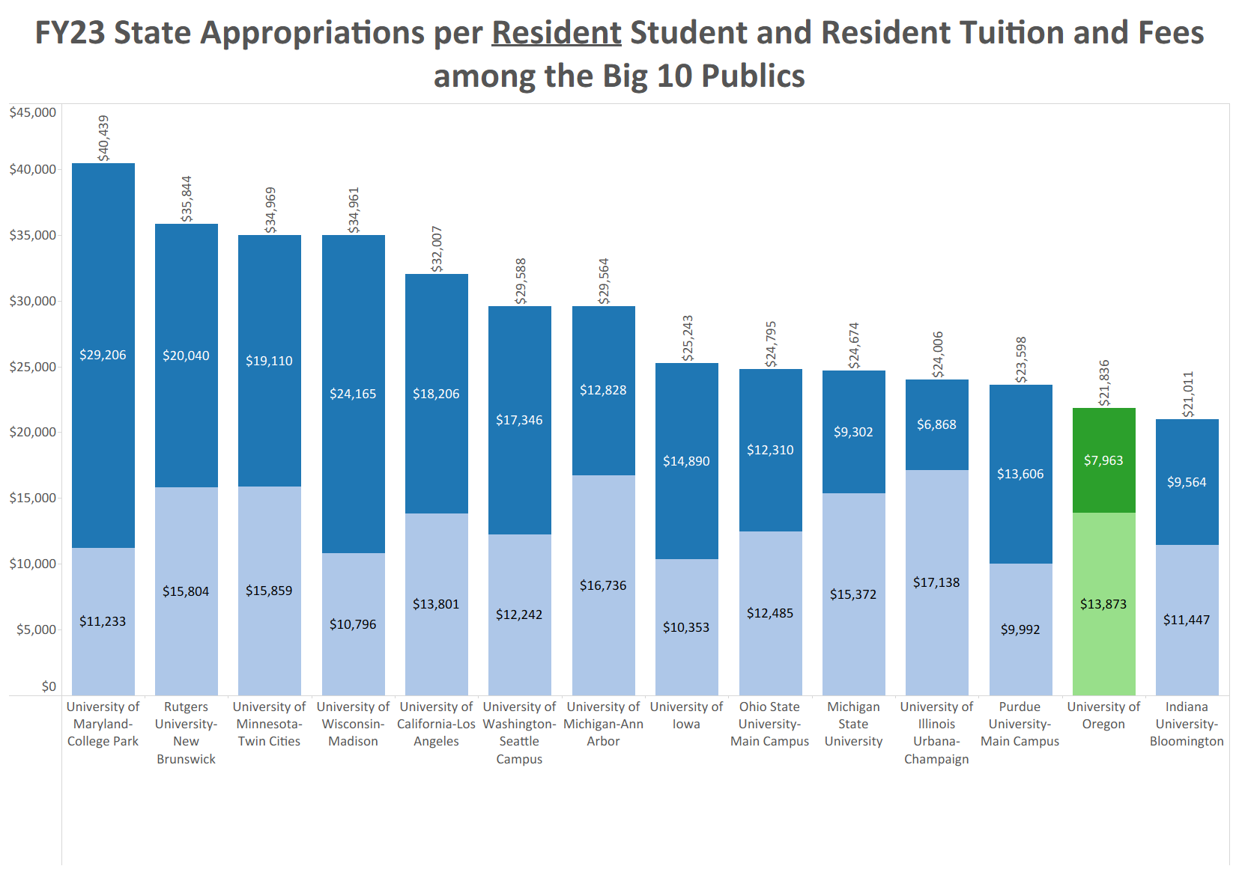

Slide 44
Previous Rounds of Cost Reductions
FY2017
  Administrative Cuts: $3.0M
  CAS Cost Cut: $3.3M
FY2018
  Presidential Directed Cuts: $4.5M
FY2019
  Administrative & Academic Cuts: $11.6 million
FY2025
  E&G fund wide $29.2 million

Slide 45
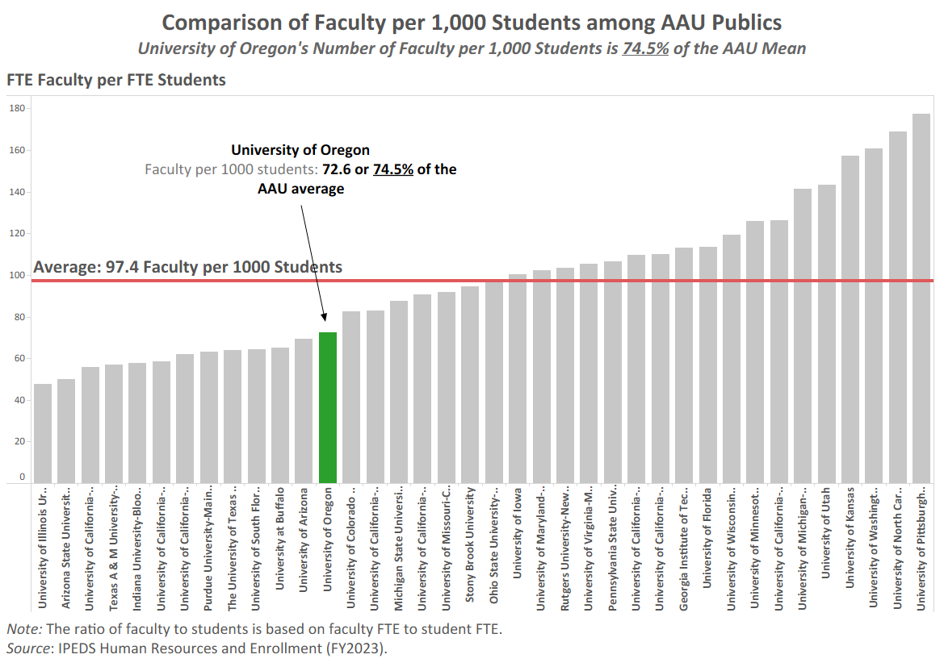

Slide 46
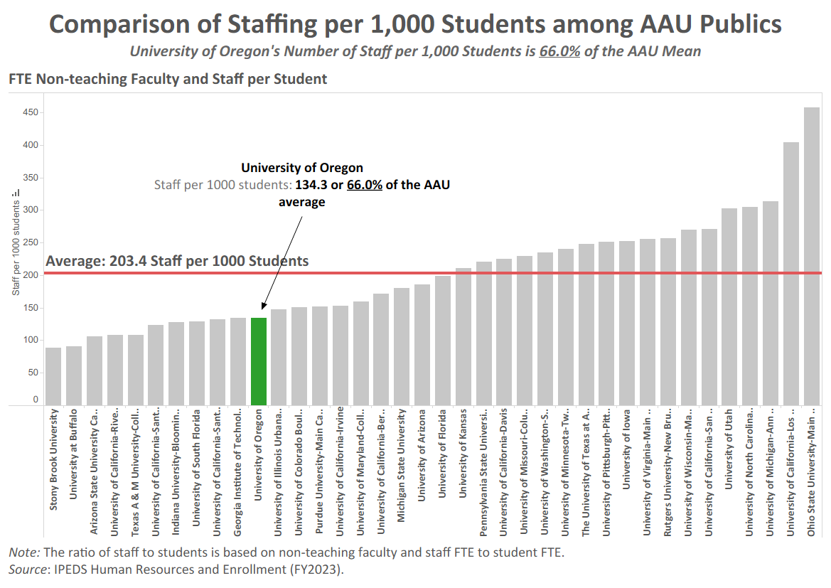

Slide 47
E&G Fund Balance
 | FY2018 | FY2019 | FY2020 | FY2021 | FY2022 | FY2023 | FY2024 | FY2025
Total Expenses including CapEx | $520.0M | $544.0M | $552.6M | $524.1M | 564.5M | $597.6M | $650.1M | $686.1M
Weekly OpEx | $10.0M | 10.5M | $10.6M | $10.1M | $10.9M | $11.5M | $12.5M | $13.2M
End of Year Fund Balance | $80.0M | $65.4M | $56.7M | $65.3M | $93.3M | $114.3M | $116.2M | $119.7M
Weeks of OpEx | 8.0 | 6.3 | 5.3 | 6.5 | 8.6 | 9.9 | 9.3 | 9.1

