Slide 1
Tuition Plateau Discussion
TFAB 2025-26

Slide 2
Tuition Structures
Current Tuition Structure
  Per credit tuition, all credits have the same per credit rate differentiated across residency status
Tuition Plateau
  A pricing model where students pay a flat rate for a certain range of credit hours (e.g., 12-18 credits)
Guaranteed tuition structure would still apply to any tuition structure

Slide 3
Advantages/Risks
Advantages
  Students can take additional credits without additional cost, improving progression, credit momentum and allowing students to explore new subject areas more easily
  Potential for improved four-year graduation rates
  Competitive recruiting advantage
  A consistent term price helps students plan financially
Risks
  Students taking fewer credits could see a significant increase to their tuition charges with a plateau
  Student behavior change (taking additional credits) may increase costs without associated revenue
  Short-term pressure on course availability because students take courses earlier in their progression

Slide 4
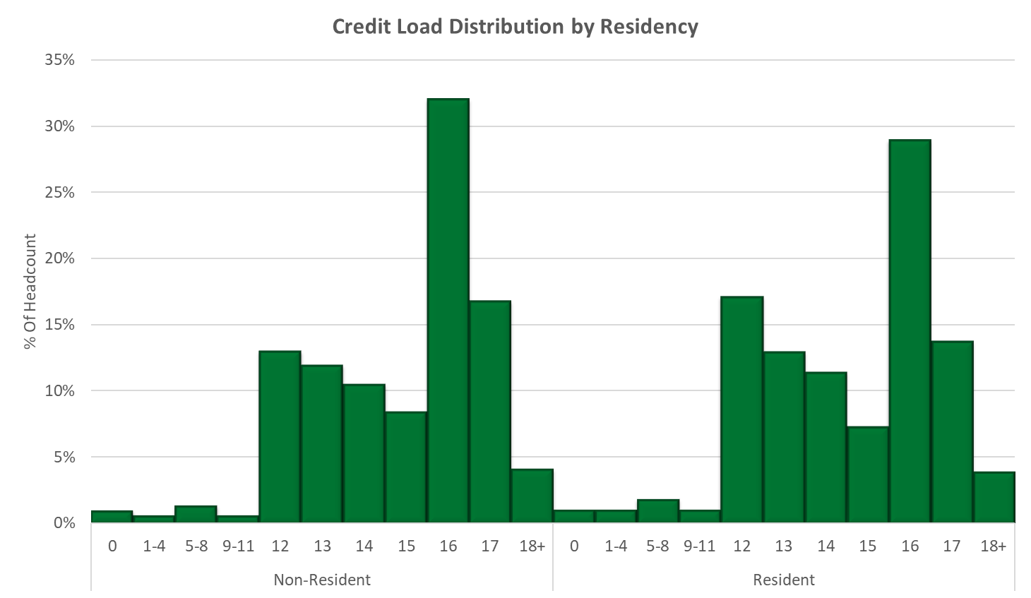
Current Credit Load Distribution

Slide 5
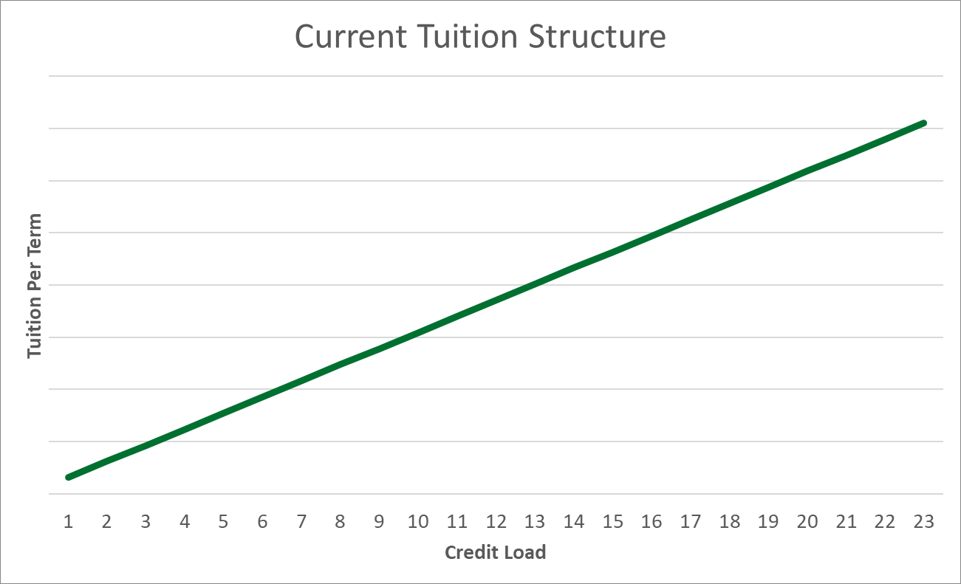
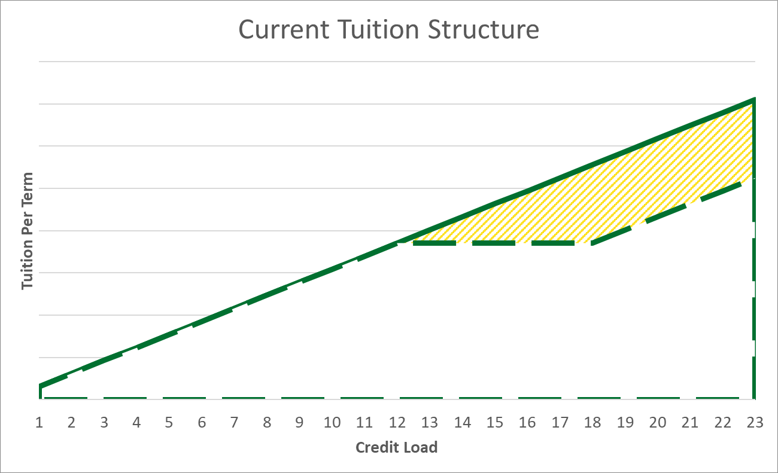
From Per Credit to Plateau: Revenue Impacts
Foregone revenue per cohort: $29M
Foregone revenue could be as much as $29M for the incoming cohort, and as much as $116M once fully phased in, if the tuition plateau were set at the 12 credit rate.

Slide 6
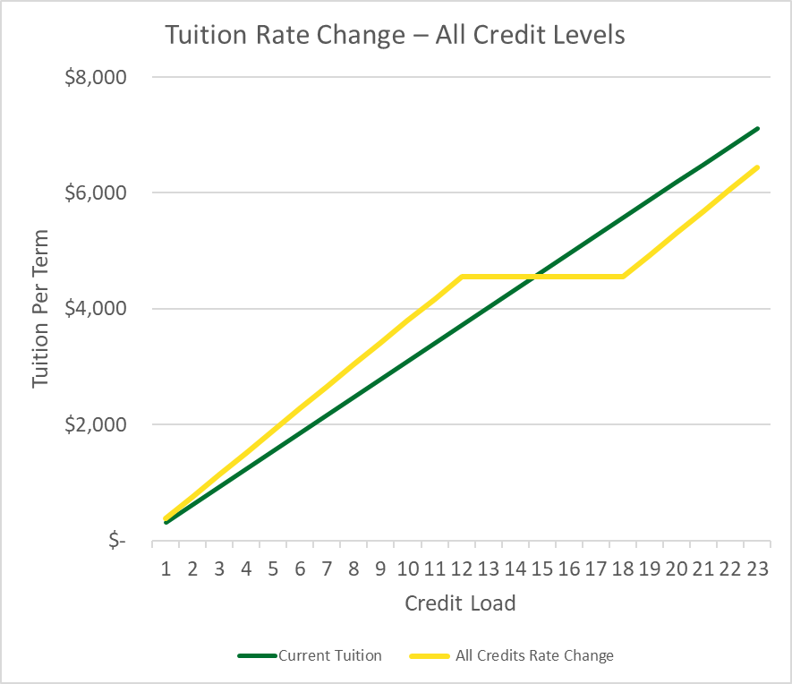
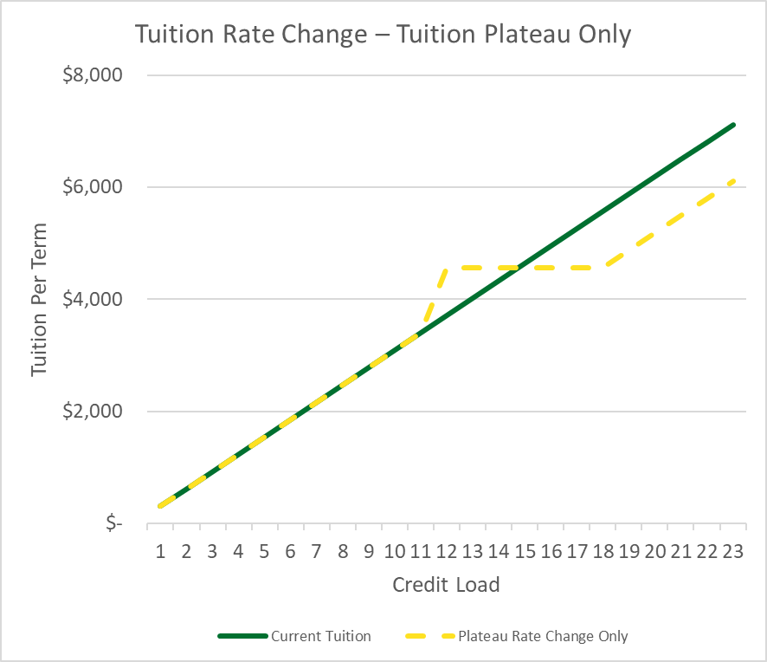
Potential Tuition Plateau Designs
23% Tuition Increase
18% Tuition Decrease

Slide 7
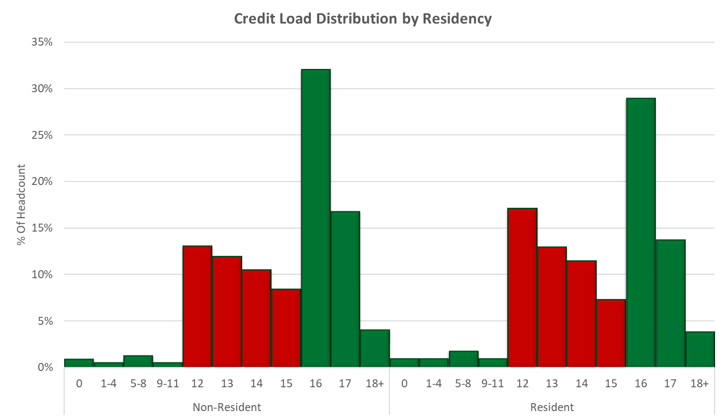
Credit Load Distribution – Behavior Change

Slide 8
Discussion
Should TFAB recommend that the President launch a task force to evaluate if and how UO might transition to a tuition plateau structure?

