Slide 1
University of Oregon
Tuition and Fee Advisory Board
Information Services – Technology (Tech) Fee
Presented by: Abhijit Pandit, Vice President for Information Services and Chief Information Officer

Slide 2
High-Level Summary
Tech Fee Used for
  Technology Infrastructure End of life/Growth
  Mission Critical Software
  Cyber Security tools
  Classroom Tech refresh
The Provost reviews recommendations and provides final approval
Main Drivers
  Increased dependency on technology
  Many IT related costs outpace inflation
  Current funding levels don’t meet demands
Current fee - $67.00/Term.
Proposed Fee - $70.25./Term ($3.25 increase)

Slide 3








How is the tech fee used?
Cybersecurity tools
Student technology fee:
  Currently:
    $ 67.00 per term
  Proposed for 2026-27:
  $70.25 per term
  Applies to:
  New, incoming undergrads
Infrastructure end of life/growth
Mission critical software

Slide 4
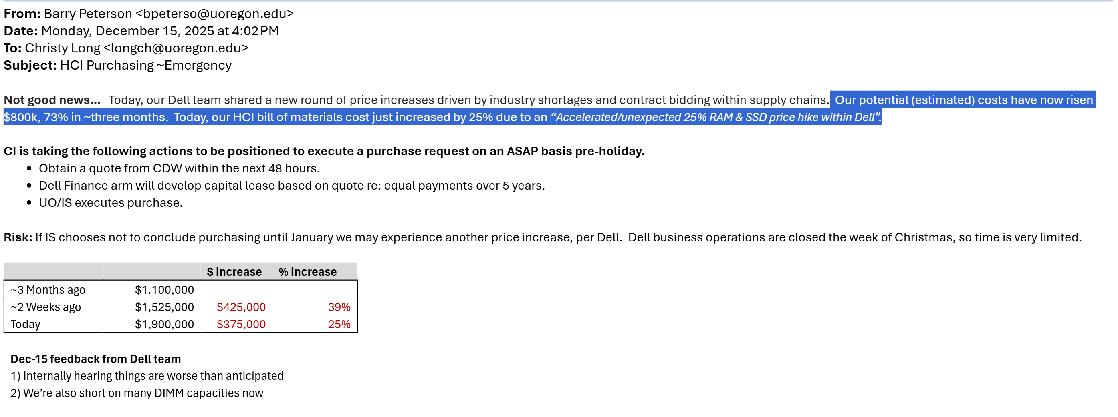

Slide 5

Questions?

