Slide 1

University of Oregon
Financial Briefing
Student Tuition Forum
January 16th, 2018

Slide 2
Agenda
UO Budget Structure
Key Sources of E&G Funding
Historical & Comparative Data
Projected FY19 Cost Drivers
Tuition Revenue
Campus Growth

Slide 3
UO Budget Structure
E&G Funds
Other Funds
Tuition revenue
State Appropriation
F&A Return
Overhead revenue
Fee revenue, interest earnings
Grants and Contracts revenue
Auxiliary Revenue
Service Center Revenue
Designated Operations Revenue
Restricted gifts
School & College Budgets
Grants & Contracts
Central Admin
Budgets
Plant Funds
Institutional Expenses
(Debt, assessments, utilities, leases)
Auxiliary, Service Centers, and Designated Ops Funds
Restricted Gifts

Slide 4
Agenda
UO Budget Structure
Key Sources of E&G Funding
Historical & Comparative Data
Projected FY19 Cost Drivers
Tuition Revenue
Campus Growth

Slide 5
Decreased levels of State Appropriation

Slide 6
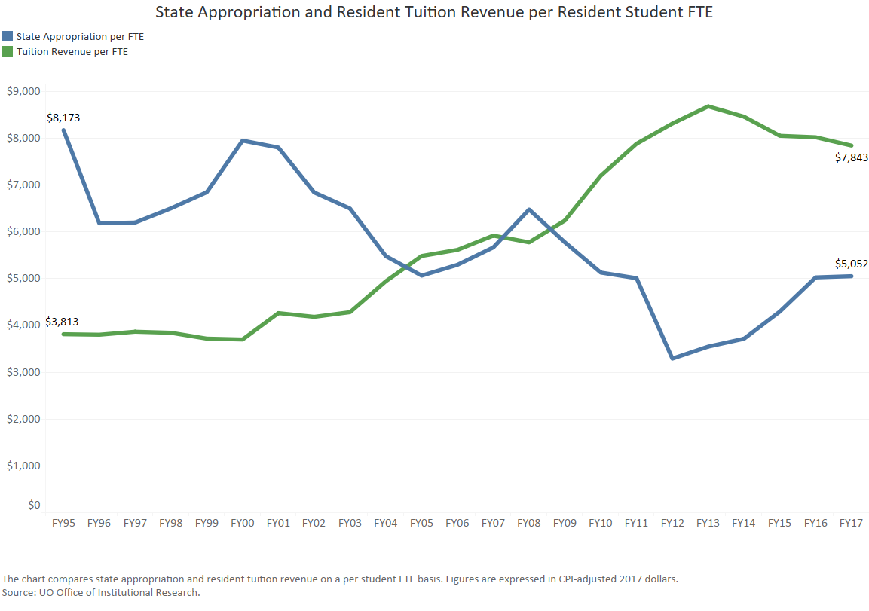
State Appropriation and Tuition

Slide 7
University Resources
FY2017 Major Revenue Streams
(E&G Fund)
State Appropriation $66.8 million
Resident Tuition $114.5 mill
Resident Tuition $103.7 million
Non-resident Tuition $308.8 million
UO Professional Development http://odt.uoregon.edu

Slide 8
Increasing Dependence Upon Nonresident Tuition
FY2002 – Revenue Breakdown
FY2017 – Revenue Breakdown

Slide 9
Agenda
UO Budget Structure
Key Sources of E&G Funding
Historical & Comparative Data
Projected FY19 Cost Drivers
Tuition Revenue
Campus Growth

Slide 10
UO Budget Structure
E&G Funds
Other Funds
Tuition revenue
State Appropriation
F&A Return
Overhead revenue
Fee revenue, interest earnings
Grants and Contracts revenue
Auxiliary Revenue
Service Center Revenue
Designated Operations Revenue
Restricted gifts
School & College Budgets
Grants & Contracts
Central Admin
Budgets
Plant Funds
Institutional Expenses
(Debt, assessments, utilities, leases)
Auxiliary, Service Centers, and Designated Ops Funds
Restricted Gifts

Slide 11
Context – E&G Fund
  E&G Fund - Characteristics
    80% funded with tuition revenue
    Funds majority of activity in schools and colleges and administrative units
    Over 80% invested in people
  E&G Fund – Recent History
    FY15: $10 million deficit ($6.5 million related to recurring issues)
    FY16: Balanced due to state investment and tuition increase
    FY17: Balanced due to tuition increase and cost containment efforts
    FY18: Projected to be balanced based on state investment, tuition increase, and cost cutting

Slide 12
Recent Cost Cutting and Savings Initiatives
    FY17 Administrative Cuts - $3.0M
    FY17 CAS Cost Cut - $3.3M
    FY18 Presidential Directed Cuts- $4.5M
    FY15 - FY18 Efficiencies Savings - $8.8M one time; $4.6 M - $5.6M recurring

Slide 13
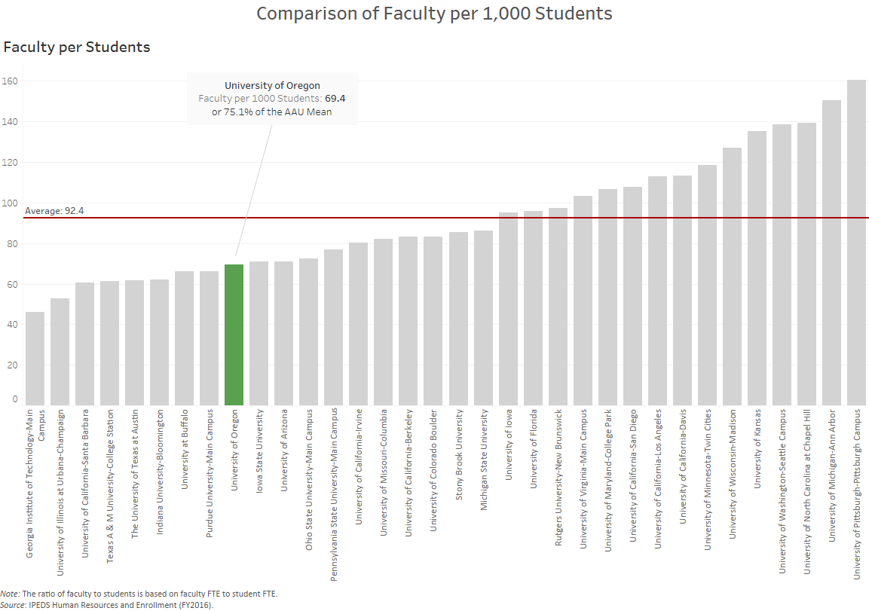
Faculty Staffing Levels – 75.1% of AAU Average

Slide 14
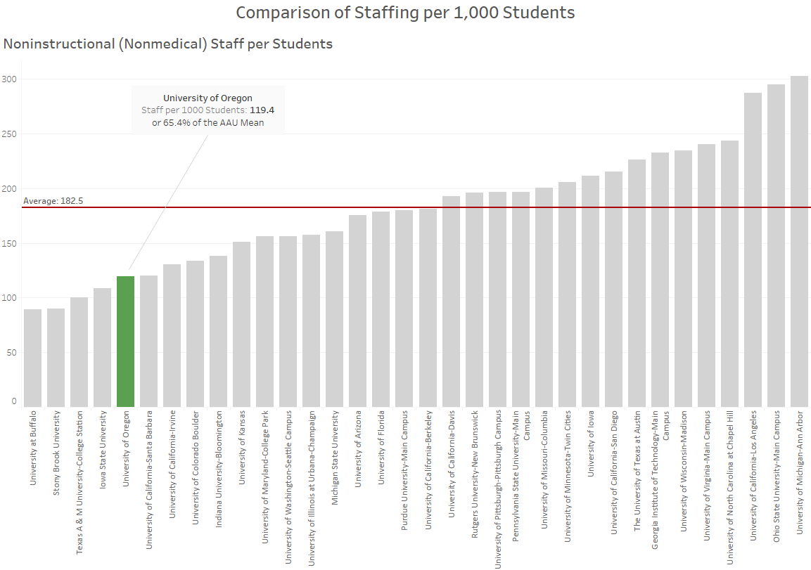
Non – Instructional Staffing Levels – 65.4% of AAU Average

Slide 15
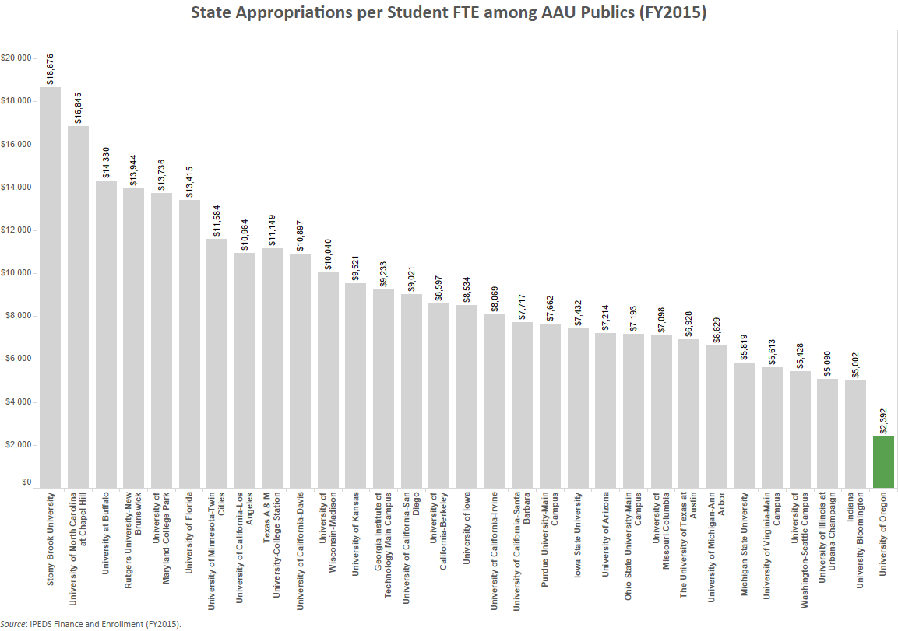

Slide 16
Agenda
UO Budget Structure
Key Sources of E&G Funding
Historical & Comparative Data
Projected FY19 Cost Drivers
Tuition Revenue
Campus Growth

Slide 17
Summary – Major FY2019 E&G Fund Cost Drivers
Cost Driver | FY18 Cost Increases | FY19 Cost Increase
Faculty and Staff Salary and Wages | $11.0 million | $9.8 million
GE Salary and Benefits | $800K | $1.0 million
Medical Costs | $1.6 million | $1.8 million
Retirement Costs | $7.1 million | n/a
Institutional Expenses | $1.0 million | $600K
Strategic Investments (includes $1 million for new faculty) | $2.0 million | $2.0 million
Investments in Tenure Track Faculty | $1.5 million | $1.5 million
Total Projected Cost Increases* | $25.0 million* | $16.7 million
*Does not include, increases to minimum wage, costs related to federal FLSA regulations changes regarding eligibility for overtime pay; further investments in diversity initiatives, or individual school/college/department investments.
Notes:
Defining how Sightlines breaks up the areas of project funding necessary to maintain a campus.
DM and CR are what this presentation concentrates on.
Definitions taken from APPA (Association of Physical Plant Administrators)

Slide 18
Cost Driver | FY19 Cost Increases | Notes
Faculty and Staff Salary and Wages | $9.8 million | Increases per collective bargaining agreements for approximately 1700 faculty and 900 classified staff. Also includes increases for approximately 1200 unrepresented staff.
GE Salary and Benefits | $1.0 million | Estimate based on collective bargaining agreement for GEs; includes estimate of health insurance cost increases
Medical Costs | $1.8 million | Assumed annual increase of 3.7%
Retirement Costs | n/a | PERS rates only increase every two years
Institutional Expenses | $600K | Increases related to utilities, insurance, debt for academic buildings, assessments, and leases. Lower than normal annual increase due to Power Station savings.
Strategic Investments (includes $1 million for new faculty) | $2.0 million | Allocated via strategic investment process. $1 million pre-committed for tenure track faculty hiring related to Cluster Hires.
Investments in Tenure Track Faculty | $1.5 million | Supporting long term strategic plan to increase number of tenure track faculty
Total Projected Cost Increases* | $16.7 million*
*Does not include, increases to minimum wage, costs related to federal FLSA regulations changes regarding eligibility for overtime pay; further investments in diversity initiatives, or individual school/college/department investments.
Notes:
Defining how Sightlines breaks up the areas of project funding necessary to maintain a campus.
DM and CR are what this presentation concentrates on.
Definitions taken from APPA (Association of Physical Plant Administrators)

Slide 19
Summary – Major FY2019 E&G Fund Cost Drivers
Cost Driver | FY18 Base | FY19 Cost Increase | FY19 % increase
Faculty and Staff Salary and Wages | $361.1 million | $9.8 million | 2.7%
GE Salary and Benefits | $26.2 million | $1.0 million | 3.8%
Medical Costs | $48.7 million | $1.8 million | 3.7%
Retirement Costs | $52.5 million | n/a | n/a
Institutional Expenses | $34.9 million | $600K | 1.7%
Strategic Investments (includes $1 million for new faculty) | $524.9 million | $2.0 million | 0.4%
Investments in Tenure Track Faculty (includes salary and OPE) | $156.6 million | $1.5 million | 1.0%
Totals | $524.9 million | $16.7 million | 3.18%
Notes:
Defining how Sightlines breaks up the areas of project funding necessary to maintain a campus.
DM and CR are what this presentation concentrates on.
Definitions taken from APPA (Association of Physical Plant Administrators)

Slide 20
Cost Drivers – PERS Costs
Projected Increases | FY18 | FY19 | FY20 | FY21 | FY22
E & G Fund | $7.1M | $0 | $7.1M | $0 | $7.1M
Other | $3.4M | $0 | $3.4M | $0 | $3.4M
Total | $10.5M | $0 | $10.5M | $0 | $10.5M
If PERS unfunded liabilities continue to grow, charges to the University of Oregon could grow significantly in future years.

Slide 21
Agenda
UO Budget Structure
Key Sources of E&G Funding
Historical & Comparative Data
Projected FY19 Cost Drivers
Tuition Revenue
Campus Growth

Slide 22
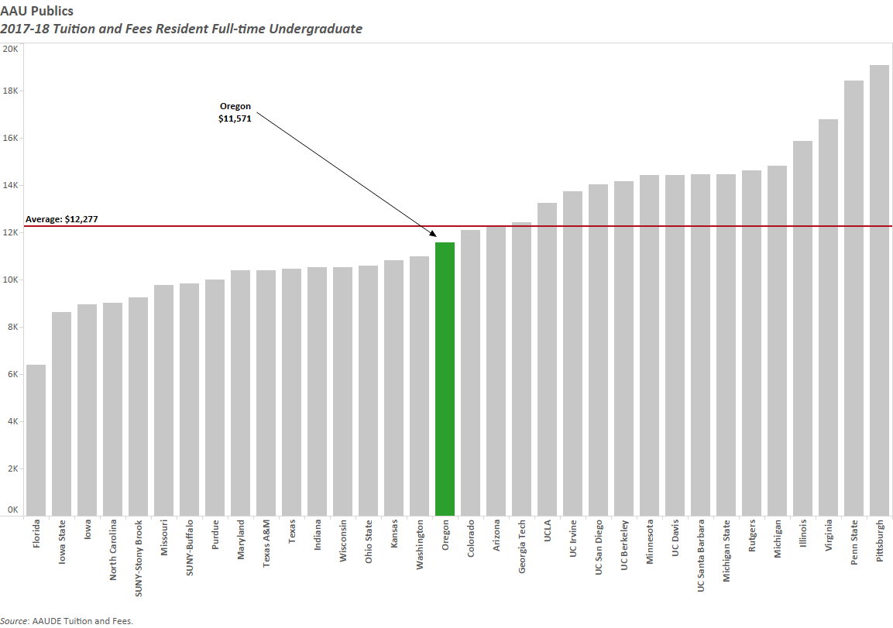
Resident Tuition – AAU Publics

Slide 23
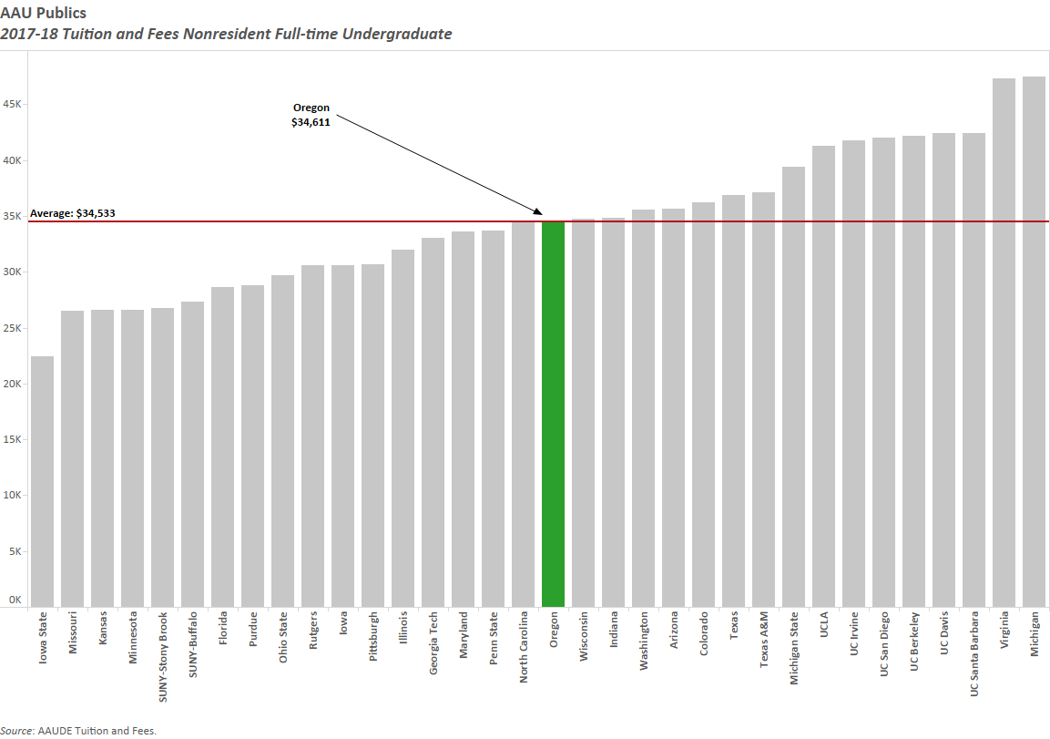
Non Resident Tuition – AAU Publics

Slide 24
Tuition Revenue
For each 1% increase in undergraduate tuition, overall revenue increases*:
  *Totals account for fee remissions and summer revenue
Resident | $800k
Non-resident | $2.5M

Slide 25
Tuition Revenue
Non-resident Tuition Rate Increase
Percent Increase (Per Student Annually) | 2.0% ($650) | 2.5% ($813) | 3.0% ($976) | 4.0% ($1,301) | 5.0% ($1,627)
2.0% ($190) | $6.6M | $7.8M | $9.1M | $11.6M | $14.1M
3.0% ($285) | $7.4M | $8.6M | $9.9M | $12.4M | $14.9M
4.0% ($380) | $8.1M | $9.4M | $10.6M | $13.2M | $15.7M
5.0% ($475) | $8.9M | $10.1M | $11.4M | $13.9M | $16.5M
Resident Tuition Rate Increase

Slide 26
Agenda
UO Budget Structure
Key Sources of E&G Funding
Historical & Comparative Data
Projected FY19 Cost Drivers
Tuition Revenue
Campus Growth

Slide 27
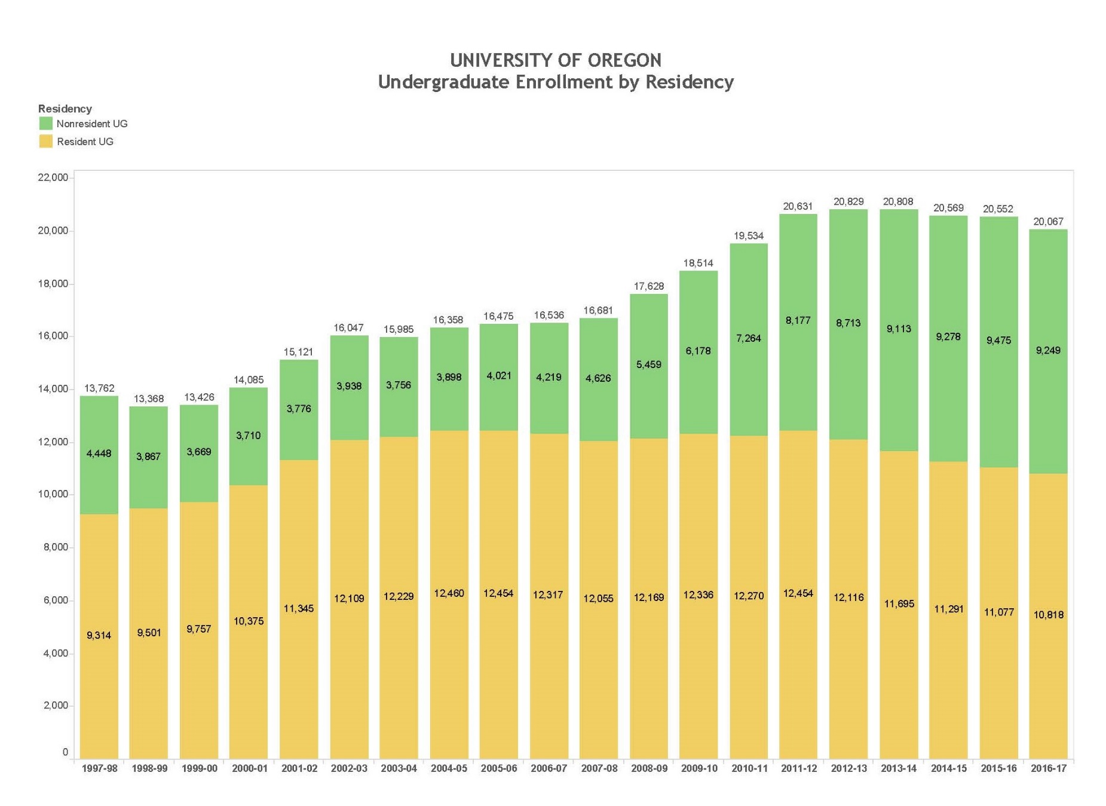
Campus Growth

Slide 28
Campus Growth
  Assumed Growth – adding 3,000 students over a period of eight years
  Necessary investments
    Recruiting
    Classroom/Faculty Office Building
    Additional new residence hall
    Variable Costs

Slide 29
Campus Growth
Financial Projections
 | FY19 | FY20 | FY21 | FY22 | FY23 | FY24 | FY25 | FY26
Entering Freshmen | 4,150 | 4,450 | 4,450 | 4,500 | 4,675 | 4,775 | 4,850 | 4,900
Total Undergrads (Admitted) | 19,892 | 20,370 | 20,782 | 21,174 | 21,619 | 22,001 | 22,348 | 22,658
Incremental Revenue from Enrollment Growth | $7.9M | $14.2M | $12.2M | $12.1M | $14.2M | $13.6M | $13.4M | $12.7M
Incremental Investment Recruiting | $1.3M | $245k | - | - | - | - | - | -
Incremental Investment New Classroom Building | - | $3.1M | - | - | - | - | - | -
Incremental Investment Variable Costs | - | $224k | $5.4M | $5.5M | $6.5M | $6.0M | $5.9M | $5.6M
Net Revenue | $6.6M | $10.6M | $6.8M | $6.6M | $7.7M | $7.6M | $7.5M | $7.1M

