Slide 1
Student Services and Enrollment Management Fees for the Tuition and Fees Advisory Board Review FY26
University Housing Proposed Rates

Slide 2
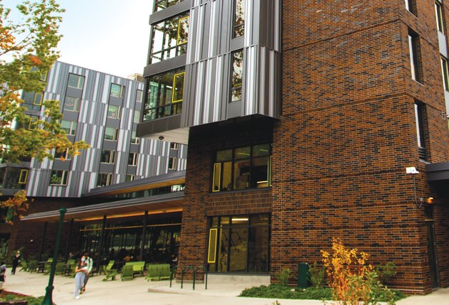
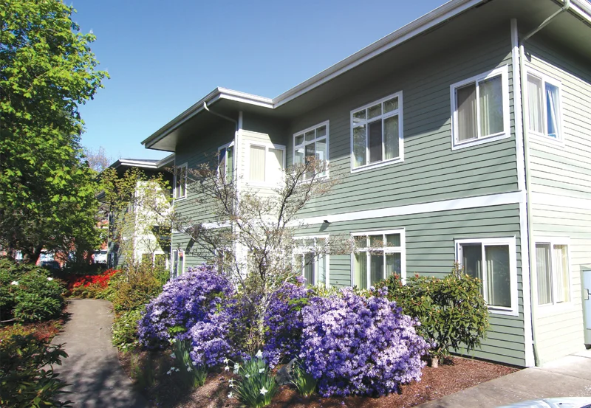
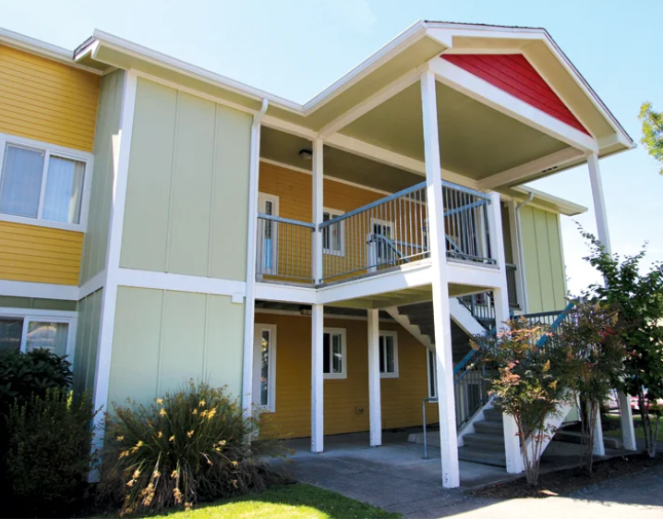
Residence Hall Room & Board and Family Housing & University Apartments FY26 Rates
4.5%-5% residence hall room and board rate increase: 4.5% double and triple occupancy; 5% single occupancy; similar rate structure to previous years
Family Housing and University Apartments increase: 3% Spencer View Apartments, Agate Street Apartments, East Campus Houses; 5% Graduate Village
Discounts
  $423 residence hall returner discount
  Possible $450 discount extended to residents most directly impacted by demolition of Hamilton and construction of new open area

Slide 3

Residence Hall Room & Board and Family Housing & University Apartments FY26 Rates
Primary Cost Drivers:
Labor and OPE (Other Personnel Expenses)
  Officers of Administration (77) 4% (October 2024); 3% in 2025 & 2026
  Classified Staff (350) 3.5% June 1, 2025 and 3% November 2025
  Minimum Wage increase (~950 students) typically 5-6% increases; collective bargaining agreement under negotiation
Construction & Maintenance increases 3-4%
Food Commodity increases 5-6%
Utility increases 2-6%
Continued necessary capital investment in our existing buildings
Second year of the included laundry program
Enhanced security measures

Slide 4
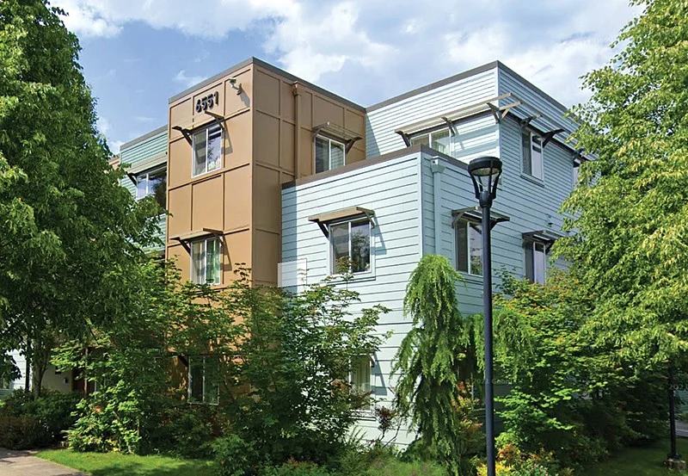
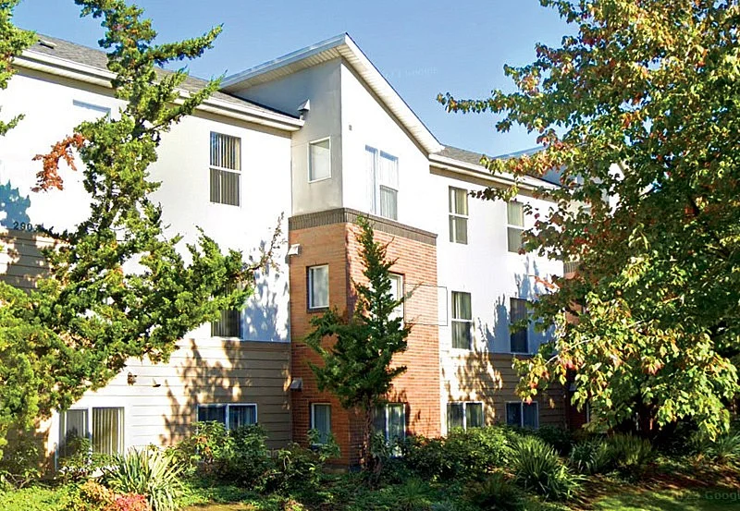
UO Northeast Portland Campus FY26 Apartment Rates
NE 27th Apartments
  Rates increases: $20 per month 1 & 2 bedroom units; $5 per month 3 & 4 bedroom units
  1 Bdrm $1,470 per person/mo
  2 Bdrm $1,220 per person/mo (or *$2,220 apt)
  3 Bdrm $1,055per person/mo (or *$2,955 apt)
  4 Bdrm $930 person/mo or (*$3,505 apt)
Holman Street Apartments
  4 Bdrm $830 person/mo or (*$3,105 apt)
  * Designed especially for Families: 11.5 month contract required; one contract holder, "sub-contracting" ("sub-leasing") not permitted; contract holder must be UO student; occupancy limited to number of bedrooms for individuals over 5 years old

Slide 5
Questions/Answers/Discussion

