Slide 1


Slide 2
Agenda
UO Budget
Cost Drivers
Guaranteed Tuition Program
TFAB Recommendations
Small Group Discussion

Slide 3
UO Budget Structure
E&G Funds
Other Funds
Tuition revenue
State Appropriation
F&A Return
Overhead revenue
Fee revenue, interest earnings
Grants and Contracts revenue
Auxiliary Revenue
Service Center Revenue
Designated Operations Revenue
Restricted gifts
School & College Budgets
Grants & Contracts
Central Admin
Budgets
Plant Funds
Institutional Expenses
(Debt, assessments, utilities, leases)
Auxiliary, Service Centers, and Designated Ops Funds
Restricted Gifts

Slide 4
Summary – Major FY2027 E&G Fund Cost Drivers
Cost Driver | Projected FY27 Cost Increase | Notes
Faculty, Staff and GE Salary and OPE | $22.2 million | E&G compensation increases based on current contracts (e.g., faculty), announced increases for OAs and assumptions of 3% annual increases for those groups without ratified contracts. Includes approximately 1,130 graduate employees, 1,520 faculty, 800 classified staff, and 1,180 unrepresented staff on the E&G fund.
Medical Costs | $2.4 million | December 2025 estimated cost increase is 3.8%. Includes estimate of rate increase and rate group shifts.
Blended OPE | $6.4 million | There were $7.2 million of one-time carry forward funds available during FY26 to “buy down” OPE rates. These one-time funds offset last year’s large increase to PERS rates. Going into FY2027, only $800k of one-time carry forward funds will be available.
Institutional Expenses | $1.8 million | Increases related to utilities, insurance, debt for academic buildings, assessments, and leases.
Strategic Investments | $1.0 million | Allocated via strategic investment process. Note that President has only allocated $1.0 million to the BAG (Budget Advisory Group) process this year given budget constraints.
Total Projected Cost Increases | $33.8 million

Slide 5
Summary – Major FY2027 E&G Fund Cost Drivers
Cost Driver | FY26 Base | Projected FY27 Cost Increase | FY27 Increase (%)
Faculty, Staff and GE Compensation
Impact of Salary Increases |  | $22.2 million
Impact of Medical Cost Rate Increases |  | $2.4 million
Impact of Blended OPE (Reduction of One Time Carry Forward Fund) |  | $6.4 million
Total | $565.9 million | $31.0 million | 5.5%
Institutional Expenses | $59.0 million | $1.8 million | 3.1%
All Other S&S, Transfers, and Capital Expenses (No assumed increases for cost driver analysis) | $86.0 million | $0.0 million | 0.0%
Strategic Investments |  | $1.0 million
Total (E&G Budget) | $710.9 million | $33.8 million | 4.8%
Note: We are projecting $11.6 million of the $29.2 million budget cuts that we just implemented to hit in FY27, which will offset some of these cost drivers. This will bring the total increase, after budget reductions, down to $22.2 million which represents a total increase on the E&G fund of 3.2%.

Slide 6
Agenda
UO Budget
Cost Drivers
Guaranteed Tuition Program
TFAB Recommendations
Small Group Discussion

Slide 7
Framework – Guaranteed Tuition Program
for Undergraduate Students
For each entering class year, there is a set resident and non-resident tuition rate per student credit hour (SCH)
That rate is guaranteed or locked for five years - no matter what
Other tuition and fees that are locked include administratively controlled mandatory fees, summer tuition, honors college differential tuition, business school differential tuition and the international student fee
Students know the expected cost of their education before they decide to come to the University of Oregon

Slide 8
Average Historical Annual Undergraduate Tuition Rate Increases – Analysis conducted in FY2020
10 Year Average
5 Year Average
Resident
5.4%
5.0%
Non-resident
4.4%
3.3%

Slide 9
New Resident Undergraduate Students
Graduation Time 4 years
Analysis Conducted in FY2020
Assumed Annual Increases 5% - Average 5 Year Historical Rate
5-year Guaranteed rate $254.62 per SCH (9.75% increase)
Total Tuition
Paid
$1,050
Total Tuition
Paid
$1,018

Slide 10
New Resident Undergraduate Students
Graduation Time 5 years
Analysis Conducted in FY2020
Assumed Annual Increases 5% - Average 5 Year Historical Rate
5-year Guaranteed rate $254.62 per SCH (9.75% increase)
Total Tuition
Paid
$1,346
Total Tuition
Paid
$1,273

Slide 11
New Resident Undergraduate Students
Graduation Time 8 years
Analysis Conducted in FY2020
Assumed Annual Increases 5% - Average 5 Year Historical Rate
5-year Guaranteed rate $254.62 per SCH (9.75% increase)
Total Tuition
Paid
$2,326
Total Tuition
Paid
$2,116

Slide 12
Advantages of Guaranteed Tuition Program for Students
Financial Predictability: Tuition rates are locked in for five years – students and their families know ahead of time exactly what they are going to pay for their education.
Peace of Mind: The guaranteed tuition program functions as a insurance policy for students. Regardless of what happens to state funding or other costs, their tuition rates are guaranteed for five years.
Protection of Scholarship Value: Many scholarships are currently fixed dollar amounts. Under a guaranteed tuition program, the value of these scholarships remains the same over their college career.

Slide 13
Advantages of Guaranteed Tuition Program for Institution
Recruiting: The stronger value proposition of a locked-in rate should be very attractive to new students. This should help support the institution’s enrollment growth initiative.
Retention: One of the main reasons students cite for dropping out of school is financial pressure. This can often be linked to students not anticipating tuition increases throughout their college career. Having a locked rate for tuition should help with this issue.
Campus Climate: Concern about continually rising tuition rates affects students, faculty and staff, and directs time, energy and focus away from other important educational issues.

Slide 14
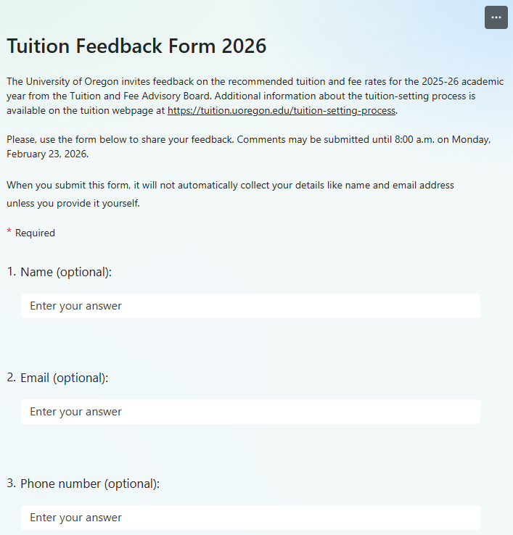



Tuition-setting process
Oct-Jan: TFAB Briefings
UO budget
PUSF (state funding)
Data
Oregon Guarantee
Financial aid
Long-term projections
Updated cost drivers
Cost management
Community feedback survey online
January: Student Forum
Mid-Feb: TFAB recommendations
to the President
Early March: Pres sends tuition rec’s to the BOT
Jan-Feb: TFAB reviews proposals
Admin controlled mandatory fees
  Rec Center fee
  Student Union fee
  Health Center fee
  Tech fee
Housing fees
Graduate tuition
Course fees and other fees
TFAB develops a recommendation on tuition rates for incoming UG cohort
February: President’s Forum
Mid-March: BOT sets tuition + fees for FY27

Slide 15
Agenda
UO Budget
Cost Drivers
Guaranteed Tuition Program
TFAB Recommendations
Small Group Discussion

Slide 16
TFAB Recommendations: Incoming cohort of new undergraduate students (2026 Tuition Cohort)
TFAB recommends the guaranteed tuition rate for new, incoming undergraduate students be set at a rate that is:
  4.5% higher than this year’s resident first-year students ($322.93 per Student Credit Hour / $14,531.85 per year)
  3.0% higher than this year’s nonresident first-year students ($989.40 per Student Credit Hour / $44,523.00 per year)
For resident and nonresident undergraduate students in the 2026 Tuition Cohort, administratively controlled mandatory fees would be 2.98% higher than the 2025 Tuition Cohort
For the incoming UG cohort: tuition rates and admin-controlled mandatory fees will be locked for 5 years

Slide 17
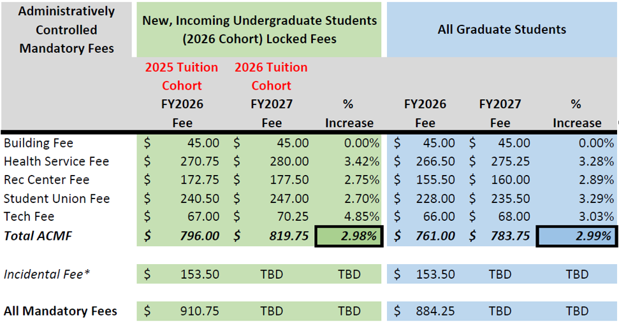
Administratively Controlled Mandatory Fees (per term)
* The Incidental Fee (I-Fee) proposal is developed by the ASUO and is not subject to the TFAB review process

Slide 18
College of Business Undergraduate Differential
Currently: $30 per student credit hour
Proposing an increase to $50 per student credit hour, effective with 2026 Tuition Cohort
  No impact to current students
  Would apply to all business courses (not just courses for business administration and accounting majors)
Rationale:
  Business education has a higher cost
  LCB differential is lower than most comparator business programs
  Struggling to provide high-quality faculty and student services demanded by business students
  Need to provide high level of services to be able attract students
Consulted the Dean’s Committee on Inter-Club Coordination: they supported the idea that high quality faculty and student services are essential, and it is important to maintain services

Slide 19
Graduate Tuition Proposals
Most proposed graduate tuition increases for FY27 vary between 0% and 4.0%
UO has over 80 separate rates for graduate programs
Schools and colleges provided detailed recommendations for graduate tuition rates
  Two propose no graduate tuition rate increases
    College of Design: conducting market analysis, and looking at pricing models, competitive demand, and long-term program sustainability
    School of Law: recommendation is based on market dynamics
  College of Business
    Proposing 6.09% increase in tuition for summer 2027 Sports Product Management grad program (to match the academic year program rate)

Slide 20
Next Steps
President Scholz is collecting feedback from students, faculty, and staff on the TFAB recommendations (via forum and online survey)
President will forward his FY27 tuition and fee proposals to the Board of Trustees in early March
The Board of Trustees will make decisions about the FY27 tuition and fee proposals at the BOT meeting on March 16th & 17th

Slide 21
Agenda
UO Budget
Cost Drivers
Guaranteed Tuition Program
TFAB Recommendations
Small Group Discussion

Slide 22
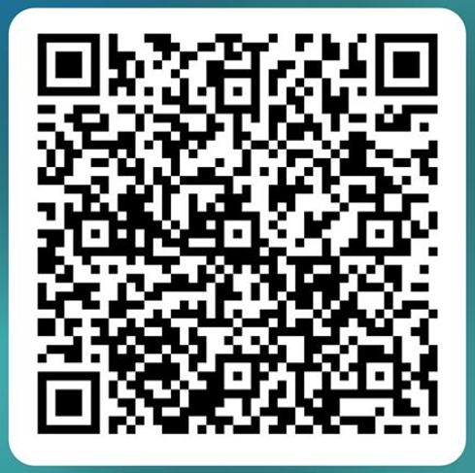
Small group discussions
Online feedback form:
UO tuition info: https://vpfa.uoregon.edu/tuition

