Slide 1


Slide 2

President’s Tuition Forum
Financial Briefing
& TFAB Recommendations
February 16th, 2023

Slide 3
Agenda
UO Budget Structure
Cost Drivers
Guaranteed Tuition Program
TFAB Recommendations
Small Group Discussions

Slide 4
UO Budget Structure
E&G Funds
Other Funds
Tuition revenue
State Appropriation
F&A Return
Overhead revenue
Fee revenue, interest earnings
Grants and Contracts revenue
Auxiliary Revenue
Service Center Revenue
Designated Operations Revenue
Restricted gifts
School & College Budgets
Grants & Contracts
Central Admin
Budgets
Plant Funds
Institutional Expenses
(Debt, assessments, utilities, leases)
Auxiliary, Service Centers, and Designated Ops Funds
Restricted Gifts

Slide 5
Summary – Major FY2024 E&G Fund Cost Drivers
Cost Driver | Projected FY24 Cost Increase | Notes
Faculty, Staff and GE Salary and OPE | $11.9 million | E&G employee increases based on collective bargaining agreements for approximately 1,216 graduate employees, 1,471 faculty, and 700 classified staff. Also includes salary increases for approximately 1,085 unrepresented staff. Figures are for employees paid with E&G funds only. Does not include any projected funding for retention, equity or market adjustments or funds needed for refilling staffing vacancies.
Medical Costs | $2.2 million | Includes weighted average increase of 4.2% for December 2022 and assumes 4.2% increase in December 2023.
Retirement Costs | $1.9 million | Increases for PERS for FY24
Oregon Paid Leave | $900K | Oregon Paid leave program starting in FY24 - September
Blended OPE | $4.0 million | Blended OPE rates artificially low in FY23 due to extremely low level of leave usage in FY21. Rates renormalizing in FY24.
Institutional Expenses | $1.5 million | Increases related to utilities, insurance, debt for academic buildings, assessments, and leases.
Strategic Investments | $2.0 million | Allocated via strategic investment process.
Total Projected Cost Increases | $24.4 million

Slide 6
Summary – Major FY2024 E&G Fund Cost Drivers
Cost Driver | FY23 Base | Projected FY24 Cost Increase | FY24% Increase
Faculty, Staff and GE Salary and Wages | $467.5 million | $11.9 million | 2.5%
Medical Costs | $52.9 million | $2.2 million | 4.2%
Retirement Costs | $62.5 million | $1.9 million | 3.0%
Oregon Paid Leave | $467.5 million | $900K | 0.2%
Blended OPE | $187.4 million | $4.0 million | 2.1%
Institutional Expenses | $36.7 million | $1.5 million | 4.1%
Strategic Investments | $606.0 million | $2.0 million | 0.3%
Totals | $606.0 million | $24.4 million | 4.0%

Slide 7
Agenda
UO Budget Structure
Cost Drivers
Guaranteed Tuition Program
TFAB Recommendations
Small Group Discussions

Slide 8
Framework – Guaranteed Tuition Program
for Undergraduate Students
For each entering class year, there is a set resident and non-resident tuition rate per student credit hour (SCH)
That rate is guaranteed or locked for five years - no matter what
Other tuition and fees that are locked include administratively controlled mandatory fees, summer tuition, honors college differential tuition, business school differential tuition and the international student fee
Students know the expected cost of their education before they decide to come to the University of Oregon

Slide 9
Average Historical Annual Undergraduate Tuition Rate Increases – Analysis conducted in FY2020
10 Year Average
5 Year Average
Resident
5.4%
5.0%
Non-resident
4.4%
3.3%

Slide 10
New Resident Undergraduate Students
Graduation Time 4 yrs
Analysis Conducted in FY2020
Assumed Annual Increases 5% - Average 5 Year Historical Rate
5 year Guaranteed rate $254.62 per SCH (9.75% increase)
Total Tuition
Paid
$1,050
Total Tuition
Paid
$1,018

Slide 11
New Resident Undergraduate Students
Graduation Time 5 yrs
Analysis Conducted in FY2020
Assumed Annual Increases 5% - Average 5 Year Historical Rate
5 year Guaranteed rate $254.62 per SCH (9.75% increase)
Total Tuition
Paid
$1,346
Total Tuition
Paid
$1,273

Slide 12
New Resident Undergraduate Students
Graduation Time 8 yrs
Analysis Conducted in FY2020
Assumed Annual Increases 5% - Average 5 Year Historical Rate
5 year Guaranteed rate $254.62 per SCH (9.75% increase)
Total Tuition
Paid
$2,326
Total Tuition
Paid
$2,116

Slide 13
Advantages of Guaranteed Tuition Program for Students
Financial Predictability: Tuition rates are locked in for five years – students and their families know ahead of time exactly what they are going to pay for their education.
Peace of Mind: The guaranteed tuition program functions as a insurance policy for students. Regardless of what happens to state funding or other costs, their tuition rates are guaranteed for five years.
Protection of Scholarship Value: Many scholarships are currently fixed dollar amounts. Under a guaranteed tuition program, the value of these scholarships remains the same over their college career.

Slide 14
Advantages of Guaranteed Tuition Program for Institution
Recruiting: The stronger value proposition of a locked-in rate should be very attractive to new students. This should help support the institution’s enrollment growth initiative.
Retention: One of the main reasons students cite for dropping out of school is financial pressure. This can often be linked to students not anticipating tuition increases throughout their college career. Having a locked rate for tuition should help with this issue.
Campus Climate: Concern about continually rising tuition rates affects students, faculty and staff, and directs time, energy and focus away from other important educational issues.

Slide 15
Students who started prior to the Guaranteed Tuition Program
Annual tuition increases for undergraduate students who started prior to the Guaranteed Tuition Program will be locked at 3.0% per year through FY2024
ANNUAL TUITION INCREASES FOR CURRENT STUDENTS LOCKED AT 3.0% PER YEAR
 | FY2021 SCH Rate | FY2022 SCH Rate | FY2023 SCH Rate | FY2024 SCH Rate
Resident Undergraduates | $238.96 | $246.13 | $253.51 | $261.12
Non-resident Undergraduates | $785.89 | $809.47 | $833.75 | $858.76

Slide 16
Agenda
UO Budget Structure
Cost Drivers
Guaranteed Tuition Program
TFAB Recommendations
Small Group Discussions

Slide 17
TFAB Recommendations: Incoming cohort of new undergraduate students (2023 Tuition Cohort)
TFAB recommends the guaranteed tuition rate for new, incoming undergraduate students be set at a rate that is:
  3.8% higher than this year’s non-resident first-year students ($903.24 per SCH / $40,645.80 per year)
  4.0% higher than this year’s resident first-year students ($289.18 per SCH / $13,013.10 per year)
For resident and non-resident undergraduate students in the 2023 Tuition Cohort, administratively controlled mandatory fees would be 4.32% higher than the 2022 Tuition Cohort
For the incoming UG cohort, tuition rates and admin-controlled mandatory fees would be locked for 5 years

Slide 18
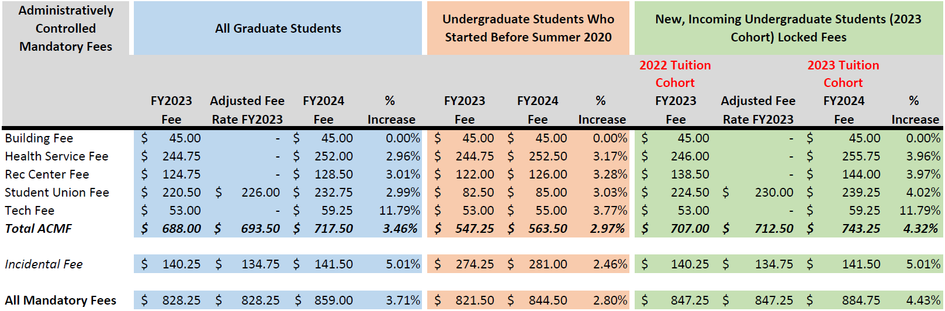
Administratively Controlled Mandatory Fees
Note: The Incidental Fee (I-Fee) proposal is developed by the ASUO and does not run through the TFAB review process.

Slide 19
Graduate Tuition Proposals
Most proposed graduate tuition increases for FY24 vary between 0% and 5.0%
School of Law: proposed increases of 5% for all programs to
  Cover increasing operational costs
  Invest in key student supports
    Scholarships
    Student advising and wellness resources
    Faculty expertise (Indian law, Business law, Environmental law)
Business School proposed to restructure tuition for new MBA / MSF students to better reflect tuition structure of underlying programs

Slide 20
Next Steps
President is collecting feedback from students, faculty, and staff on TFAB Recommendations (via forum and online survey)
President will forward his tuition and fee proposals to the Board of Trustees in early March
Board will make decisions about FY24 tuition and fee proposal at Board Meeting on March 13th & 14th

Slide 21
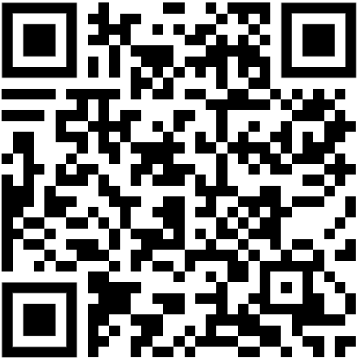
Small group discussions
Form for your feedback online:
See also: tuition.uoregon.edu

