Slide 1

University of Oregon
Financial Briefing
Tuition and Fee Advisory Board
October 9th, 2018

Slide 2
Agenda
UO Budget Structure
Key Sources of University Financing
Cost Drivers

Slide 3
UO Budget Structure
E&G Funds
Other Funds
Tuition revenue
State Appropriation
F&A Return
Overhead revenue
Fee revenue, interest earnings
Grants and Contracts revenue
Auxiliary Revenue
Service Center Revenue
Designated Operations Revenue
Restricted gifts
School & College Budgets
Grants & Contracts
Central Admin
Budgets
Plant Funds
Institutional Expenses
(Debt, assessments, utilities, leases)
Auxiliary, Service Centers, and Designated Ops Funds
Restricted Gifts

Slide 4
Decreased levels of State Appropriation

Slide 5
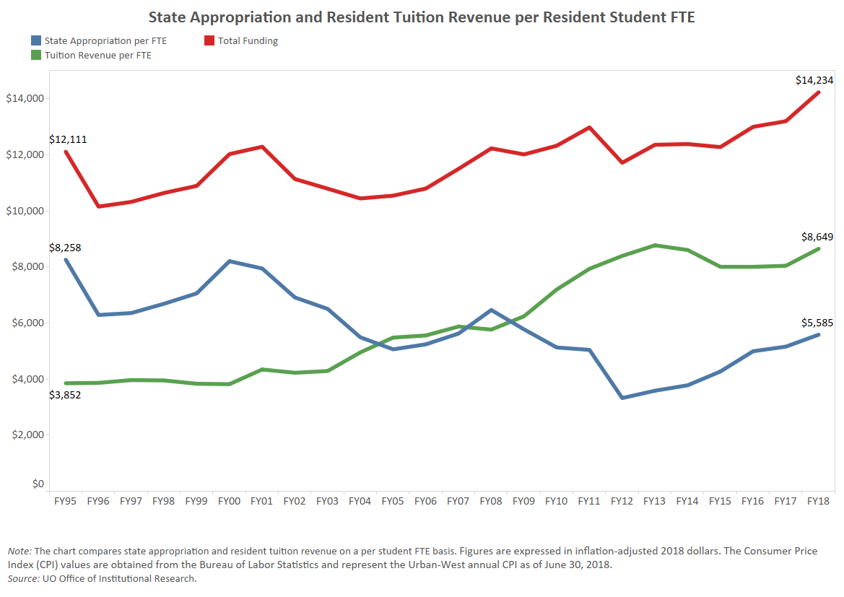
State Appropriation and Tuition

Slide 6
University Resources
FY2018 Major Revenue Streams
(E&G Fund)
State Appropriation $72.7 million
Resident Tuition $114.5 mill
Resident Net Tuition $103.4 million
Non-resident Net Tuition $281.7 million
UO Professional Development http://odt.uoregon.edu

Slide 7
Increasing Dependence Upon Nonresident Tuition
FY2003 – Revenue Breakdown
FY2018 – Revenue Breakdown

Slide 8
Agenda
  UO Budget Structure
  Key Sources of University Financing
  Cost Drivers

Slide 9
Summary – Major FY2019 E&G Fund Cost Drivers
Cost Driver | FY18 Base | FY19 Cost Increase | FY19 % increase
Faculty and Staff Salary and Wages | $361.1 million | $9.8 million | 2.7%
GE Salary and Benefits | $26.2 million | $1.0 million | 3.8%
Medical Costs | $48.7 million | $1.8 million | 3.7%
Retirement Costs | $52.5 million | n/a | n/a
Institutional Expenses | $34.9 million | $600K | 1.7%
Strategic Investments (includes $1 million for new faculty) | $524.9 million | $2.0 million | 0.4%
Investments in Tenure Track Faculty (includes salary and OPE) | $156.6 million | $1.5 million | 1.0%
Totals | $524.9 million | $16.7 million | 3.18%
Notes:
Defining how Sightlines breaks up the areas of project funding necessary to maintain a campus.
DM and CR are what this presentation concentrates on.
Definitions taken from APPA (Association of Physical Plant Administrators)

Slide 10
Cost Driver | FY19 Cost Increases | Notes
Faculty and Staff Salary and Wages | $9.8 million | Increases per collective bargaining agreements for approximately 1700 faculty and 900 classified staff. Also includes increases for approximately 1200 unrepresented staff.
GE Salary and Benefits | $1.0 million | Estimate based on collective bargaining agreement for GEs; includes estimate of health insurance cost increases
Medical Costs | $1.8 million | Assumed annual increase of 3.7%
Retirement Costs | n/a | PERS rates only increase every two years
Institutional Expenses | $600K | Increases related to utilities, insurance, debt for academic buildings, assessments, and leases. Lower than normal annual increase due to Power Station savings.
Strategic Investments (includes $1 million for new faculty) | $2.0 million | Allocated via strategic investment process. $1 million pre-committed for tenure track faculty hiring related to Cluster Hires.
Investments in Tenure Track Faculty | $1.5 million | Supporting long term strategic plan to increase number of tenure track faculty
Total Projected Cost Increases* | $16.7 million*
*Does not include, increases to minimum wage, costs related to federal FLSA regulations changes regarding eligibility for overtime pay; further investments in diversity initiatives, or individual school/college/department investments.
Notes:
Defining how Sightlines breaks up the areas of project funding necessary to maintain a campus.
DM and CR are what this presentation concentrates on.
Definitions taken from APPA (Association of Physical Plant Administrators)

Slide 11
Cost Drivers – PERS Costs
Projected Increases | FY18 | FY19 | FY20 | FY21 | FY22
E & G Fund | $7.1M | $0 | $7.1M | $0 | $7.1M
Other | $3.4M | $0 | $3.4M | $0 | $3.4M
Total | $10.5M | $0 | $10.5M | $0 | $10.5M
If PERS unfunded liabilities continue to grow, charges to the University of Oregon could grow significantly in future years.

