Slide 1
Differential Tuition Proposal
Lundquist College of Business
Bruce Blonigen
Edward Maletis Dean
Leeann Ford
Associate Dean of Finance and Administration

Slide 2
Proposal:
Increase the differential tuition fee for business courses from $30/credit hour to $50/credit hour beginning Fall 2026
Because of guaranteed tuition, this would only apply to new students beginning in fall 2026, not current students
Would apply to all business courses, not just those for the business administration and accounting majors

Slide 3
Strategic rationale
Most business schools at our comparators charge differential tuition for business education because it is in high demand and is higher cost than other programs and majors
Prospective and current business students are willing to pay more to access high-quality business education and strong student services, especially in career readiness
We are struggling to provide the high-quality faculty and student services that business students demand
Our proposed increase will help us bridge this gap and keep these additional costs for our business students low relative to comparators

Slide 4
Demand
Demand for business major is high and growing. At Lundquist:
  33% growth in student credit hours since 2019
  1 in 4 first-year students this fall were a declared business or pre-business major
Career prospects and starting salaries are high relative to other majors
Current and prospective business students are willing to pay more to access high-quality business education and strong student services, especially in career readiness
If we cannot provide this level of service, our ability to attract students to UO for a business education will diminish

Slide 5
Costs
Business school faculty have high salaries because of their specialized knowledge and market opportunities
  EX: Finance professor
Career readiness services demanded by business students, and are needed to compete for prospective business students, requires additional staff
Currently:
  Academic advising ratios in Lundquist are the poorest at UO!
  Our career services staff are small relative to comparators (e.g., B1G schools)

Slide 6
Student benefits from diff. tuition
More high-quality faculty and better access to them through lower student-faculty ratios
  Also, an important accreditation concern
Student services that we offer and want to keep/improve
  Tutoring services
  Academic advising
  Career advising
  Industry and alumni engagement team
  Professional Edge program
  Bridge programs and peer-mentoring (Flight School)

Slide 7
Student feedback
Met with our Dean’s Committee on Inter-Club Coordination
  Meet with them quarterly
  De facto student advisory committee for the Dean
  Mix of in-state and out-state students
Their feedback
  Strongly supported notion that high quality faculty and student services are essential for the business degree and that students are willing to pay extra for it
  Made the point that keeping up with B1G schools in terms of faculty and students services is especially important in their mind

Slide 8
Access concerns
Our Lundquist Bridge and Flight School programs help low-income and other under-represented populations
Our College provides over $1 million in scholarships annually based on financial need and academic merit
Ten percent of the funds raised by differential tuition will be dedicated to PathwayOregon, which serves low-income Oregon students
Fundraising for more scholarship dollars will continue to be a priority

Slide 9
Comparator Data
We look at our differential tuition costs relative to three relevant comparator groups
  Oregon State and Portland State
  B1G schools
  AAU Publics with low state support
For comparison purposes, we look at the total additional cost of of obtaining a business major versus a major from the college of arts and sciences
Even at our higher proposed differential tuition rate, the total additional cost for a UO business major is relatively low

Slide 10
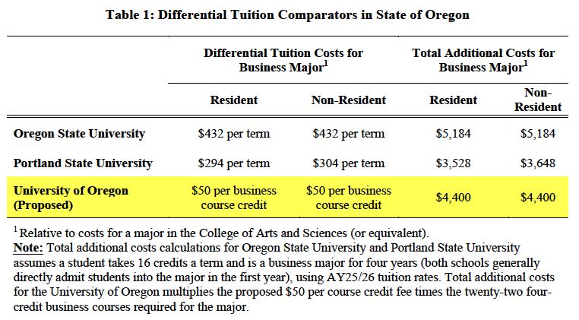

Slide 11
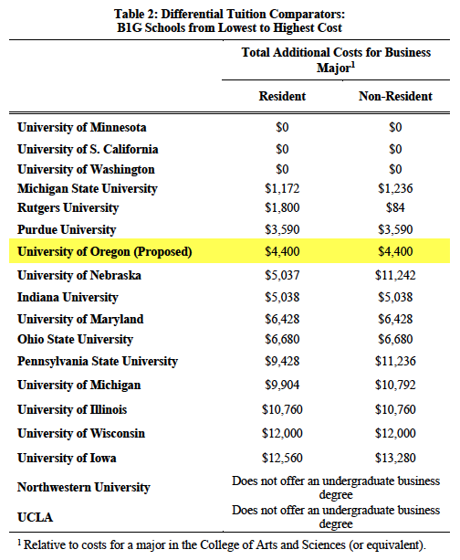

Slide 12
