Slide 1

Guaranteed Tuition Program
October 31, 2025
Tuition and Fee Advisory Board

Slide 2
Framework – Guaranteed Tuition Program
for Undergraduate Students
For each entering class year, there is a set resident and non-resident tuition rate per student credit hour (SCH)
That rate is guaranteed or locked for five years - no matter what
Other tuition and fees that are locked include administratively controlled mandatory fees, summer tuition, honors college differential tuition, business school differential tuition and the international student fee
Students know the expected cost of their education before they decide to come to the University of Oregon

Slide 3
Average Historical Annual Undergraduate Tuition Rate Increases – Analysis conducted in FY2020
10 Year Average
5 Year Average
Resident
5.4%
5.0%
Non-resident
4.4%
3.3%

Slide 4
New Resident Undergraduate Students
Analysis Conducted in FY2020
Graduation Time 4 yrs
Assumed Annual Increases 5% - Average 5 Year Historical Rate
5 year Guaranteed rate $254.62 per SCH (9.75% increase)
Total Tuition
Paid
$1,050
Total Tuition
Paid
$1,018

Slide 5
New Resident Undergraduate Students
Graduation Time 5 yrs
Analysis Conducted in FY2020
Assumed Annual Increases 5% - Average 5 Year Historical Rate
5 year Guaranteed rate $254.62 per SCH (9.75% increase)
Total Tuition
Paid
$1,346
Total Tuition
Paid
$1,273

Slide 6
New Resident Undergraduate Students
Graduation Time 8 yrs
Analysis Conducted in FY2020
Assumed Annual Increases 5% - Average 5 Year Historical Rate
5 year Guaranteed rate $254.62 per SCH (9.75% increase)
Total Tuition
Paid
$2,326
Total Tuition
Paid
$2,116

Slide 7
Advantages of Guaranteed Tuition Program for Students
Financial Predictability: Tuition rates are locked in for five years – students and their families know ahead of time exactly what they are going to pay for their education.
Peace of Mind: The guaranteed tuition program functions as a insurance policy for students. Regardless of what happens to state funding or other costs, their tuition rates are guaranteed for five years.
Protection of Scholarship Value: Many scholarships are currently fixed dollar amounts. Under a guaranteed tuition program, the value of these scholarships remains the same over their college career.

Slide 8
Advantages of Guaranteed Tuition Program for the Institution
Recruiting: The stronger value proposition of a locked-in rate should be very attractive to new students. This should help support the institution’s enrollment growth initiative.
Retention: One of the main reasons students cite for dropping out of school is financial pressure. This can often be linked to students not anticipating tuition increases throughout their college career. Having a locked rate for tuition should help with this issue.
Campus Climate: Concern about continually rising tuition rates affects students, faculty and staff, and directs time, energy and focus away from other important educational issues.

Slide 9
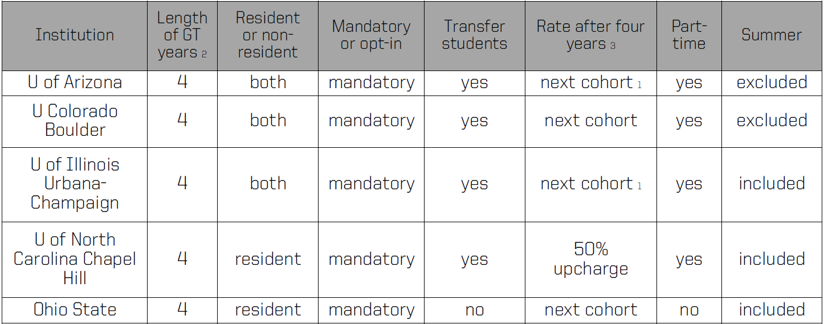
Guaranteed Tuition at Other Universities
(Research conducted in 2020)

