Slide 1
Financial Aid at the
University of Oregon
Mark Diestler
Associate Vice President for SSEM
Director of Student Financial Aid and Scholarships

Slide 2
Financial Aid Overview
$383m in financial aid ($329m to UG)
82% of first year students receive aid
29% of freshmen are Federal Pell Grant eligible
40% of the graduating class have student debt
  Average debt of borrowers: $28,197

Slide 3
2025-2026 Cost of Attendance
Resident Cost of Attendance: $38,607
Non-Resident Cost of Attendance: $68,931
  Resident Tuition and Fees: $16,755
  Non-Resident Tuition and Fees: $46,077
  On-Campus Food and Housing: $17,400
  Books and Supplies: $1,395
  Resident Transportation: $456
  Non-Resident Transportation: $1,458
  Miscellaneous Personal Expenses: $2,601

Slide 4
Need Based Financial Aid
Federal Pell Grant
Federal SEOG
Federal Work-Study
Federal Direct Loans
Oregon Opportunity Grant
PathwayOregon Award*
Duck Excellence Scholarship (DES)*

Slide 5
Merit Based Financial Aid
Stamps Scholarship
Presidential Scholarship
UO Excellence Scholarship
Summit Scholarship
Apex Scholarship
PathwayOregon Award*
Duck Excellence Scholarship (DES)*

Slide 6
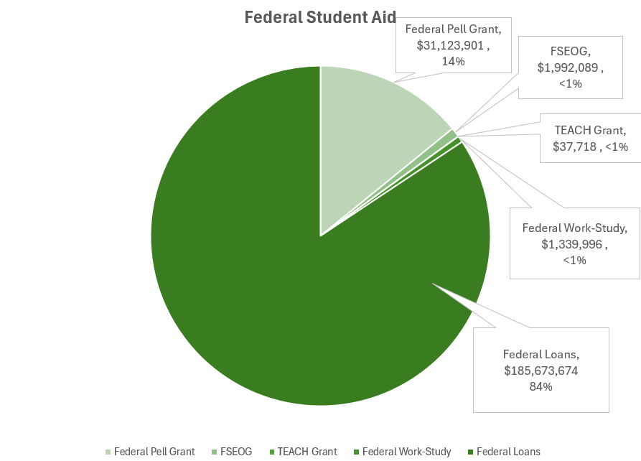
Federal Student Aid Snapshot, FY25

Slide 7
State Financial Aid Snapshot, FY25
Oregon Opportunity Grants: $20,271,186
  FY25 grant range: $1,788 to $7,524
  FY26 grant range: $1,740 to $7,800
Foster Youth Tuition Waiver: $26,279
State Scholarships: $2,021,768
National Guard Tuition Assistance: $288,942
Oregon Tribal Student Grant: $1,341,138

Slide 8
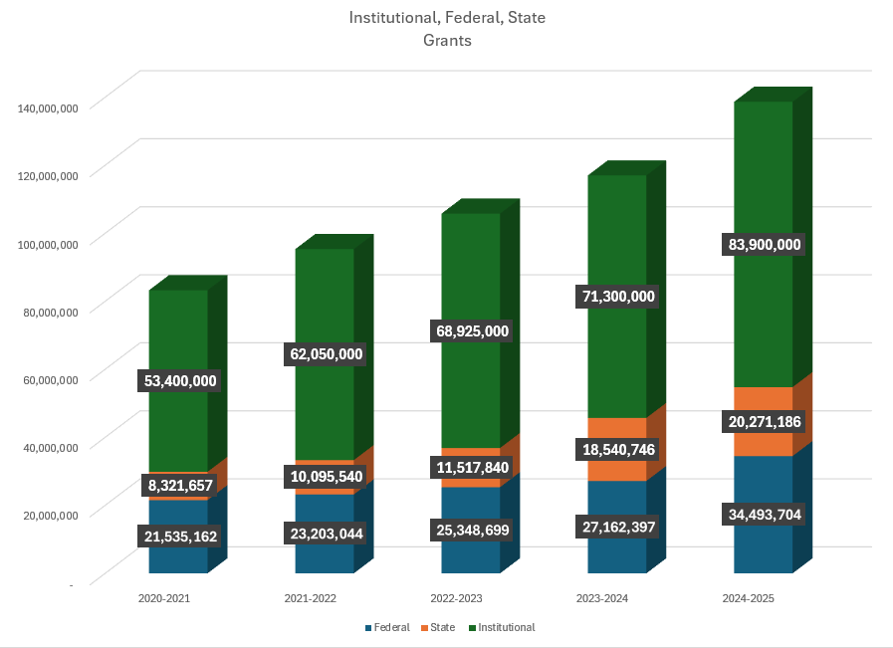

Slide 9
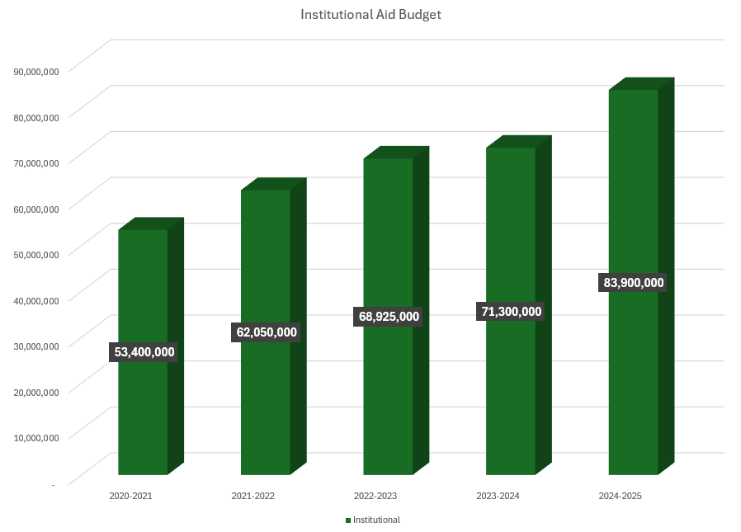

Slide 11
UO Scholarship Eligibility and Amounts
Changes in 2019, 2021, 2023, 2024
 | 2016 Programs |  | 2019 Programs |  | 2021 Programs |  | 2023 Programs |  | 2024 Programs
 | Eligibility | Award | Eligibility | Award | Eligibility | Award | Eligibility | Award | Eligibility | Award
Resident
Summit | 3.80 GPA/1250 SAT | $6,000 | 3.80 GPA/1250 SAT | $6,000 | 3.90 GPA | $4,000 | 3.90 GPA | $5,000 | 3.90 GPA | $5,000
Apex | 3.60 GPA/1220 SAT | $3,000 | 3.60 GPA/1220 SAT | $3,000 | 3.70 GPA | $2,000 | 3.70 GPA | $2,000 | 3.70 GPA | $2,000
PathwayOregon | 3.40 GPA/ Pell eligible | Tuition/ Fees | 3.40 GPA/Pell eligible | Tuition/ Fees | 3.40 GPA/ Pell eligible | Tuition/ Fees | 3.40 GPA/ Pell eligible | Tuition/ Fees | 3.40 GPA/ Pell eligible | Tuition/ Fees
Non-Resident
Excellence | None |  | 3.90 GPA/1450 SAT | $15,000 | Non-Auto | $15,000 | Non-Auto | $15,000 | Non-Auto | $20,000
Summit | 3.80 GPA/ 1250 SAT | $9,000 | 3.80 GPA/1250 SAT | $10,000 | 3.90 GPA | $10,000 | 3.90 GPA | $10,000 | 3.90 GPA | $12,500
Apex | 3.60 GPA/ 1220 SAT | $4,000 | 3.60 GPA/1220 SAT | $7,500 | 3.70 GPA | $7,500 | 3.70 GPA | $7,500 | 3.70 GPA | $10,000
The implementation of test optional admissions in 2021 increased the number of scholarship eligible students and required a change in scholarship amounts.

Slide 12
Application Process
Apply for Admission
File the FAFSA / ORSAA
File any Institutional Application

Slide 13
FAFSA Data
Family Income
Family Assets – cash, savings, investments, business/farm
Family Size

Slide 14
Financial Need
Cost of attendance – SAI = Need
Resident example: 38,607 – 2,000 = 36,607
Non-Resident example: 68,931 – 3,500 = 65,431

Slide 15
Resident Financial Aid Offer (example)
SAI=$2,000, 3.5 HS GPA
Federal Pell Grant: $5,395
Oregon Opportunity Grant: $6,312
UO Tuition Waiver: $750
PathwayOregon Award: $4,298
Total Grants/Scholarships: $16,755 (T&F)
Net Price: COA – Grants/Scholarships = $21,852
Federal Work Study: $2,400
Federal Direct Subsidized Loan: $3,500
Federal Direct Unsubsidized Loan: $2,000
Other options may include: Federal Direct PLUS Loan: $13,952
Cash, Savings, Private Loans, Home Equity Loan, 529, etc.

Slide 16
Non-Resident Financial Aid Offer (example)
SAI=$3,500, 3.9 HS GPA
Scholarship: $12,500
Federal Pell Grant: $3,895
Total Grants/Scholarships: $16,395
Net Price: COA – Grants/Scholarships = $52,536
Federal Work Study: $2,400
Federal Direct Subsidized Loan: $3,500
Federal Direct Unsubsidized Loan: $2,000
Other options may include: Federal Direct PLUS Loan: $44,636
Cash, Savings, Private Loans, Home Equity Loan, 529, etc.
**Note: max PLUS Loan set to be $20k starting 26-27

Slide 17
2025-26 and 2026-27 Changes
25-26 is 2nd year of “FAFSA Simplification”
2026-27 FAFSA available on-site (by October 1), first time in 3 years
  Numerous changes set to take effect 26-27 as part of “OB3”
Pell Grant calculations unchanged for 25-26, but 26-27 is unknown at this time
  Max Pell ($7,395)
    SAI <= $0
  Calculated Pell
    Max Pell ($7,395) – SAI = Pell award
  Minimum Pell
    10% of max ($740)

Slide 18
Fundraising
During our last capital campaign, UO raised $427M for scholarships and student support. (campus wide)
This was 13% of the total raised in the campaign.
$3 billion goal finished at $3.24 billion.
Oregon150 has raised over $430M, well on way to $500M goal.

Slide 19
Questions?
Mark Diestler
diestler@uoregon.edu
541.346.8945

