Slide 1

University of Oregon
Financial Briefing
Tuition and Fee Advisory Board
October 11, 2017

Slide 2
Agenda
UO Budget Structure
Key Sources of University Financing
Cost Drivers

Slide 3
UO Budget Structure
E&G Funds
Other Funds
Tuition revenue
State Appropriation
F&A Return
Overhead revenue
Fee revenue, interest earnings
Grants and Contracts revenue
Auxiliary Revenue
Service Center Revenue
Designated Operations Revenue
Restricted gifts
School & College Budgets
Grants & Contracts
Central Admin
Budgets
Plant Funds
Institutional Expenses
(Debt, assessments, utilities, leases)
Auxiliary, Service Centers, and Designated Ops Funds
Restricted Gifts

Slide 4
Agenda
UO Budget Structure
Key Sources of University Financing
Cost Drivers

Slide 5
Decreased levels of State Appropriation

Slide 6
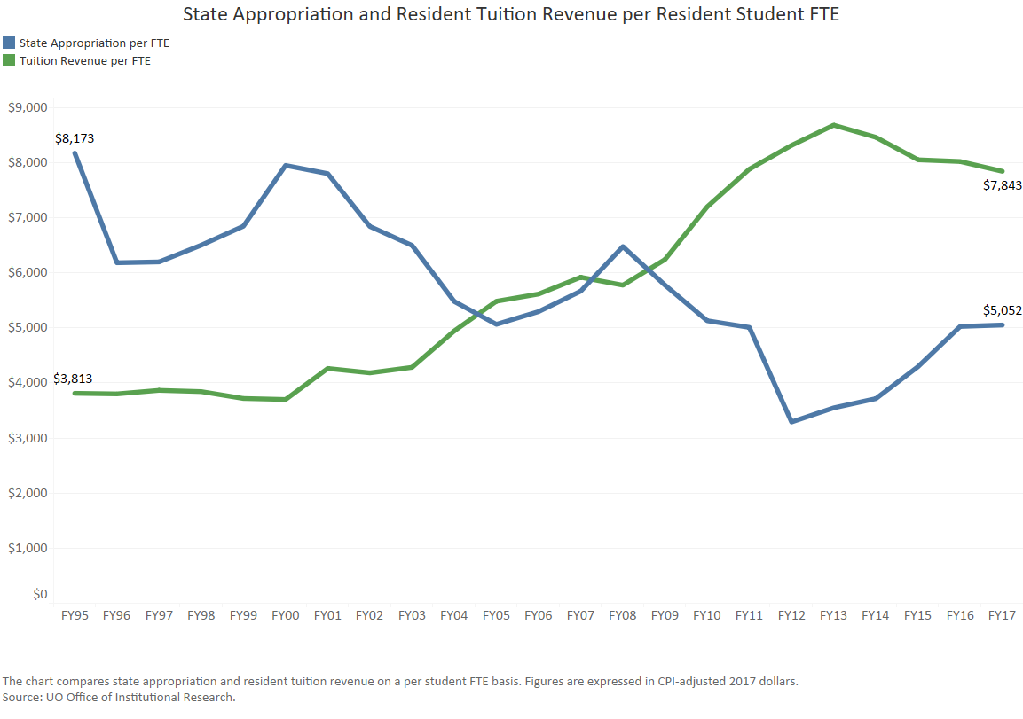
State Appropriation and Tuition

Slide 7
University Resources
FY2017 Major Revenue Streams
(E&G Fund)
State Appropriation $66.8 million
Resident Tuition $114.5 mill
Resident Tuition $103.7 million
Non-resident Tuition $308.8 million
UO Professional Development http://odt.uoregon.edu

Slide 8
Increasing Dependence Upon Nonresident Tuition
FY2002 – Revenue Breakdown
FY2017 – Revenue Breakdown

Slide 9
Agenda
  UO Budget Structure
  Key Sources of University Financing
  Cost Drivers

Slide 10
Summary – Major E&G Fund Cost Drivers
Cost Driver | FY17 Base | FY18 Cost Increases | FY18 % increase
Faculty and Staff Salary and Wages | $347.8 million | $11.0 million | 3.2%
GE Salary and Benefits | $26.5 million | $800K | 3.0%
Medical Costs | $54.3 million | $1.6 million | 2.9%
Retirement Costs | $44.4 million | $7.1 million | 16.0%
Institutional Expenses | $32.9 million | $1.0 million | 3.0%
Strategic Investments (includes $1 million for new faculty) | $503.0 million | $2.0 million | 0.4%
Investments in Tenure Track Faculty | $94.7 million | $1.5 million | 1.6%
Total Project Cost Increases* | $503.0 million | $25.0 million* | 5.0%
*Does not include, increases to minimum wage, costs related to federal FLSA regulations changes regarding eligibility for overtime pay; further investments in diversity initiatives, or individual school/college/department investments.

Slide 11
FY18 E&G Fund Major Cost Drivers
Factor | Projected Cost Increase | Notes
Faculty and Staff Salary and Wages | $11.0 million | Per collective bargaining agreements. Officers of Administration salary package assumed to be similar to faculty salary package. Does not include GE salary increases
GE Salary and Wages | $800K | Assumes insurance cost increases only 50% of last year
Medical Cost (PEBB) | $1.6 million | Assumes average 3.4% increase (Dec. 2016 rate) for entire year

Slide 12
FY18 E&G Fund Major Cost Drivers (continued)
Factor | Projected Cost Increase | Notes
Retirement Costs (PERS) | $7.1 million | Based on recently released updated PERS information. Assumes 400K of savings as Tier 1&2 employees retire and are replaced with Tier 3 & 4 employees. PERS Board projecting additional significant increases to occur in FY20 and FY22.
Institutional Expenses | $1.0 million | Debt, rent, utilities, insurance and assessments.
Strategic Investment Fund | $2.0 million | $1 million pre-committed to tenure track faculty hires as part of cluster hires.
Investments in New Tenure Track Faculty | $1.5 million

Slide 13
Cost Drivers - E&G Fund
Annual Typical Cost Drivers | FY17-FY18 Average Cost Increase
Faculty and Staff Salary and Wages | $9.3M
GE Salary and Benefits | $1.1M
Medical Costs | $1.9M
Institutional Expenses | $1.2M
Strategic Investments (includes $1 million for new faculty) | $2.0M
Investments in Tenure Track Faculty | $1.5M
Total Project Cost Increases | $17.0M
However, these totals do not include rising PERS costs.

Slide 14
Cost Drivers – PERS Costs
Projected Increases | FY18 | FY19 | FY20 | FY21 | FY22
E & G Fund | $7.1M | $0 | $7.1M | $0 | $7.1M
Other | $3.4M | $0 | $3.4M | $0 | $3.4M
Total | $10.5M | $0 | $10.5M | $0 | $10.5M
If PERS unfunded liabilities continue to grow, charges to the University of Oregon could grow significantly in future years.

Slide 15
Cost Drivers
Annual Typical Cost Drivers | FY17-FY18 Average Cost Increase
Faculty and Staff Salary and Wages | $9.3M
GE Salary and Benefits | $1.1M
Medical Costs | $1.9M
Institutional Expenses | $1.2M
Strategic Investments (includes $1 million for new faculty) | $2.0M
Investments in Tenure Track Faculty | $1.5M
Total Project Cost Increases | $17.0M

Slide 16
Cost Drivers
Annual Typical Cost Drivers | FY17-FY18 Average Cost Increase
Faculty and Staff Salary and Wages | $9.3M
GE Salary and Benefits | $1.1M
Medical Costs | $1.9M
Institutional Expenses | $1.2M
Strategic Investments (includes $1 million for new faculty) | $2.0M
Investments in Tenure Track Faculty | $1.5M
Retirement Costs ($7.1M every other year) | $3.5M
Total Project Cost Increases | $20.5M

