Slide 1
Early Childhood CARES
Early Intervention
and Early Childhood Special Education
in Lane County
Notes:
Play is the work of children
Early Childhood CARES was founded on the values of inclusion

Slide 2
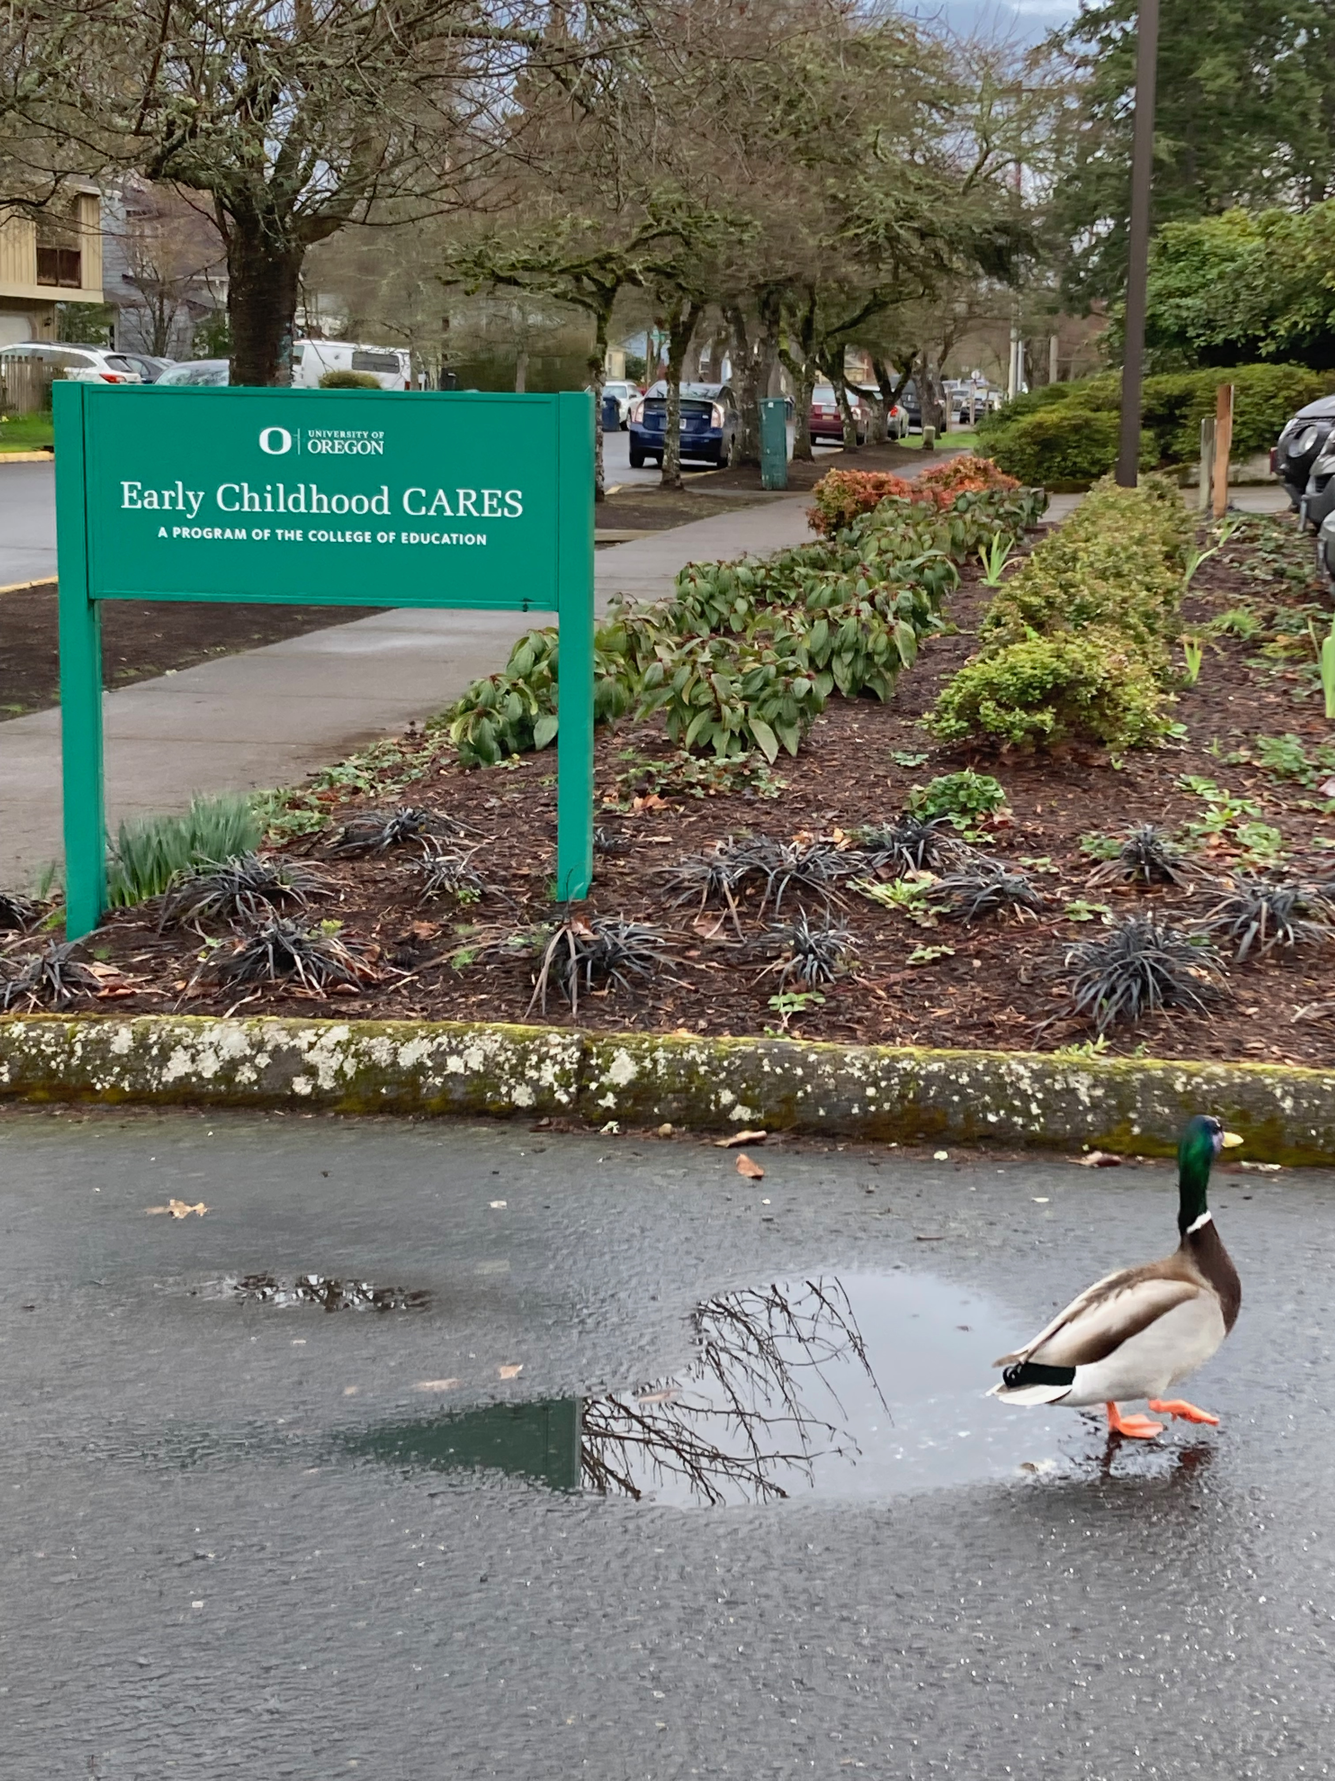
nellie huggins parent outreach coordinator
ecparent@uoregon.edu
541-514-7953
@earlychildhoodcares
http://earlychildhoodcares.uoregon.edu
Notes:
My credentials – history in Early Childhood development – at EC CARES since December
My job is to help reach every child in Lane county who needs services near home. I do this through communication, social media, newsletters, community training facilitation/planning, and support for staff

Slide 3
Overview of Early Childhood CARES
Types of Supports Provided
Where do services take place?
How to connect with Early Childhood CARES
Today’s Agenda

Slide 4
Some Core Values:
Respect for diversity of families
We treat all families with honor and respect. We value diversity of cultures, languages, customs, religion, family type, social and economic status, and education.
Community-based services
We provide educational services where children can be most successful. We utilize existing community resources and serve children with typical peers in natural environments whenever possible.

Slide 5
Early Childhood CARES provides Early Intervention and Early Childhood Special Education services to children ages birth through five in Lane County. All services are free of charge to eligible children.

Slide 6
Early Intervention is a service(s) provided to children from birth to age 3 who have developmental delays.
Early Childhood Special Education are services for children ages 3 and up, who have a specific diagnosis.

Slide 7
Serve over 1,400 children from birth through 5 years each year – State and Federal funding
Services are free to qualified families; no insurance required

Slide 9
Questions So Far?

Slide 10
The Process: Referral Developmental Screening Educational Evaluation and Eligibility
Notes:
Developmental Screening:
Skill Areas Screened: Speech and Language Motor Skills Problem Solving Health, Hearing and Vision

Slide 11
Who Can Refer: Parents Family Members Physicians Public Health Nurses Preschool Teachers Childcare Providers
How Can Referrals be Made: Call 541-346-2578 Email eccares@uoregon.edu Visit our Website: earlychildhoodcares.uoregon.edu

Slide 12
Services are provided:
In-home
At parent-toddler classes
At community preschools
In specialized preschool classrooms
Services are provided in the least restrictive environment and as close to home as possible. Inclusion is the goal (and benefits everyone). Services are always free to qualifying families.

Slide 13
Who Provides the Services?
Early Interventionists
Early Childhood Special Educators
Speech Therapists
Physical Therapists
Occupational Therapists
Autism/ Behavior Consultants
Vision and Hearing Specialists

Slide 14
Educational Evaluation: Evaluations are conducted in all areas of development for children under 3 and in suspected area of delay for children 3-5
If a child is eligible for services an Individualized Family Service Plan (IFSP) is developed. The IFSP specifies goals and the services that will be provided to address those goals

Slide 15
Why Is Inclusion Important?

Slide 16
Additional Resources for Families
Annual Resource Guide Resources Shared on Social Media Parent Chats Family Events (Adventure! Childrens Museum) Monthly Newsletter Lending Library

Slide 17
In the community: We provide community trainings to Preschool Teachers and Child Care providers, through Quality Care Connections (LCC)
Service providers act as mentors to working professionals, providing resources, ongoing training, etc

Slide 18
Questions?

Slide 19
nellie huggins parent outreach coordinator
ecparent@uoregon.edu
541-514-7953
@earlychildhoodcares
http://earlychildhoodcares.uoregon.edu

