Slide 1

The Size of Campus – Considerations and Analyses
Friday, September 8th, 2017
Board of Trustees of the University of Oregon

Slide 2

Agenda
Cost Drivers
Tuition Revenue
Potential Ways to Close the Gap
Campus Growth

Slide 3
Agenda
Cost Drivers
Tuition Revenue
Potential Ways to Close the Gap
Campus Growth

Slide 4
Cost Drivers
E&G Fund
Annual Typical Cost Drivers | FY17-FY18 Average Cost Increase
Faculty and Staff Salary and Wages | $9.3M
GE Salary and Benefits | $1.1M
Medical Costs | $1.9M
Institutional Expenses | $1.2M
Strategic Investments (includes $1 million for new faculty) | $2.0M
Investments in Tenure Track Faculty | $1.5M
Total Project Cost Increases | $17.0M
However, these totals do not include rising PERS costs.

Slide 5
Cost Drivers
PERS Costs
Projected Increases | FY18 | FY19 | FY20 | FY21 | FY22
E & G Fund | $7.1M | $0 | $7.1M | $0 | $7.1M
Other | $3.4M | $0 | $3.4M | $0 | $3.4M
Total | $10.5M | $0 | $10.5M | $0 | $10.5M
If PERS unfunded liabilities continue to grow, charges to the University of Oregon could grow significantly in future years.

Slide 6
Cost Drivers
Annual Typical Cost Drivers | FY17-FY18 Average Cost Increase
Faculty and Staff Salary and Wages | $9.3M
GE Salary and Benefits | $1.1M
Medical Costs | $1.9M
Institutional Expenses | $1.2M
Strategic Investments (includes $1 million for new faculty) | $2.0M
Investments in Tenure Track Faculty | $1.5M
Total Project Cost Increases | $17.0M

Slide 7
Cost Drivers
E&G Fund
Annual Typical Cost Drivers | FY17-FY18 Average Cost Increase
Faculty and Staff Salary and Wages | $9.3M
GE Salary and Benefits | $1.1M
Medical Costs | $1.9M
Institutional Expenses | $1.2M
Strategic Investments (includes $1 million for new faculty) | $2.0M
Investments in Tenure Track Faculty | $1.5M
Retirement Costs ($7.1M every other year) | $3.5M
Total Project Cost Increases | $20.5M

Slide 8
Agenda
Cost Drivers
Tuition Revenue
Potential Ways to Close the Gap
Campus Growth

Slide 9
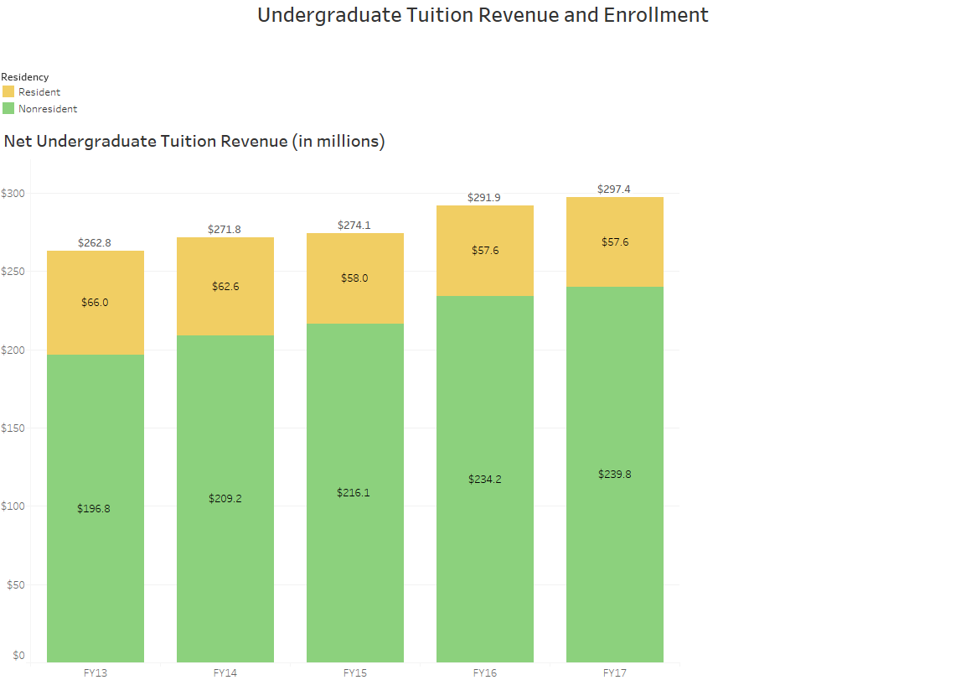
Tuition Revenue
In FY17, 80.6% of net tuition came from non-resident students

Slide 10
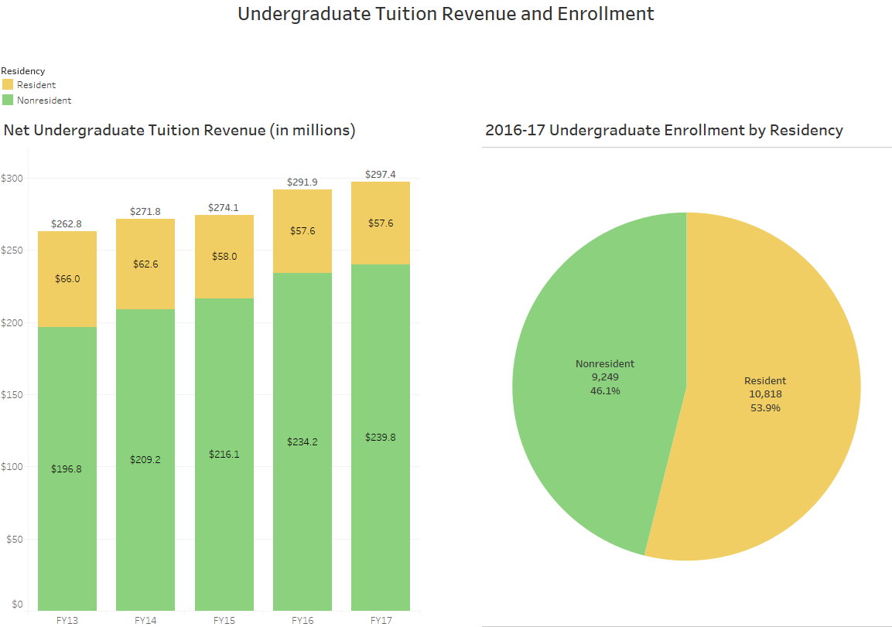
Tuition Revenue

Slide 11
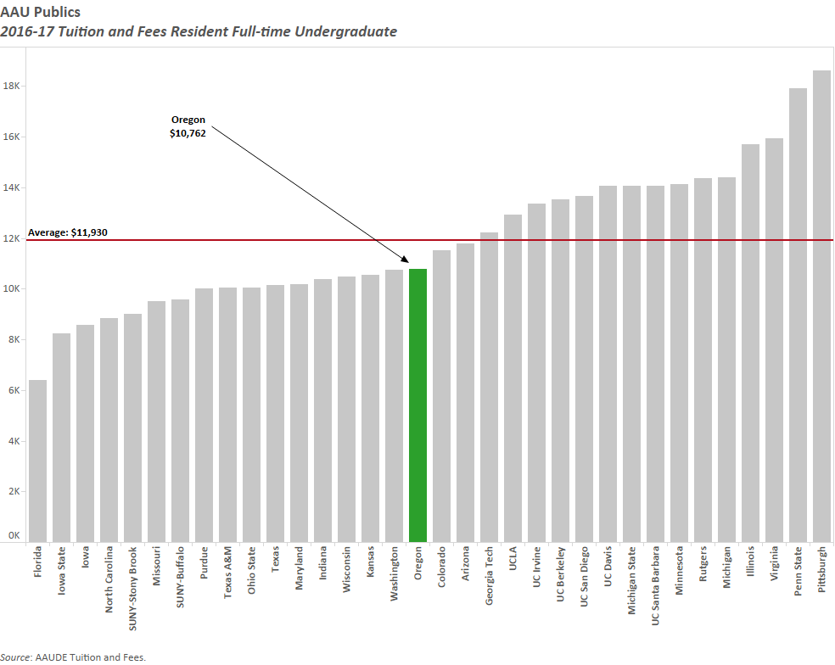
Tuition Revenue

Slide 12
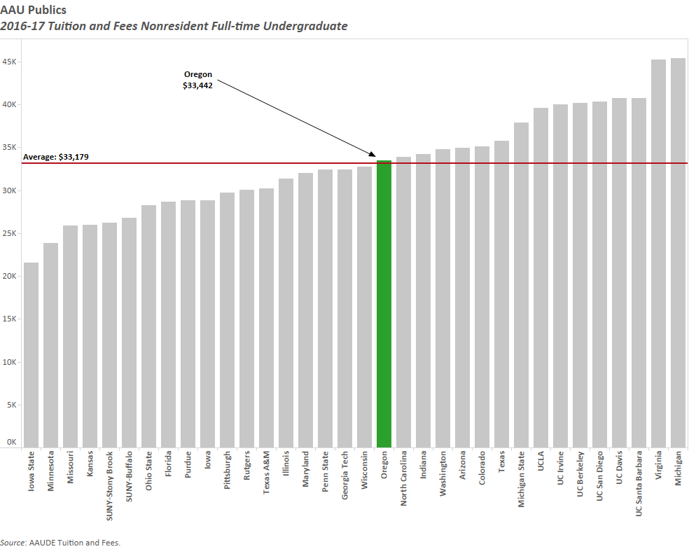
Tuition Revenue

Slide 13
Tuition Revenue
For each 1% increase in undergraduate tuition, overall revenue increases*:
  *Totals account for fee remissions and summer revenue
Resident | $800k
Non-resident | $2.5M

Slide 14
Tuition Revenue
Annual E&G Cost drivers likely to be around $20.5M
Non-resident Tuition Rate Increase
Percent Increase (Per Student Annually) | 2.0% ($650) | 2.5% ($813) | 3.0% ($976) | 4.0% ($1,301) | 5.0% ($1,627)
2.0% ($190) | $6.6M | $7.8M | $9.1M | $11.6M | $14.1M
3.0% ($285) | $7.4M | $8.6M | $9.9M | $12.4M | $14.9M
4.0% ($380) | $8.1M | $9.4M | $10.6M | $13.2M | $15.7M
5.0% ($475) | $8.9M | $10.1M | $11.4M | $13.9M | $16.5M
Resident Tuition Rate Increase

Slide 15
Agenda
Cost Drivers
Tuition Revenue
Potential Ways to Close the Gap
Campus Growth

Slide 16
Potential Ways to Close the Gap
New and Expanded Graduate Programs
  Expanded graduate revenue from programs in Business, Journalism and Design launched
  After accounting for necessary teaching and administrative costs, new net revenue from all programs likely to be around $1 million

Slide 17
Potential Ways to Close the Gap
Further Cost Cutting / Efficiencies
  Historical Cost Cutting already incorporated into budgets:
    FY17 Administrative Cuts - $3.0M
    FY17 CAS Cost Cut - $3.3M
    FY18 Presidential Directed Cuts- $4.5M
    FY15 - FY18 Efficiencies Savings - $8.8M one time; $4.6 M - $5.6M recurring
  University will continue to actively look for ways to operate more efficiently

Slide 18
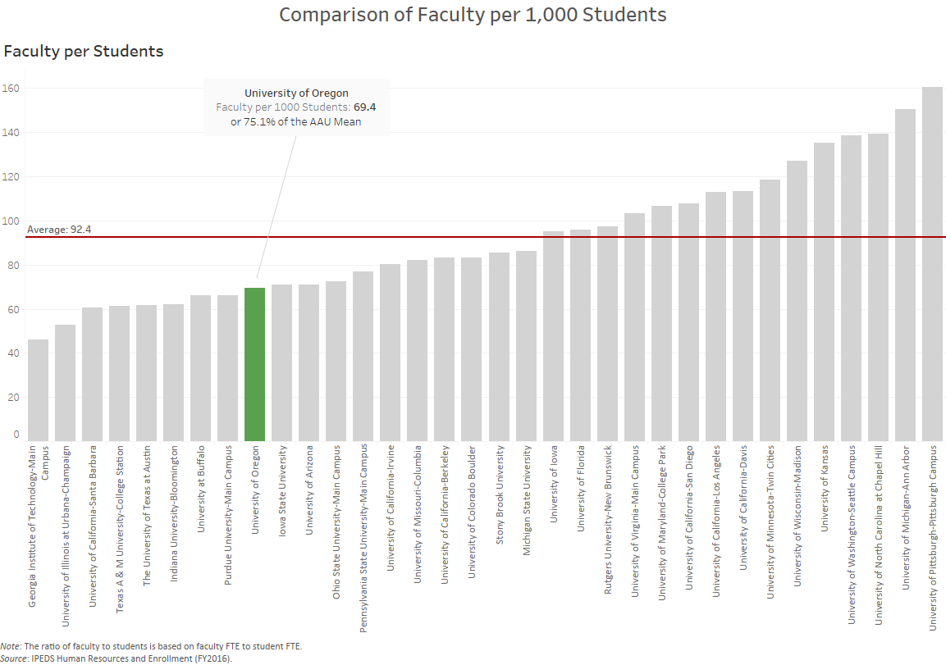
Potential Ways to Close the Gap

Slide 19
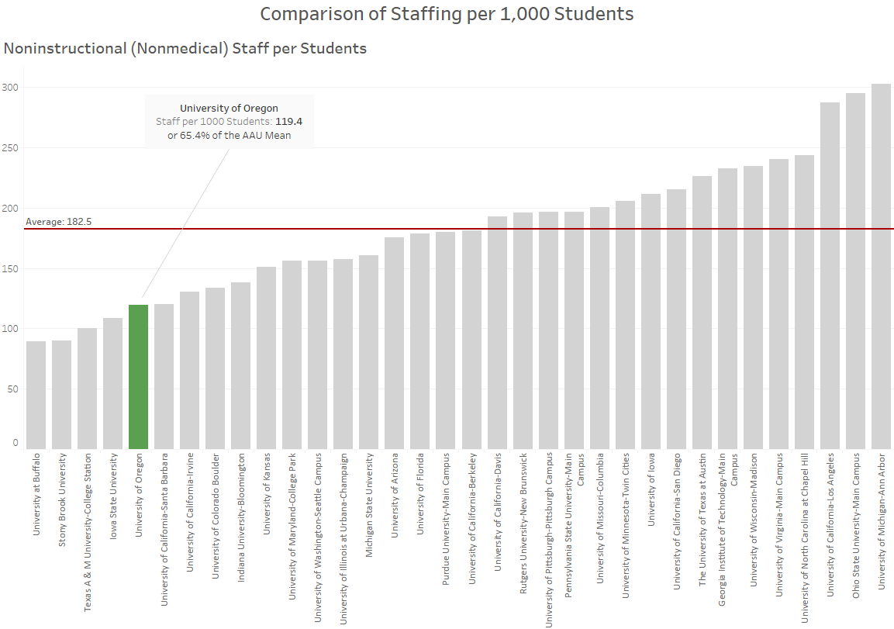
Potential Ways to Close the Gap

Slide 20
Potential Ways to Close the Gap
Expand Online Education
  College of Arts and Sciences (CAS) currently developing online options for current courses
  TBD, but will require significant upfront investment
  Coordination of online education assigned to Provost office and investment funds identified

Slide 21
Agenda
Cost Drivers
Tuition Revenue
Potential Ways to Close the Gap
Campus Growth

Slide 22
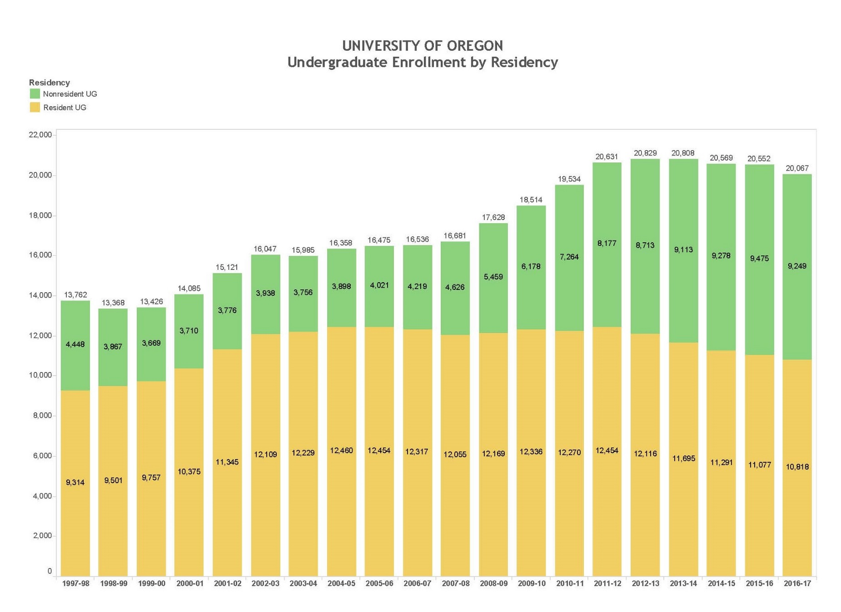
Campus Growth

Slide 23
Campus Growth
Financial Impact of Growth
 | Resident | Non-Resident
Number of Additional New Students | 100 | 100
Tuition Per Student | $9,495 | $32,535
Gross Tuition Revenue (Net of fee remissions) | $854,550 | $2,928,150
These totals represent gross revenue and do not account for costs.

Slide 24
Campus Growth
  Assumed Growth – adding 3,000 students over a period of eight years
  Necessary investments
    Recruiting
    Classroom/Faculty Office Building
    Additional new residence hall
    Variable Costs

Slide 25
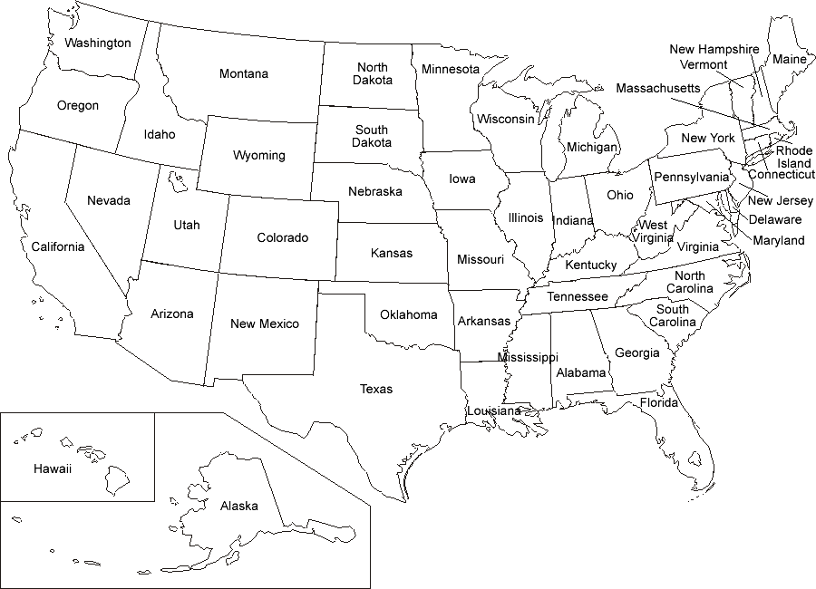
Recruiter Locations: Fall 2017 Cycle
Three Regional Recruiters

Slide 26
Recruiter Locations: Fall 2018 Cycle
Eight Regional Recruiters and increased national recruitment activities
Staff added in state
Staff increasing presence in this state
(number of days and/or range of events)

Slide 27
Campus Growth
  Assumed Growth– 3,000 students over a period of eight years
  Necessary investments
    Recruiting
    Classroom/Faculty Office Building
      Minimum of 45,000-60,000 gross square foot building needed to support classroom and faculty offices for student growth
    Additional new residence hall
    Variable Costs – additional investments related to cost of education after the first 750 new additional students

Slide 28
Campus Growth
Financial Projections
 | FY19 | FY20 | FY21 | FY22 | FY23 | FY24 | FY25 | FY26
Entering Freshmen | 4,150 | 4,450 | 4,450 | 4,500 | 4,675 | 4,775 | 4,850 | 4,900
Total Undergrads (Admitted) | 19,892 | 20,370 | 20,782 | 21,174 | 21,619 | 22,001 | 22,348 | 22,658
Incremental Revenue from Enrollment Growth | $7.9M | $14.2M | $12.2M | $12.1M | $14.2M | $13.6M | $13.4M | $12.7M
Incremental Investment Recruiting | $1.3M | $245k | - | - | - | - | - | -
Incremental Investment New Classroom Building | - | $3.1M | - | - | - | - | - | -
Incremental Investment Variable Costs | - | $224k | $5.4M | $5.5M | $6.5M | $6.0M | $5.9M | $5.6M
Net Revenue | $6.6M | $10.6M | $6.8M | $6.6M | $7.7M | $7.6M | $7.5M | $7.1M

Slide 29
Summary
Annual Cost Drivers $20.5 million
Net Revenue from Tuition Rate $8.0 million - $11.0 million
Increases

Slide 30
Tuition Revenue
Annual E&G Cost drivers likely to be around $20.5M
Non-resident Tuition Rate Increase
Percent Increase (Per Student Annually) | 2.0% ($650) | 2.5% ($813) | 3.0% ($976) | 4.0% ($1,301) | 5.0% ($1,627)
2.0% ($190) | $6.6M | $7.8M | $9.1M | $11.6M | $14.1M
3.0% ($285) | $7.4M | $8.6M | $9.9M | $12.4M | $14.9M
4.0% ($380) | $8.1M | $9.4M | $10.6M | $13.2M | $15.7M
5.0% ($475) | $8.9M | $10.1M | $11.4M | $13.9M | $16.5M
Resident Tuition Rate Increase

Slide 31
Summary
Annual Cost Drivers $20.5 million
Net Revenue from Tuition Rate $8.0 million - $11.0 million
Increases
Net Revenue from Enrollment $7.0 million - $7.5 million
Growth (out years)
State Appropriation (estimate) $2.0 million
Remainder (covered by further
cost cutting, new grad programs, $0 - $3.5 million
fundraising, additional growth, etc.)

Slide 32
Risks
  Significant cut in state appropriation
  Drop in non-resident student demand
  Further deterioration of PERS
  Deferred maintenance in critical buildings

