Slide 1

Long-Term Projections
Education & General Fund
May 2022
Board of Trustees of the University of Oregon

Slide 2
Long-Term Projection Model Scenarios
  The purpose of this analysis is to show the range of E&G fund budget scenarios that the University could be facing over the next five years, given different assumptions about tuition rates for entering cohorts of undergraduate students, state appropriation levels, enrollment levels and inflation.
  We are not forecasting any one specific scenario, but instead are trying to illustrate the projected impact of various potential assumptions
  If some of these adverse scenarios were to materialize, the institution would need to take budget actions to balance projected revenue and expenses. The projected financials do not include these cost cutting actions, as we wanted the board to have information about the magnitude of the budget challenge we would face in each scenario

Slide 3
Long-Term Projection Model Scenarios
  The analysis includes three sets of scenarios based on different assumptions about how much the guaranteed tuition rate for incoming first year undergraduate cohorts increases each year:
    Set A: 3.0% increase for non-residents / 4.5% increase for residents
    Set B: 3.0% increase for non-residents / 3.0% increase for residents
    Set C: 2.5% increase for non-residents / 4.5% increase for residents
  Within each set of scenarios, there are five different cases:
    (1) Base Case – 100% of non-resident enrollment targets
    (2) Downside Case – Below-Target Enrollment
    (3) Downside Case – Significant Reduction in State Funding
    (4) Downside Case – Extended Inflation
    (5) Upside Case – Above-Target Enrollment

Slide 4
Long-Term Projection Model Scenarios
  Basic Assumptions included in all scenarios:
    Increased staffing over several years to build back from current pandemic low level of employees
    Supplies and Services assumed to return to pre-pandemic levels of activity, with increases for inflation, as well as specific increases for property/liability insurance
    Small PERS increase in FY2024 and full PERS increase in FY2026
    Unless otherwise indicated, state appropriation assumed to grow modestly (e.g., 4%) per year
    No additional cost cutting measures assumed (e.g. skipping strategic investment process, budget cuts, etc.)

Slide 5
Illustrative Assumptions
Scenario A-1 Base Case

Slide 6
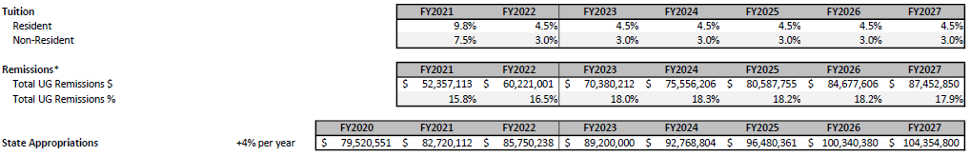
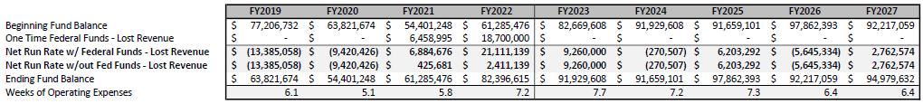
Illustrative Assumptions
Scenario A-1 Base Case

Slide 7
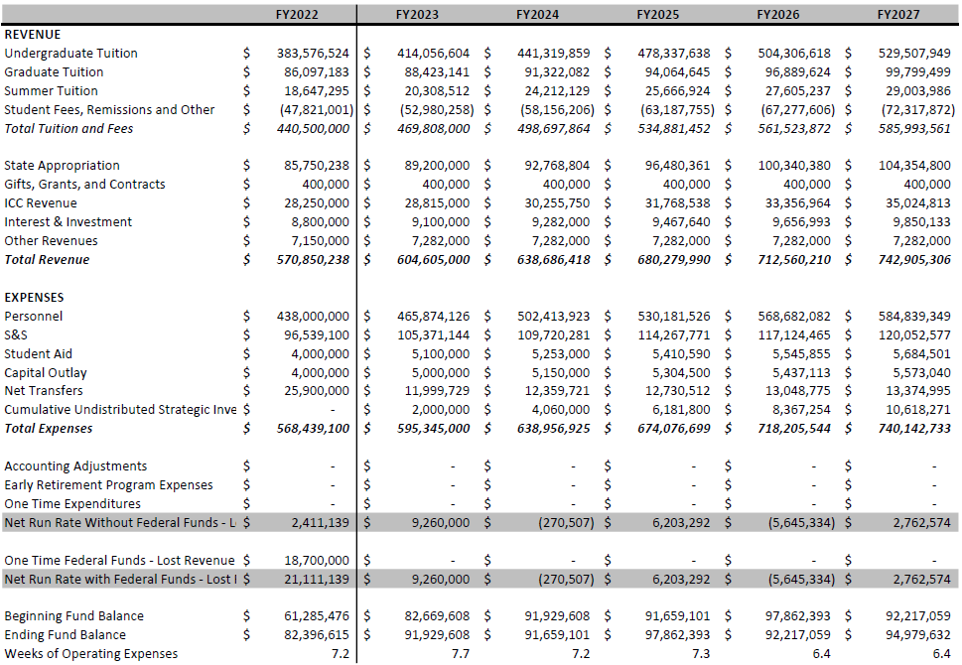
Illustrative Financials
Scenario A-1 Base Case

Slide 8
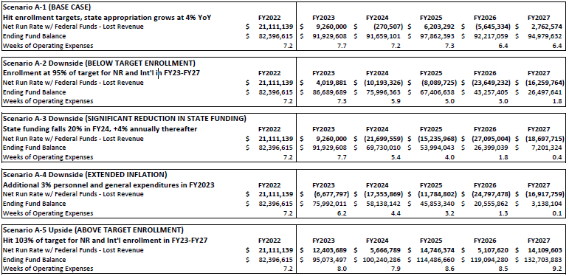
Set A of Scenarios: 3.0% Non-resident tuition rate increase
& 4.5% resident tuition rate increase (entering cohorts)

Slide 9
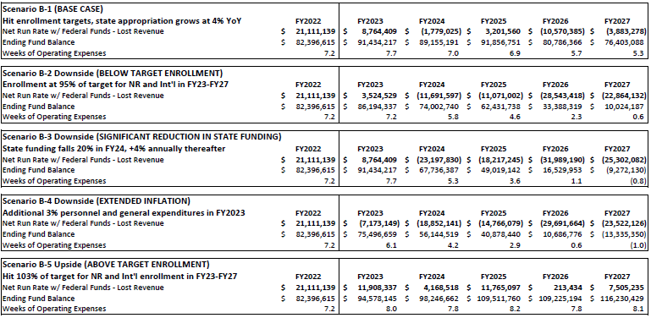
Set B of Scenarios: 3.0% Non-resident tuition rate increase
& 3.0% resident tuition rate increase (entering cohorts)

Slide 10
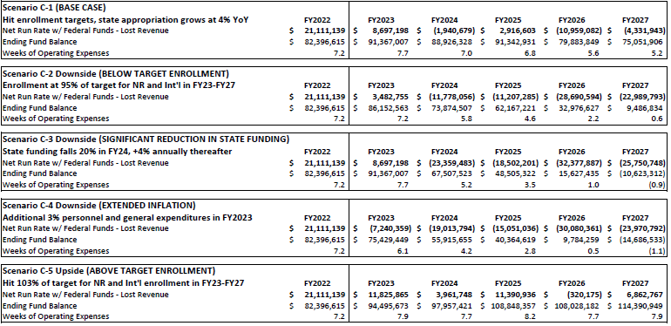
Set C of Scenarios: 2.5% Non-resident tuition rate increase
& 4.5% resident tuition rate increase (entering cohorts)

