Slide 1

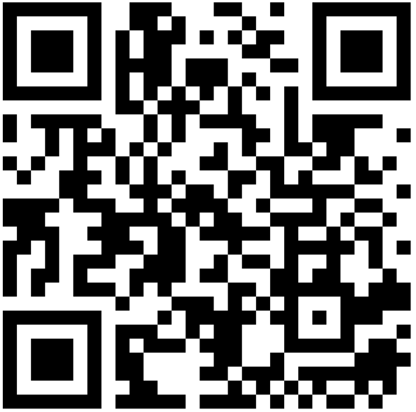
Sign up to receive follow-up information (optional)→

Slide 2

Student Tuition Forum
Financial Briefing
January 13, 2026

Slide 3
Agenda
UO Budget
State Appropriation
Cost Drivers
Guaranteed Tuition Program
Info and Input on Tuition
Small Group Discussion

Slide 4
UO Budget Structure
E&G Funds
Other Funds
Tuition revenue
State Appropriation
F&A Return
Overhead revenue
Fee revenue, interest earnings
Grants and Contracts revenue
Auxiliary Revenue
Service Center Revenue
Designated Operations Revenue
Restricted gifts
School & College Budgets
Grants & Contracts
Central Admin
Budgets
Plant Funds
Institutional Expenses
(Debt, assessments, utilities, leases)
Auxiliary, Service Centers, and Designated Ops Funds
Restricted Gifts

Slide 5
E&G Fund Balance
 | FY2018 | FY2019 | FY2020 | FY2021 | FY2022 | FY2023 | FY2024 | FY2025
Total Expenses including CapEx | $520.0M | $544.0M | $552.6M | $524.1M | 564.5M | $597.6M | $650.1M | $686.1M
Weekly OpEx | $10.0M | 10.5M | $10.6M | $10.1M | $10.9M | $11.5M | $12.5M | $13.2M
End of Year Fund Balance | $80.0M | $65.4M | $56.7M | $65.3M | $93.3M | $114.3M | $116.2M | $119.7M
Weeks of OpEx | 8.0 | 6.3 | 5.3 | 6.5 | 8.6 | 9.9 | 9.3 | 9.1

Slide 6
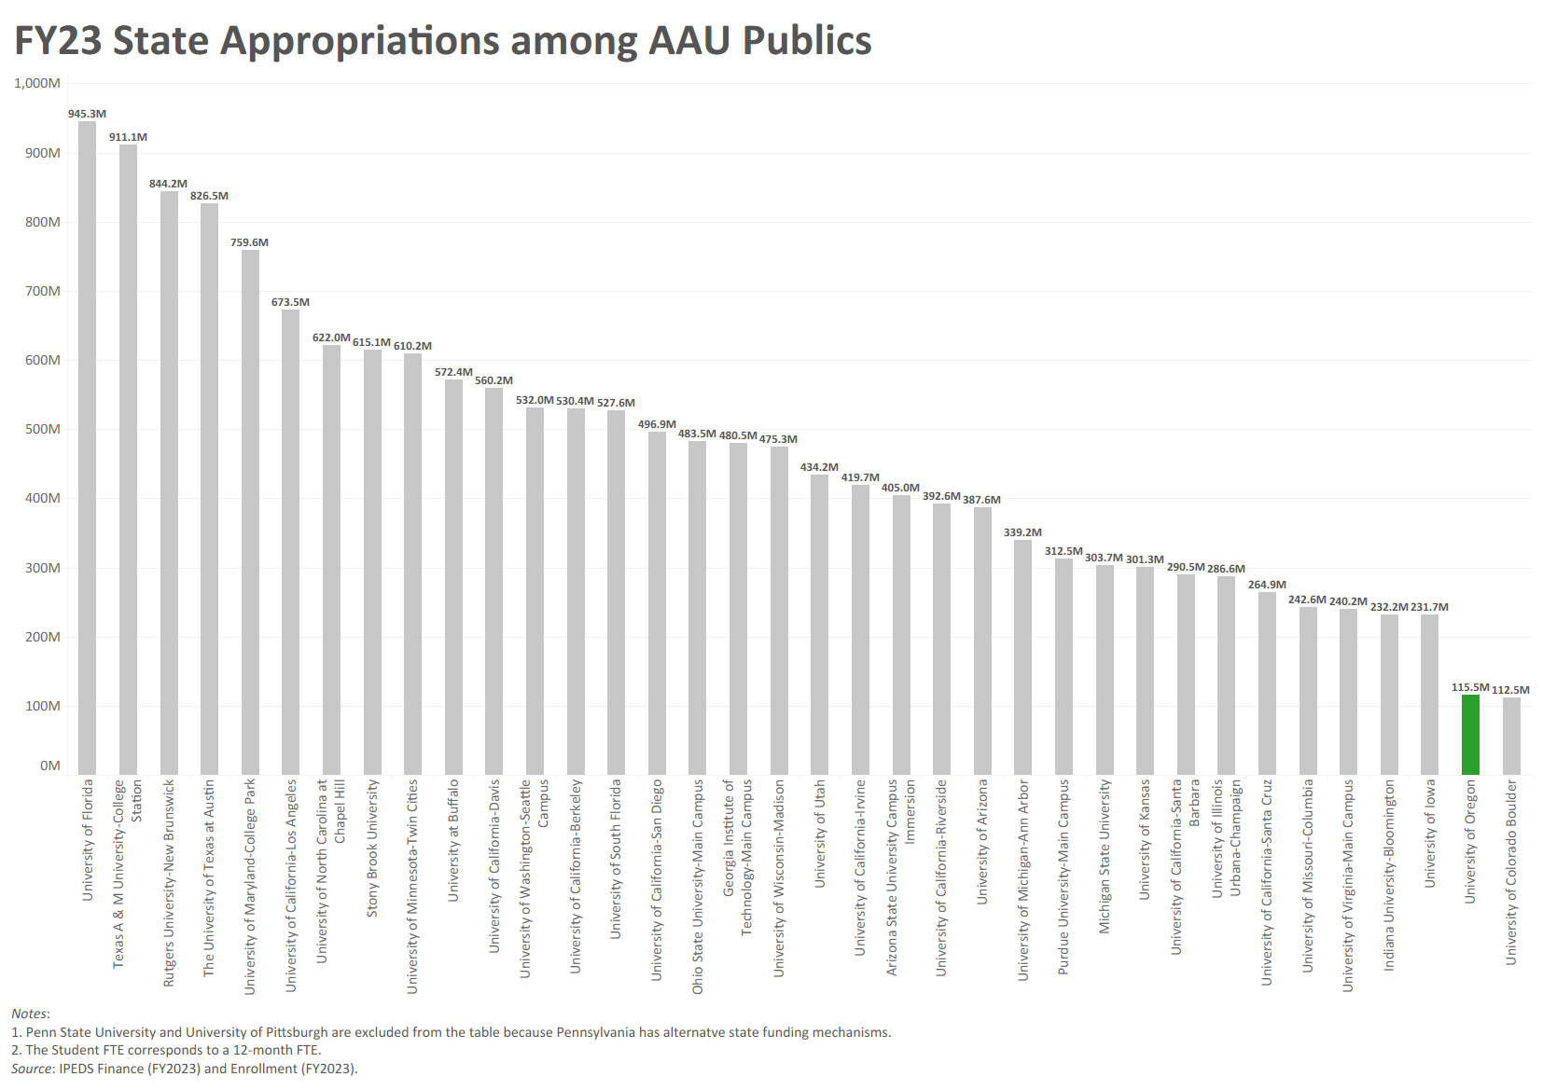

Slide 7
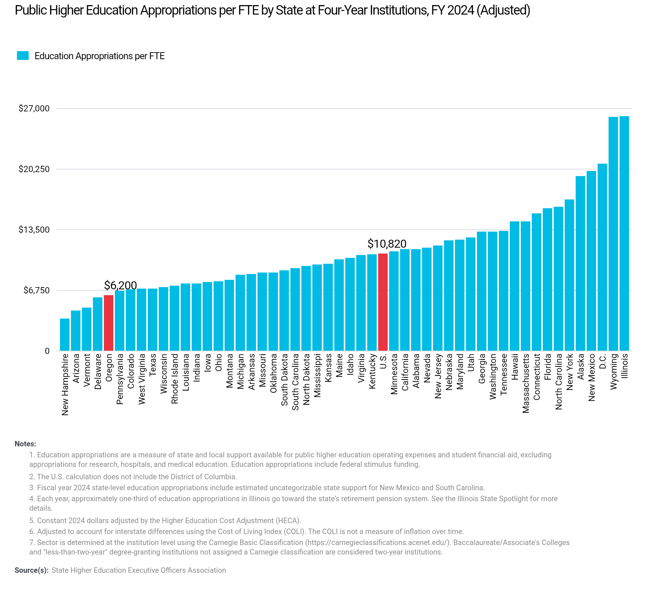
Oregon is ranked 46th in the country in 4-year university per-student funding

Slide 8
Comparative University Funding
FY 2025 | EOU | OIT | OSU | PSU | SOU | UO | WOU | Total
Fundable Students (AY24) | 1,532 | 2,531 | 17,936 | 12,276 | 2,395 | 12,794 | 3,061 | 52,526
PUSF Funding | $24.1M | $35.9M | $168.7M | $119.1M | $28.3M | $99.0M | $34.3M | $509.4M
PUSF Funding Per Fundable Student | $15,741 | $14,199 | $9,404 | $9,705 | $11,826 | $7,735 | $11,195 | $9,699
Total FY 2025 State Funding | $27.1M | $41.1M | $297.5M | $132.3M | $33.1M | $105.3M | $37.9M | $674.3M
State Funding per Fundable Student | $17,666 | $16,217 | $16,589 | $10,775 | $13,810 | $8,232 | $12,388 | $12,837
Note: All data collected from HECC or publicly available websites. Data as of October 2025.

Slide 9
Comparative University Funding
FY 2025 | EOU | OIT | OSU | PSU | SOU | UO | WOU | Total
Net Tuition Revenue | $26.4M | $33.8M | $514.4M | $177.1M | $31.8M | $529.1M | $32.9M | $1,345.7M
State & Governmental Appropriations | $25.6M | $38.2M | $287.9M | $130.1M | $28.7M | $106.5M | $34.9M | $651.9M
Other Revenue | $3.9M | $4.1M | $139.4M | $38.7M | $4.0M | $56.0M | $6.1M | $252.1M
Total E&G Revenue | $56.0M | $76.0M | $941.7M | $345.9M | $64.5M | $691.6M | $73.9M | $2,249.6M
Percentage of E&G Funded with State & Governmental Appropriations | 45.8% | 50.2% | 30.6% | 37.6% | 44.4% | 15.4% | 47.2% | 29.0%
Sources:
Various university FYE Actual BOT Management Reports. WOU Q3 Forecast.
Note: All data collected from HECC or publicly available websites. Data as of October 2025.

Slide 10
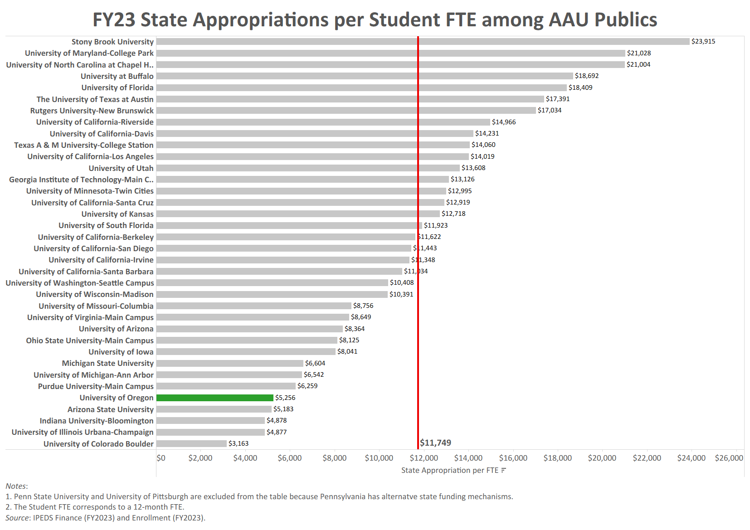

Slide 11
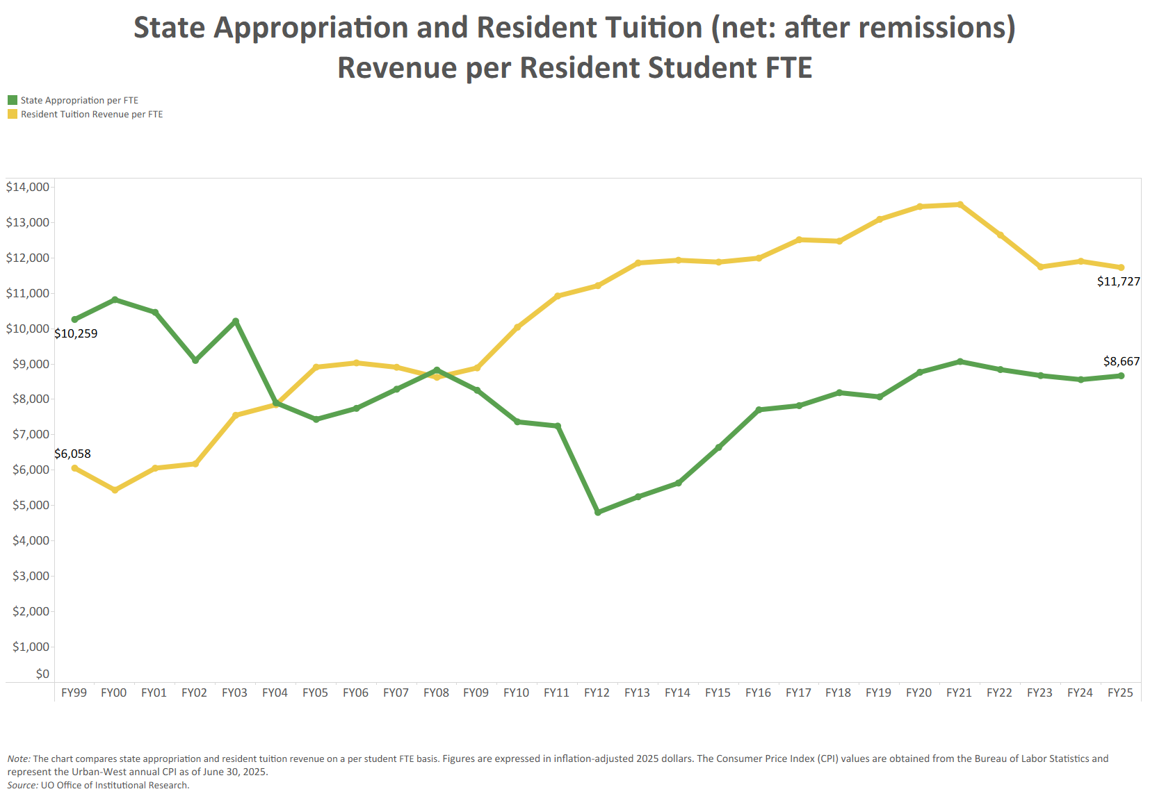

Slide 12
Agenda
UO Budget
State Appropriation
Cost Drivers
Guaranteed Tuition Program
Info and Input on Tuition
Small Group Discussion

Slide 13
Summary – Major FY2027 E&G Fund Cost Drivers
Cost Driver | Projected FY27 Cost Increase | Notes
Faculty, Staff and GE Salary and OPE | $22.2 million | E&G compensation increases based on current contracts (e.g., faculty), announced increases for OAs and assumptions of 3% annual increases for those groups without ratified contracts. Includes approximately 1,130 graduate employees, 1,520 faculty, 800 classified staff, and 1,180 unrepresented staff on the E&G fund.
Medical Costs | $2.4 million | December 2025 estimated cost increase is 3.8%. Includes estimate of rate increase and rate group shifts.
Blended OPE | $6.4 million | There were $7.2 million of one-time carry forward funds available during FY26 to “buy down” OPE rates. These one-time funds offset last year’s large increase to PERS rates. Going into FY2027, only $800k of one-time carry forward funds will be available.
Institutional Expenses | $1.8 million | Increases related to utilities, insurance, debt for academic buildings, assessments, and leases.
Strategic Investments | $1.0 million | Allocated via strategic investment process. Note that President has only allocated $1.0 million to the BAG (Budget Advisory Group) process this year given budget constraints.
Total Projected Cost Increases | $33.8 million

Slide 14
Summary – Major FY2027 E&G Fund Cost Drivers
Cost Driver | FY26 Base | Projected FY27 Cost Increase | FY27 Increase (%)
Faculty, Staff and GE Compensation
Impact of Salary Increases |  | $22.2 million
Impact of Medical Cost Rate Increases |  | $2.4 million
Impact of Blended OPE (Reduction of One Time Carry Forward Fund) |  | $6.4 million
Total | $565.9 million | $31.0 million | 5.5%
Institutional Expenses | $59.0 million | $1.8 million | 3.1%
All Other S&S, Transfers, and Capital Expenses (No assumed increases for cost driver analysis) | $86.0 million | $0.0 million | 0.0%
Strategic Investments |  | $1.0 million
Total (E&G Budget) | $710.9 million | $33.8 million | 4.8%
Note: We are projecting $11.6 million of the $29.2 million budget cuts that we just implemented to hit in FY27, which will offset some of these cost drivers. This will bring the total increase, after budget reductions, down to $22.2 million which represents a total increase on the E&G fund of 3.2%.

Slide 15
Summary – Major FY2027 E&G Fund Cost Drivers
Cost Driver | Projected FY21 Cost Increase | Projected FY22 Cost Increase | Projected FY23 Cost Increase | Projected FY24 Cost Increase | Projected FY25 Cost Increase | Projected FY26 Cost Increase | Projected FY27 Cost Increase
Faculty, Staff & GE Salary & Wages | $11.6 million | $7.3 million | $15.0 million | $11.9 million | $13.0 million | $19.5 million | $22.2 million
Medical Costs | $2.5 million | $1.2 million | $1.6 million | $2.2 million | $2.5 million | $2.9 million | $2.4 million
Retirement Costs | ($500K) | - | - | $1.9 million | - | $7.6 million | -
Oregon Paid Leave | - | - | - | $900K | $300K | - | -
Blended OPE | - | - | - | $4.0 million | - | ($7.2 million) | $6.4 million
Institutional Expenses | $1.5 million | $1.2 million | $1.2 million | $1.5 million | $2.0 million | $2.6 million | $1.8 million
Faculty Hiring | - | - | - | - | $3.0 million | $1.6 million | -
Strategic Investments | $2.0 million | $600K | $2.0 million | $2.0 million | $2.0 million | $1.0 million | $1.0 million
Minimum Wage Increase | $1.9 million | $320K | $257K | - | - | - | -
Total Projected Cost Increases | $19.0 million | $10.6 million | $20.1 million | $24.4 million | $22.8 million | $28.0 million | $33.8 million

Slide 16
Agenda
UO Budget
State Appropriation
Cost Drivers
Guaranteed Tuition Program
Info and Input on Tuition
Small Group Discussion

Slide 17
Framework – Guaranteed Tuition Program
for Undergraduate Students
For each entering class year, there is a set resident and non-resident tuition rate per student credit hour (SCH)
That rate is guaranteed or locked for five years - no matter what
Other tuition and fees that are locked include administratively controlled mandatory fees, summer tuition, honors college differential tuition, business school differential tuition and the international student fee
Students know the expected cost of their education before they decide to come to the University of Oregon

Slide 18
Average Historical Annual Undergraduate Tuition Rate Increases – Analysis conducted in FY2020
10 Year Average
5 Year Average
Resident
5.4%
5.0%
Non-resident
4.4%
3.3%

Slide 19
New Resident Undergraduate Students
Graduation Time 4 years
Analysis Conducted in FY2020
Assumed Annual Increases 5% - Average 5 Year Historical Rate
5-year Guaranteed rate $254.62 per SCH (9.75% increase)
Total Tuition
Paid
$1,050
Total Tuition
Paid
$1,018

Slide 20
New Resident Undergraduate Students
Graduation Time 5 years
Analysis Conducted in FY2020
Assumed Annual Increases 5% - Average 5 Year Historical Rate
5-year Guaranteed rate $254.62 per SCH (9.75% increase)
Total Tuition
Paid
$1,346
Total Tuition
Paid
$1,273

Slide 21
New Resident Undergraduate Students
Graduation Time 8 years
Analysis Conducted in FY2020
Assumed Annual Increases 5% - Average 5 Year Historical Rate
5-year Guaranteed rate $254.62 per SCH (9.75% increase)
Total Tuition
Paid
$2,326
Total Tuition
Paid
$2,116

Slide 22
Advantages of Guaranteed Tuition Program for Students
Financial Predictability: Tuition rates are locked in for five years – students and their families know ahead of time exactly what they are going to pay for their education.
Peace of Mind: The guaranteed tuition program functions as a insurance policy for students. Regardless of what happens to state funding or other costs, their tuition rates are guaranteed for five years.
Protection of Scholarship Value: Many scholarships are currently fixed dollar amounts. Under a guaranteed tuition program, the value of these scholarships remains the same over their college career.

Slide 23
Advantages of Guaranteed Tuition Program for Institution
Recruiting: The stronger value proposition of a locked-in rate should be very attractive to new students. This should help support the institution’s enrollment growth initiative.
Retention: One of the main reasons students cite for dropping out of school is financial pressure. This can often be linked to students not anticipating tuition increases throughout their college career. Having a locked rate for tuition should help with this issue.
Campus Climate: Concern about continually rising tuition rates affects students, faculty and staff, and directs time, energy and focus away from other important educational issues.

Slide 24
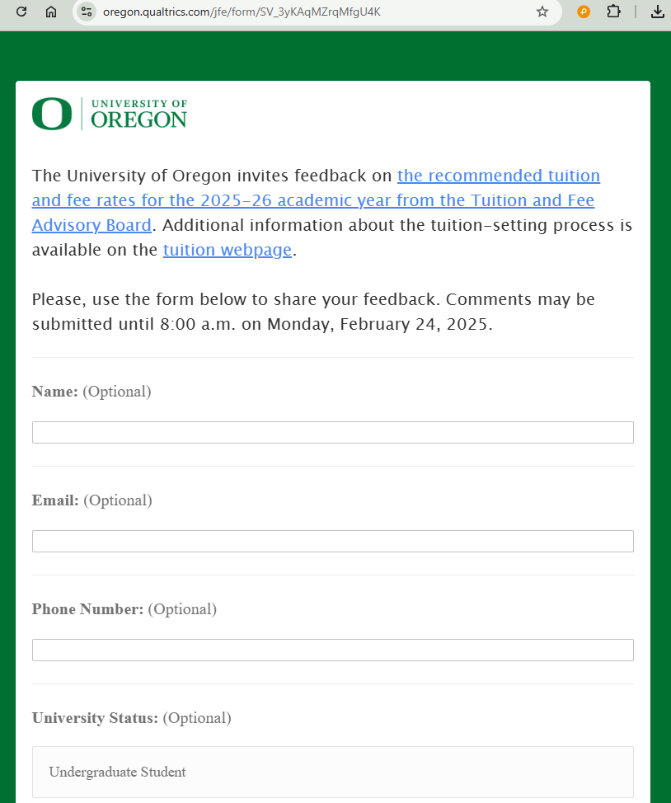



Tuition-setting process
Oct-Jan: TFAB Briefings
UO budget
PUSF (state funding)
Data
Oregon Guarantee
Financial aid
Long-term projections
Updated cost drivers
Cost management
Community feedback survey online
January: Student Forum
Mid-Feb: TFAB recommendations
to the President
Late Feb: Pres sends tuition rec’s to the BOT
Jan-Feb: TFAB reviews proposals
Admin controlled mandatory fees
  Housing fees
  Rec Center fee
  Student Union fee
  Health Center fee
  Tech fee
Graduate tuition
Course fees and other fees
TFAB develops a recommendation on tuition rates for incoming UG cohorts
February: President’s Forum
March: BOT sets tuition for FY27

Slide 25
Opportunities for Learning and Input
Tuition info online: https://vpfa.uoregon.edu/tuition
Input to TFAB during meetings (all open to the public): https://vpfa.uoregon.edu/tuition/tfab-schedule
Input to ASUO
Community survey input to the President following release of TFAB recommendations in mid-February
Input on tuition recommendations directly to President Karl Scholz at his tuition forum on February 19th
Get involved: https://gcr.uoregon.edu/advocacy

Slide 26
Agenda
UO Budget
State Appropriation
Cost Drivers
Guaranteed Tuition Program
Info and Input on Tuition
Small Group Discussion

