Slide 1

Education & General Fund
Budget Reductions
September 2025
Board of Trustees of the University of Oregon

Slide 2
Agenda
  Initial Targets
  Long-Term Projections (Pre-Budget Reductions)
  National Context
  Budget Cut Process
  Impact of Cuts
  Updated Long-Term Projections (After-Budget Reductions)

Slide 3
Initial Targets – Spring 2025
  Overall reduction in expenses of $25 million - $30 million in E&G funds
  Spending cuts to bring budgets into balance - estimated at $10 million recurring correction
  Budget cut targets:
      Administrative units: average of 4% ($9.2 million)
      Schools and colleges: average of 2.5% ($8.0 million)

Slide 4
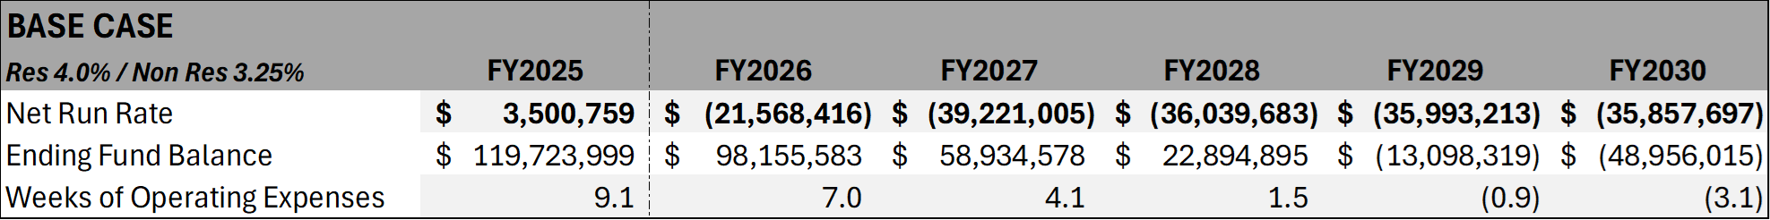
Updated Financial Projections –
Prior to Budget Reductions
  Projections were updated to reflect:
    Improved FY2025 financial position
    Lower level of expected first year resident students
    Greater PERS impact on blended OPE rates
    Increased number of net TTF hires
  Updated projected structural deficit is estimated to be slightly above $30 million (in FY26 dollars)

Slide 5
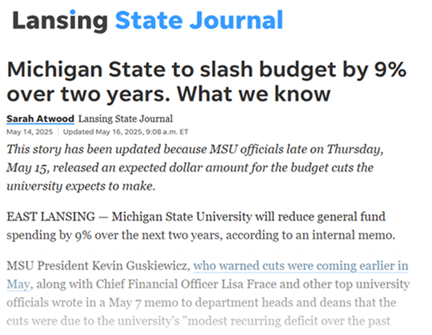
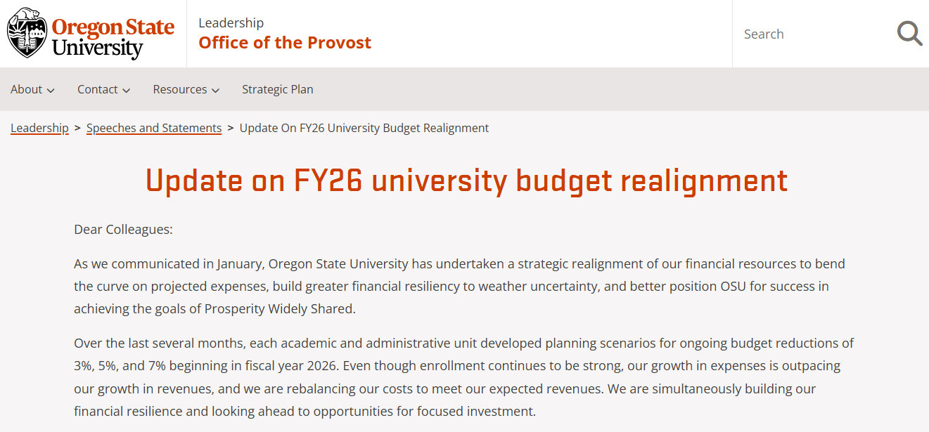
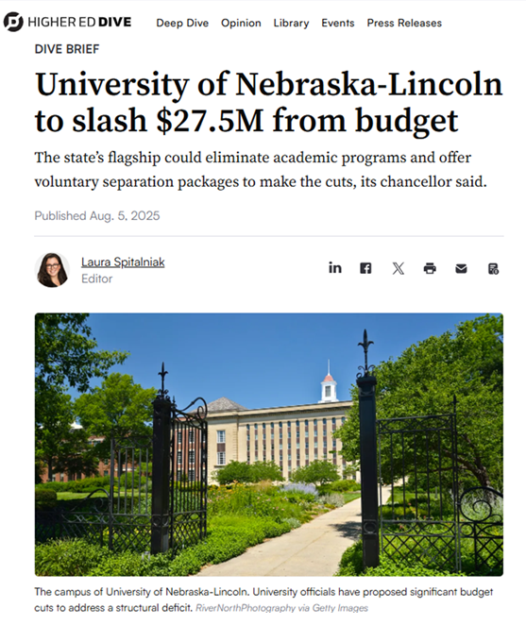
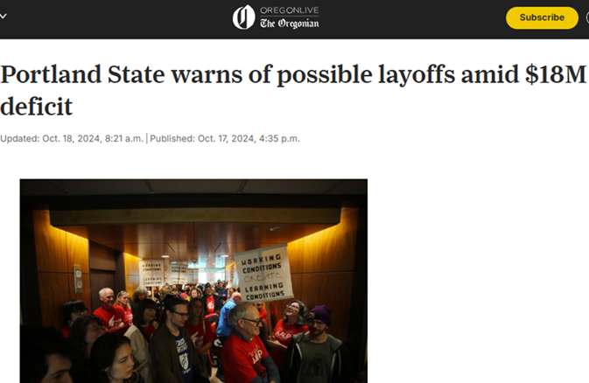
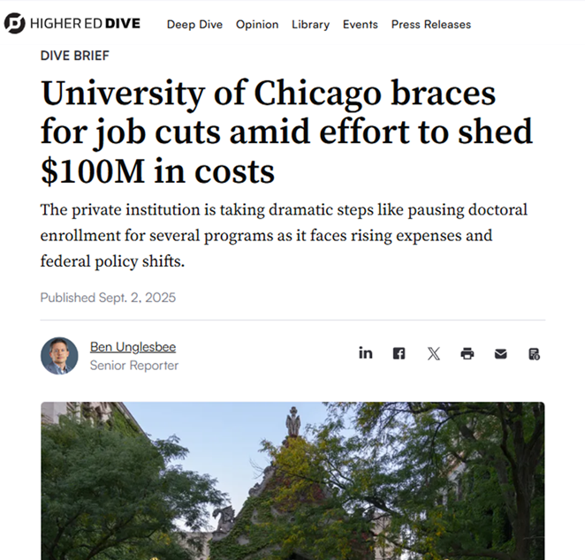
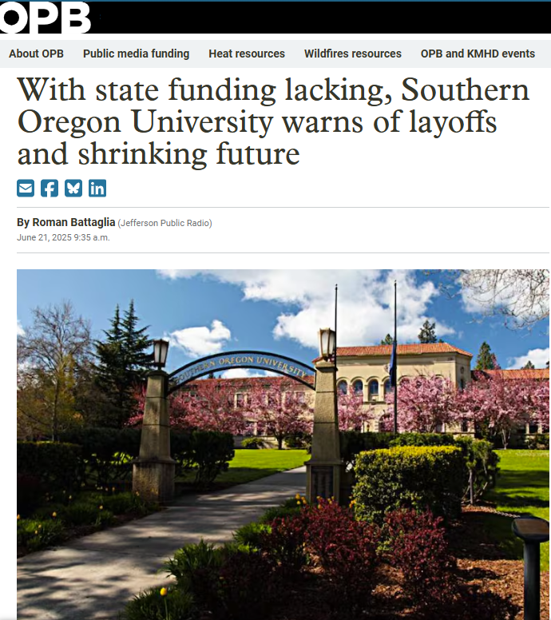
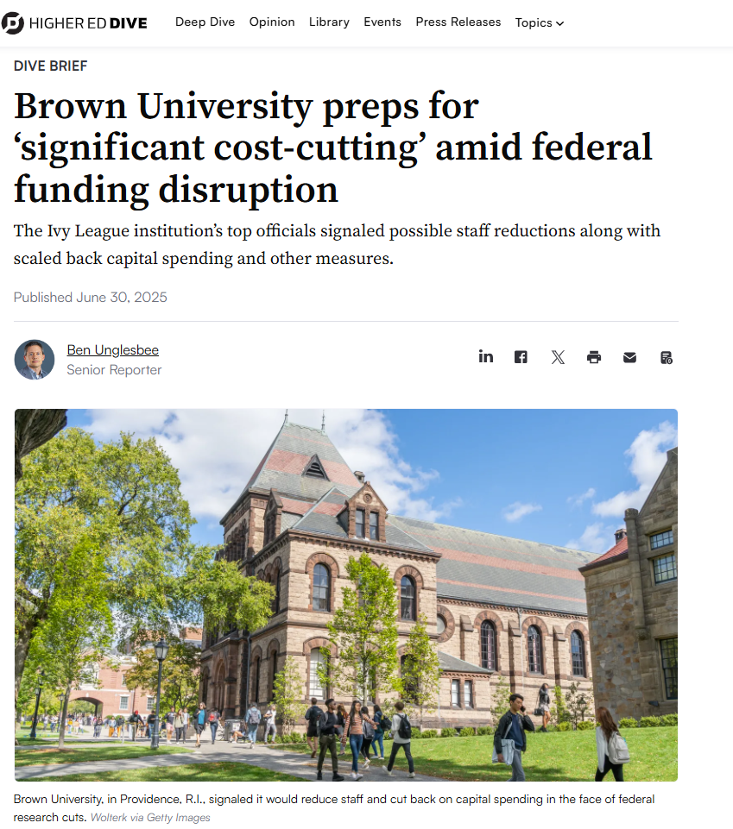
National Context

Slide 6
Budget Cut Process
  Administrative Units:
    President directed each VP to develop 2%, 4%, and 6% budget cut scenarios for each administrative portfolio
    Meetings held with President to discuss line-items cuts and impact
  Schools and Colleges
    Provost worked with Deans to establish principles for cut targets
    Schools and Colleges developed proposals for actions
    Consultation process related to possible academic program reductions or eliminations implemented per Article 25 of the Faculty CBA

Slide 7
Summary of Cuts
Expenditure Reductions
Personnel | $24.9 million | 85.2%
S&S | $3.2 million | 11.0%
Funding Source Shift | $1.1 million | 3.8%
Total | $29.2 million

Slide 8
Personnel Impact
Personnel Reductions (Headcount) | Filled Positions | Vacant Positions | Total
Officers of Administration | 42 | 21 | 63
Classified Staff | 49 | 21 | 70
Other Staff | 6 | 3 | 9
Tenure Track Faculty | 0 | 14 | 14
Career Faculty | 20 | 0 | 20
Total | 117 | 59 | 176
    Note: Figures for Pro Tem Faculty, Graduate Employee and undergraduate student positions are not shown on this chart as they are budgeted in dollar figures rather than by position.

Slide 9
Personnel Impact – Filled Positions
Personnel Reductions (Headcount) | Spring / Summer 2025 Actions | Fall 2025 Actions | Total Actions
Officers of Administration | 14 | 28 | 42
Classified Staff | 28 | 21 | 49
Other Staff | 0 | 6 | 6
Tenure Track Faculty | 0 | 0 | 0
Career Faculty | 15 | 5 | 20
Total | 57 | 60 | 117

Slide 10
Examples of Impacts
Eliminate UOPD Community Service Officer Program (except for Housing and UO Portland)
Restructure and reduce the size of Information Services user support team
Cancel all print journal subscriptions in the library, reduce library staffing in some areas which will delay access to new material
Significantly reduce custodial cleaning of individual offices on campus (current practice is weekly; moving to monthly)
Eliminate Continuity Planning Program in Safety and Risk Services
Many units will have staff reductions that affect service levels and timelines
Reduction in General Fund-supported Graduate Employee (GE) positions in many schools (commitments to current GE’s will be honored, fewer new GE positions will be funded in the future). This will result in fewer graduate degrees in some programs
Selective increases in class sizes, and limits on course offerings, especially impacting non-majors
Enforcement of minimum class sizes redirecting more tenure track faculty to larger classes

Slide 11
Updated Long Term Projections
  Total Budgets Cuts: $29.2 million
  Projected impact in FY2026: $17.6 million

